Slide 1
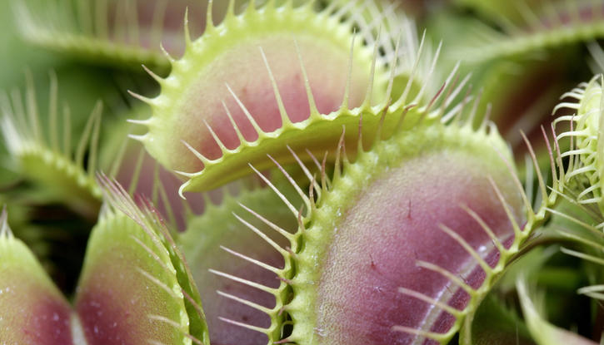
AP Environmental Science
Carnivorous Plants
ICPS Grant Proposal
Notes:
Note: The following slides are animated. To view slides in addition to notes, please select “Presenter View”. A PDF of the slides have been included as well as a PowerPoint version of these slides.

Slide 2
Carnivorous Plants
Notes:
Note: The title is animated. When displayed, only the image behind the title will be shown.
Teacher Notes:
Have slide be displayed for students when entering the room. Do not discuss what the image is of or why it is on the board.
Once class starts → Teacher: “Who can tell me what this is an image of?”
(Wait for responses. This is a common type of Carnivorous Plant, and there will be someone who will most likely be familiar with it. If not, explain that it is a Venus Fly Trap.)
Teacher: “Venus Fly Traps are part of what kingdom?”
[Answer: Plant/Plantae Kingdom]

Slide 3
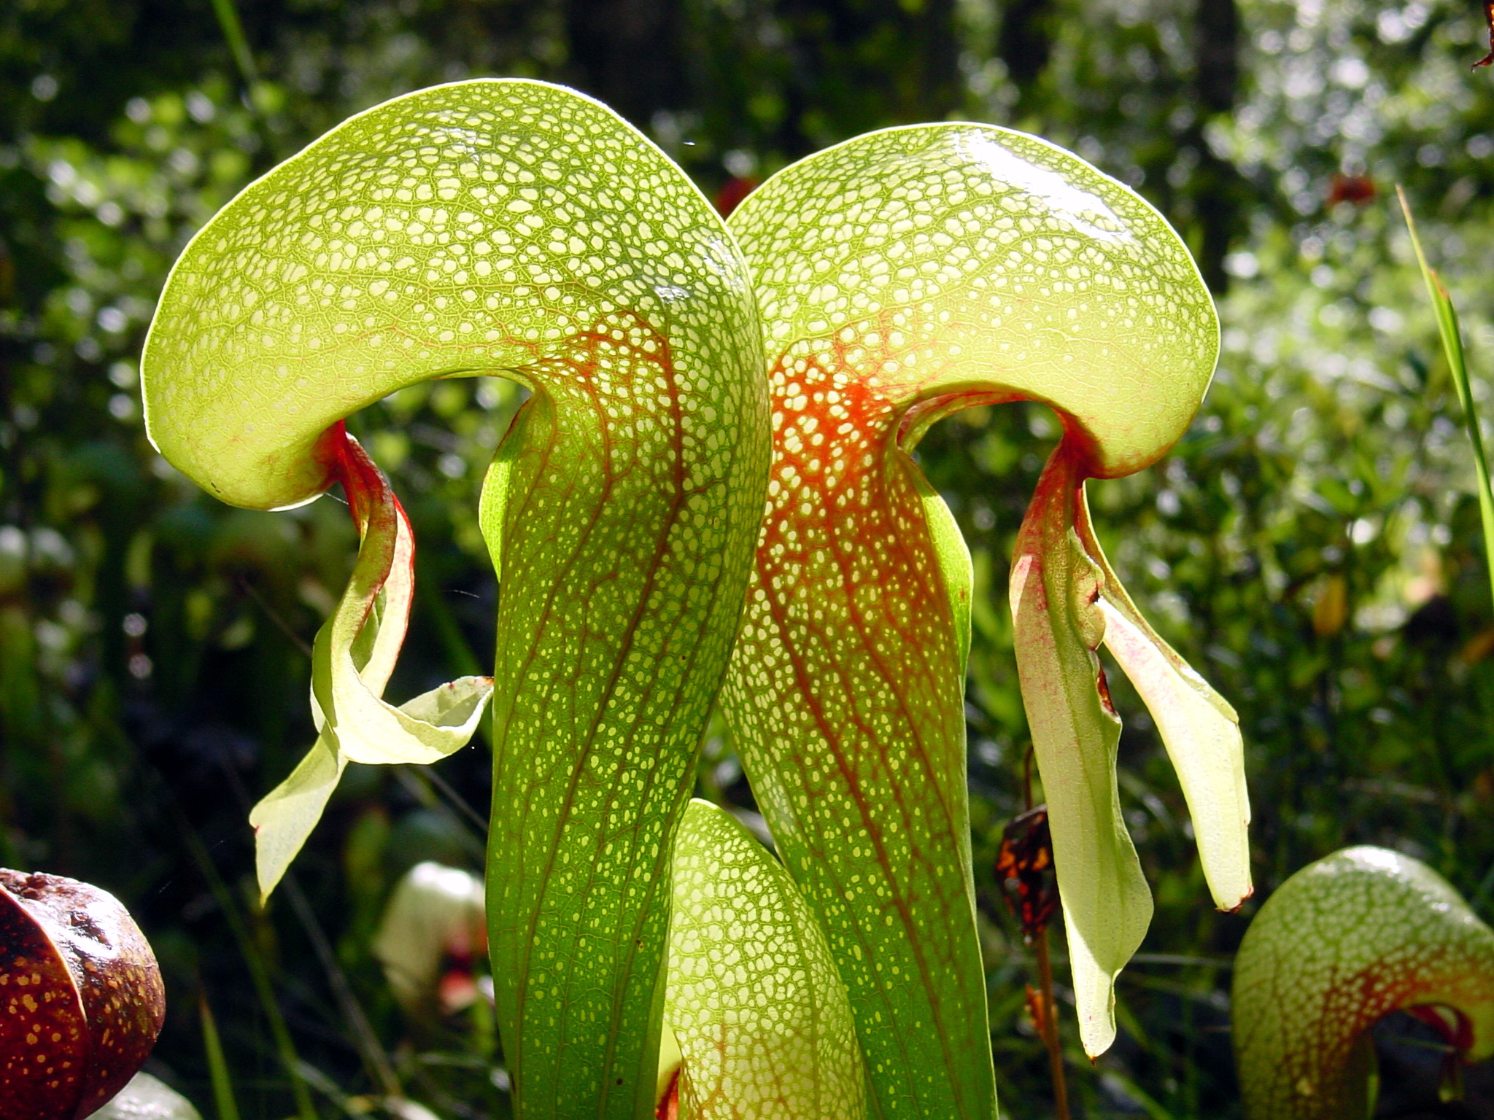
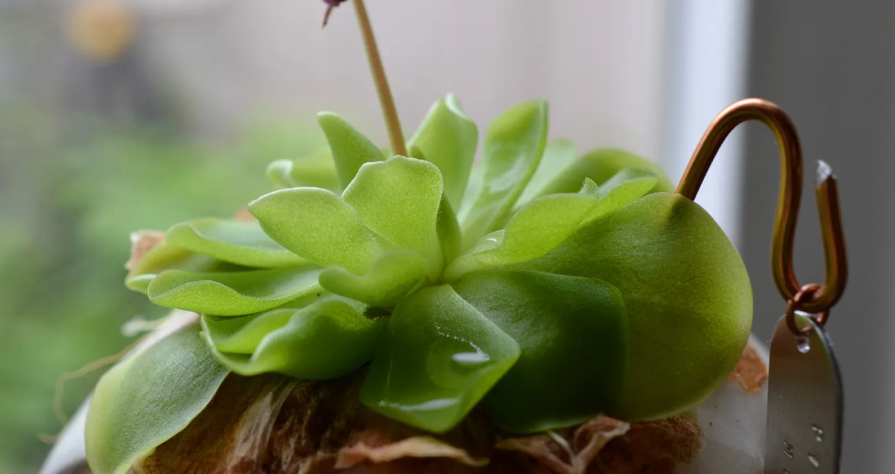
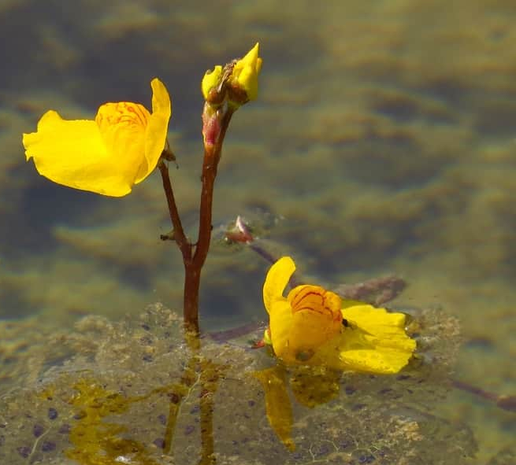
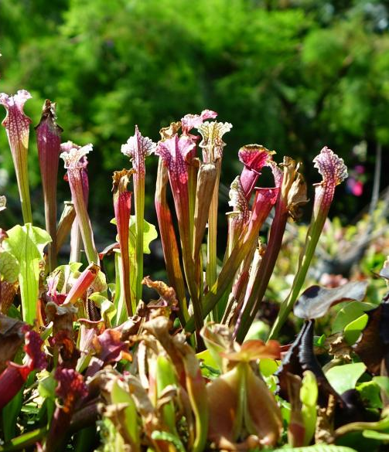
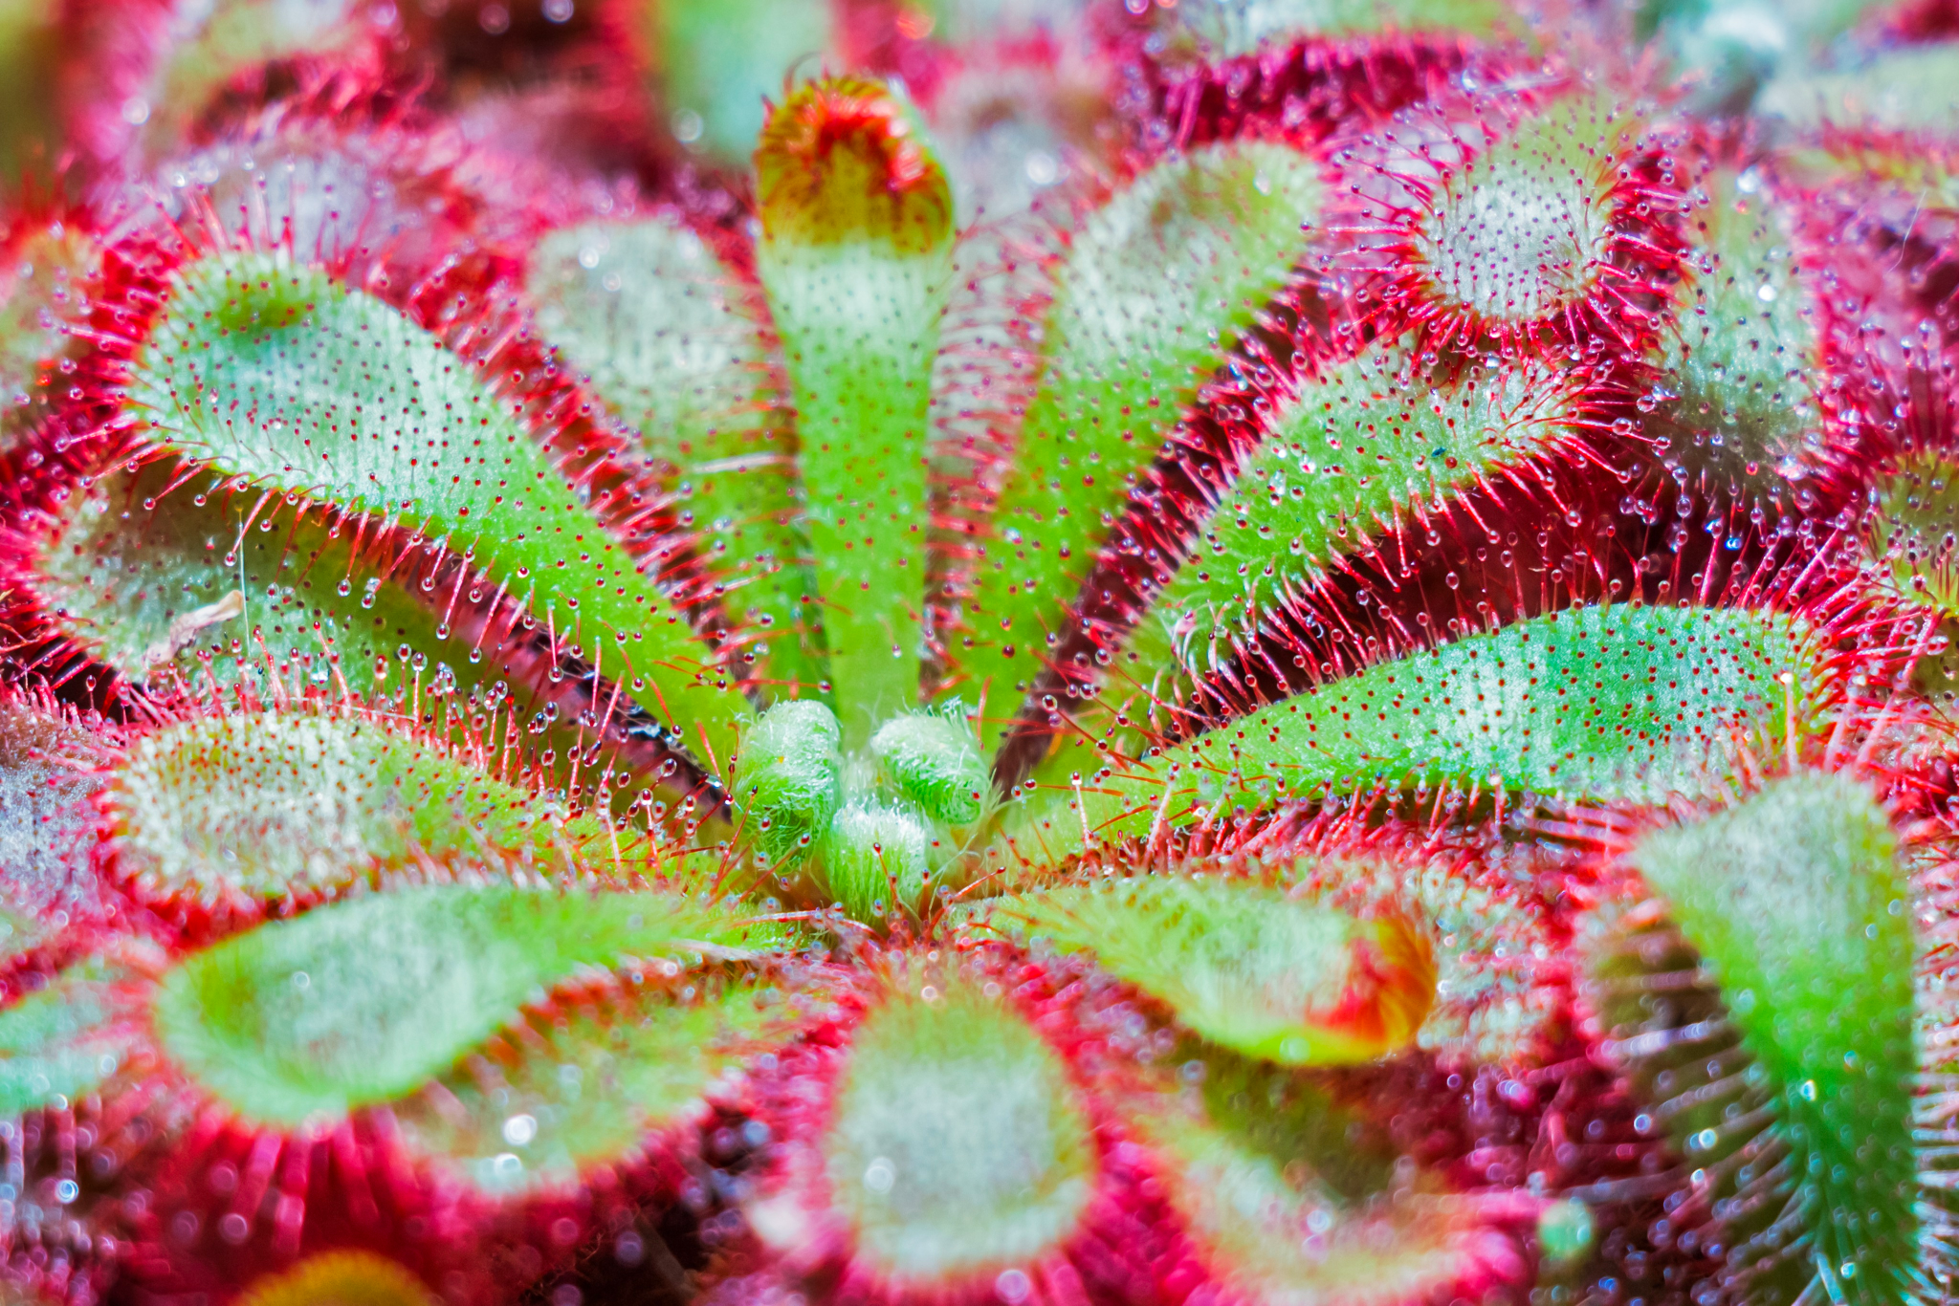
Carnivorous Plants
Notes:
Note: On Click, the title will disappear and then the dark green to reveal several different types of carnivorous plants.
Teacher Notes:
Teacher: “Do any of you know of any other types of Carnivorous Plants, other than the Venus Flytrap?”
[Answer: Students may or may not know of other types. Some may include: Pitcher Plant, Cobra Lily, Butterwort, Monkeycup, Sundew]
If students do not know of any additional Carnivorous Plants, click on the slide. Five different plants will appear. Click again to see their labels.
Next Slide

Slide 4
Cobra Lily
butterwort
spoonleaved- sundew
Pitcher plant
bladderwort
Notes:
Note: On Click, the title will disappear and then the dark green to reveal several different types of carnivorous plants.
Teacher Notes:
Teacher: “Do any of you know of any other types of Carnivorous Plants, other than the Venus Flytrap?”
[Answer: Students may or may not know of other types. Some may include: Pitcher Plant, Cobra Lily, Butterwort, Bladderwort, Monkeycup, Sundew]
If students do not know of any additional Carnivorous Plants, click on the slide. Five different plants will appear. Click again to see their labels.
Next Slide

Slide 5
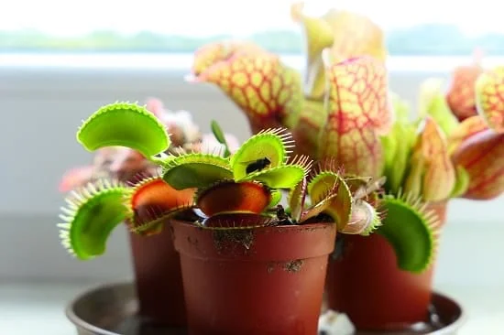
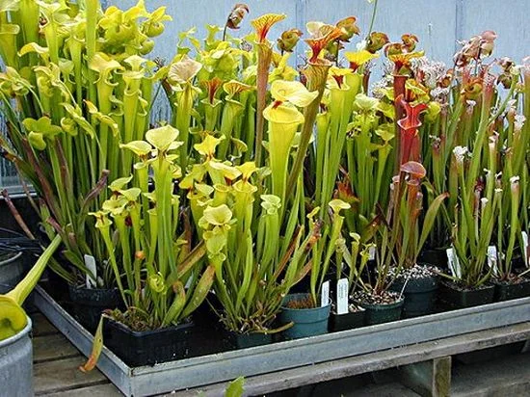
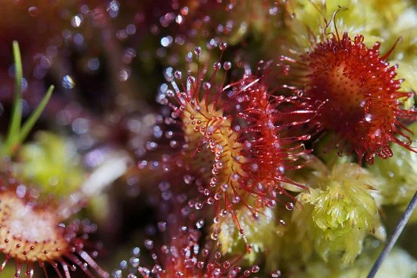
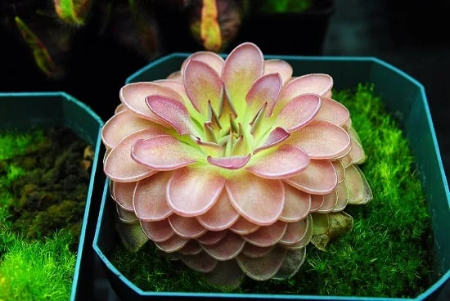
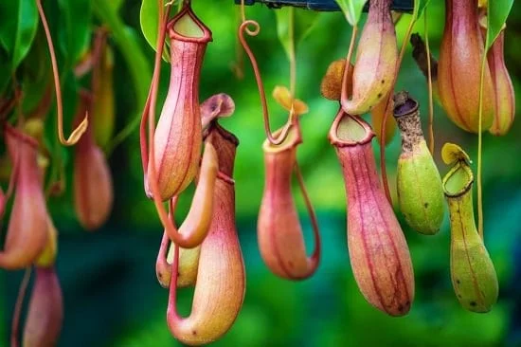
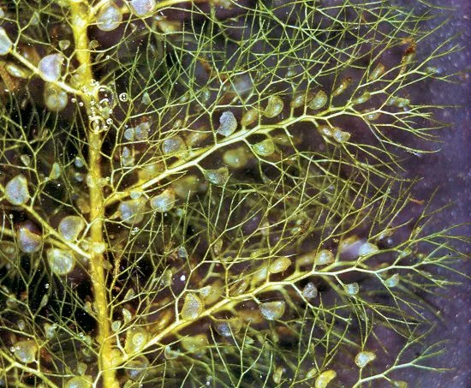
Venus flytrap
Pitcher plant
sundew
butterwort
Monkey cups
bladderwort
Carnivorous Plants
(That can be grown indoors)
Notes:
Note: Title will appear immediately. On click, the rest of the carnivorous plants will appear, with labels.
Teacher Notes:
Teacher: “These are just some of the Carnivorous Plants that can be grown indoors. You will now be put into partners/groups of three. You will randomly be given one of these plants to explore. You will have 10 minutes to answer three questions about your carnivorous plant?”
Have these plants (with accompanying genus and species) be written on small pieces of paper. Be sure to have enough for all groups in the class.
Break up class into groups of two or three. Some groups may be given the same plant as others.
Image References: https://balconygardenweb.com/indoor-carnivorous-plants-beginners-houseplants/
Next Slide

Slide 6
Question #1 - What type of habitat can your plant be found?
Some species of these plants CAN be found on Long Island!
Question #2 - What is a main food source of your plant?
Question #3 - What is the main mechanism used to capture food by your plant?
Carnivorous Plants
(That can be grown indoors)
Notes:
Note: Title will appear immediately. On click, the rest of the carnivorous plants will appear, with labels.
Teacher Notes:
Teacher: “These are just some of the Carnivorous Plants that can be grown indoors. You will now be put into partners/groups of three. You will randomly be given one of these plants to explore. You will have 10 minutes to answer three questions about your carnivorous plant. You do not have to be specific - we are looking for similarities amongst the carnivorous plants”
Have these plants (with accompanying genus and species) be written on small pieces of paper. Be sure to have enough for all groups in the class.
Pass out white boards and markers so that all members of the group have one of each.
Break up class into groups of two or three. Some groups may be given the same plant as others.
Once students are in groups, click on the slide to display the questions.
Next Slide for TIMING.

Slide 7
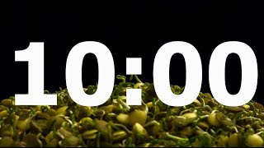
Question #1 - What type of habitat can your plant be found?
Some species of these plants CAN be found on Long Island!
Question #2 - What is a main food source of your plant?
Question #3 - What is the main mechanism used to capture food by your plant?
Notes:
Note: Title will disappear immediately. This is to give room for the timer.
Teacher Notes:
Teacher
Click on “10 minute timer video” to time students for 10 minutes. [This has accompanying music as it shows plants sprouting in the time they are working]
Next Slide [after 10 minutes]

Slide 8
Venus flytrap
Pitcher plant
sundew
butterwort
Monkey cups
bladderwort
Carnivorous Plants
(That can be grown indoors)
Notes:
Note: After timer is completed, have each group present their findings. Some may be repeats of others, which is a good way to peer-review one another’s research.
Teacher Notes:
Teacher: “Each group will now present their findings. I will be writing this information on the board. Remember, we are looking for both similarities and differences amongst this group of plants.”
Click to have each plant appear separately.
Be sure to write the information for each plant:
Habitat (including if it is found on Long Island)
Main food source
Main mechanism for capturing food
Image References: https://balconygardenweb.com/indoor-carnivorous-plants-beginners-houseplants/
Next Slide

Slide 9
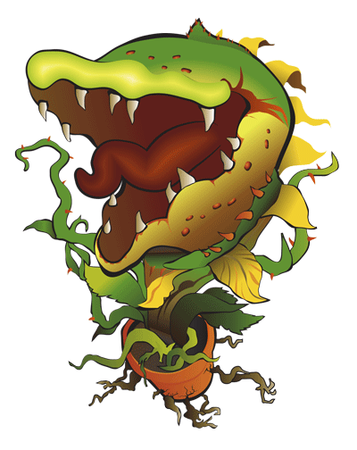
Similarities & Differences
Similarities?
Habitat (nutrient-poor soil)
Trap prey and digest them
Use prey to supplement missing nutrients
Differences?
Types of traps used
Habitat (location on planet)
Carnivorous Plants
Notes:
Note: After timer is completed, have each group present their findings. Some may be repeats of others, which is a good way to peer-review one another’s research.
Teacher Notes:
Teacher: “Each group will now present their findings. I will be writing this information on the board. Remember, we are looking for both similarities and differences amongst this group of plants.”
Click to have each plant appear separately.
Be sure to write the information for each plant:
Habitat (including if it is found on Long Island)
Main food source
Main mechanism for capturing food
Image References: https://carolkassie.com/2015/05/19/slow-burn-theatre-company-presents-little-shop-of-horrors-june-5-28/
Next Slide

Slide 10
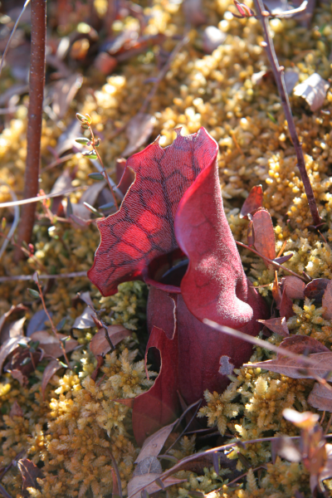
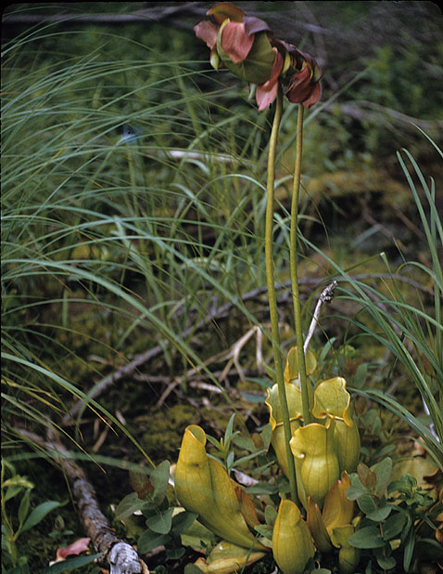
Purple pitcher plant. Photo by Lilly Schelling, OPRHP.
Purple pitcher plants have tall stalked flowers, keeping pollinators away from the hungry mouths of the pitchers. Photo by Andrew Nelson, SUNY Oswego.
Pitcher plant
(Sareacenia)
Carnivorous Plants of Long Island!
Notes:
Note: Each click will make a new set of plants appear. There are four main carnivorous plants found on Long Island.
Teacher Notes:
Teacher: “Believe it or not, Long Island is home to many Carnivorous Plants! Here are the main types, courtesy of the NYS Parks Website. I will click to reveal the plant. Let’s see if you can now name the type of Carnivorous Plant we have on our island.”
Click to have each plant appear separately.
See if students can name the plant.
Click again to reveal the name and references.
Image References: https://nystateparks.blog/2015/06/09/plant-eats-bug-new-yorks-carnivorous-plants/#:~:text=NYS%20is%20home%20to%20pitcher,thrive%20in%20wet%2C%20sunny%20conditions.
Pitcher Plant (Purple pitcher plant. Photo by Lilly Schelling, OPRHP.), Purple pitcher plants have tall stalked flowers, keeping pollinators away from the hungry mouths of the pitchers. Photo by Andrew Nelson, SUNY Oswego.
Next Slide

Slide 11
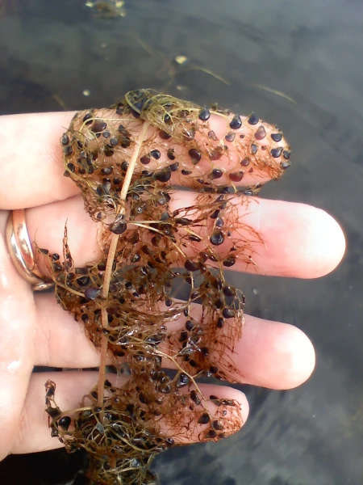
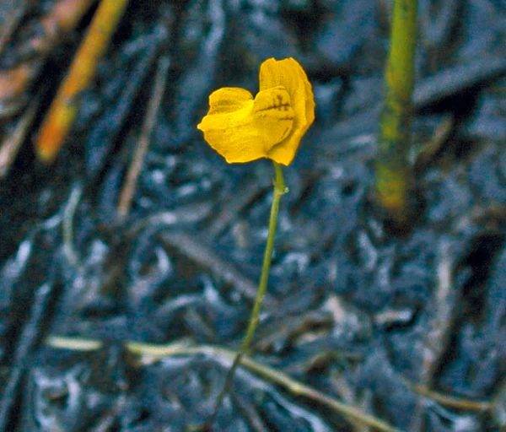
Bladderwort get their name form the bladder of the shaped traps they catch prey with. Photo by Lilly Schelling, OPRHP.
Bladderworts primarily have one flower per stalk. Most species in NY have yellow flowers. Photo by Andrew Nelson, SUNY Oswego.
Bladderwort
(Utricularia)
Carnivorous Plants of Long Island!
Notes:
Note: Each click will make a new set of plants appear. There are four main carnivorous plants found on Long Island.
Teacher Notes:
Teacher
Click to have each plant appear separately.
See if students can name the plant.
Click again to reveal the name and references.
Image References: https://nystateparks.blog/2015/06/09/plant-eats-bug-new-yorks-carnivorous-plants/#:~:text=NYS%20is%20home%20to%20pitcher,thrive%20in%20wet%2C%20sunny%20conditions.
Bladderwort Bladderworts primarily have one flower per stalk. Most species in NY have yellow flowers. Photo by Andrew Nelson, SUNY Oswego., Bladderwort get their name form the bladder of the shaped traps they catch prey with. Photo by Lilly Schelling, OPRHP.
Next Slide

Slide 12
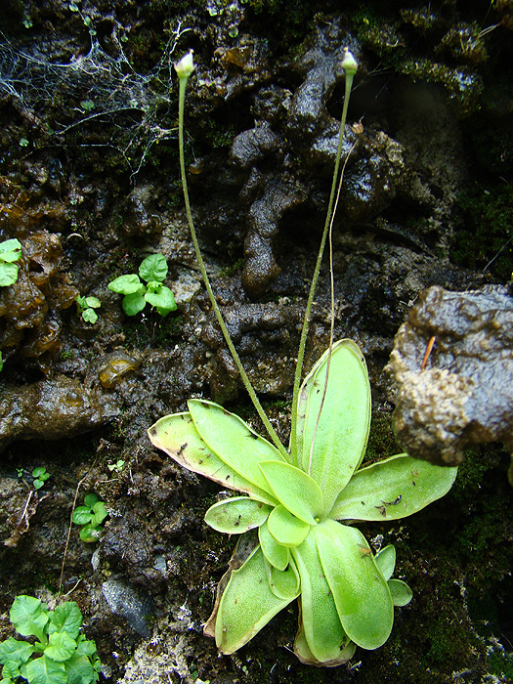
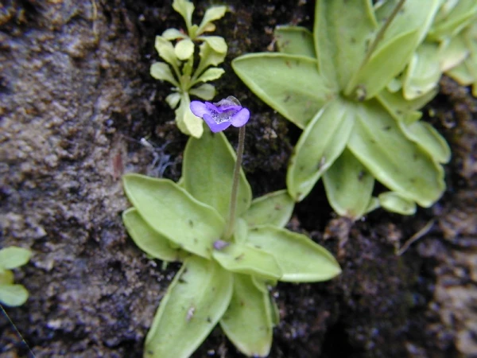
Insects are caught and digested on the sticky leaves of the butterwort. Photo by Kim Smith, NYNHP.
The species we have in NY has purple flowers. Photo by Troy Weldy, The Nature Conservancy.
Butterwort
(Pinguicula)
Carnivorous Plants of Long Island!
Notes:
Note: Each click will make a new set of plants appear. There are four main carnivorous plants found on Long Island.
Teacher Notes:
Teacher
Click to have each plant appear separately.
See if students can name the plant.
Click again to reveal the name and references.
Image References: https://nystateparks.blog/2015/06/09/plant-eats-bug-new-yorks-carnivorous-plants/#:~:text=NYS%20is%20home%20to%20pitcher,thrive%20in%20wet%2C%20sunny%20conditions.
Butterwort: The species we have in NY has purple flowers. Photo by Troy Weldy, The Nature Conservancy., Insects are caught and digested on the sticky leaves of the butterwort. Photo by Kim Smith, NYNHP.
Next Slide

Slide 13
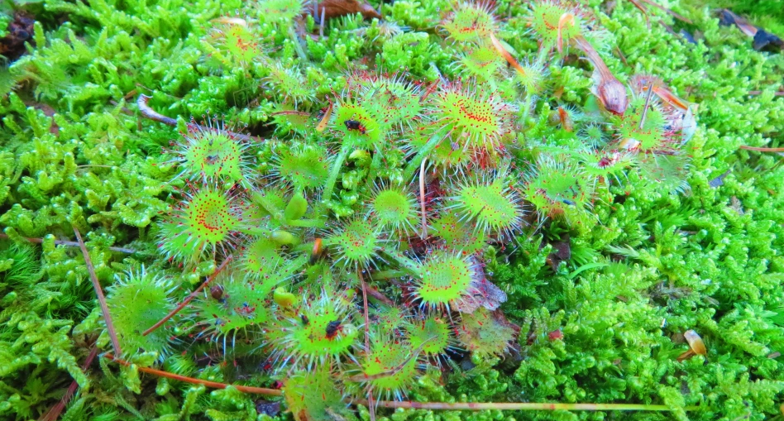
This is the round-leaved sundew. Notice the many fine hairs with droplets of shiny – glue like digestive juices that insects mistake for water. Photo by Lilly Schelling, OPRHP.
Sundew
(Drosera)
Carnivorous Plants of Long Island!
Notes:
Note: Each click will make a new set of plants appear. There are four main carnivorous plants found on Long Island.
Teacher Notes:
Teacher
Click to have each plant appear separately.
See if students can name the plant.
Click again to reveal the name and references.
Image References: https://nystateparks.blog/2015/06/09/plant-eats-bug-new-yorks-carnivorous-plants/#:~:text=NYS%20is%20home%20to%20pitcher,thrive%20in%20wet%2C%20sunny%20conditions.
Sundew: This is the round-leaved sundew. Notice the many fine hairs with droplets of shiny – glue like digestive juices that insects mistake for water. Photo by Lilly Schelling, OPRHP.
Next Slide

Slide 14
Your project!
Ecosystems & Biodiversity
You may work in groups (up to 3)
You will choose your plant(s)
This project will count as an exam for the marking period
Carnivorous Plants Project
Notes:
Note: A supplemental worksheet will go along with this slide. You may want to hand out the worksheet as you describe the project.
Teacher Notes:
Teacher: “You will be working on a project involving your carnivorous plants.”
Click to have each line appear on the “Your Project!” section of the slide
Image References: https://carolkassie.com/2015/05/19/slow-burn-theatre-company-presents-little-shop-of-horrors-june-5-28/
Next Slide

Slide 15
To be included in your project:
General evolution of your plant
How the nitrogen cycle is performed by your plant (in comparison to C3, C4, CAM and aquatic plants)
A food chain/web involving your plant.
Ecological tolerance - why your plant exists in its preferred habitat
Natural and Human disruptions to your plant
Care for your plant in a classroom setting!
Carnivorous Plants Project
Notes:
Note: A supplemental worksheet will go along with this slide. You may want to hand out the worksheet as you describe the project.
Teacher Notes:
Teacher: “Here are some of the specifics of your project.”
Click to have each line appear on the “To be included in your project!” section of the slide
Evolution of your plant: Instruct students that this is a general evolution. Diagrams are welcome.
Nitrogen Cycle: The nitrogen cycle is a part of the AP Environmental Science curriculum. However, it is not the same in all organisms. Be specific in how the nitrogen cycle is performed in your plant.
Food Chain/Web: Create a food chain or food web involving the organisms that your plant would encounter. Diagrams are welcome.
Ecological Tolerance: Why organisms live where they do has to do with limiting factors and their tolerance to such factors. Why does your plant exist in its specific habitat? Are there are similar species that are even less tolerant?
Natural and Human Disruptions: Natural disruptions, such as Earth’s changing climate, can affect the survivorship of your plant. In addition, human disruptions can also harm your plant. Name ONE natural disruption and the consequences of this disruption. Name ONE human disruption and its consequences.
Care for your plant!: YOU and your group are responsible for the well-being of your plant. What is the best care for your plant? You may have to research this information!
Image References: https://carolkassie.com/2015/05/19/slow-burn-theatre-company-presents-little-shop-of-horrors-june-5-28/
Next Slide

Slide 16
Paying it forward…
We will be donating some of these plants to our elementary students, so that they may also learn and appreciate carnivorous plants.
Once you learn how to care for your plant(s),you will need to teach our Elementary teachers and students how to care for them as well.
Create an Instructional Care Sheet explaining the proper care for your plant.
Carnivorous Plants Project
Notes:
Note: A supplemental worksheet will go along with this slide. You may want to hand out the worksheet as you describe the project.
Teacher Notes:
Teacher: “We will also be donating some of our Carnivorous Plants to our Elementary Students. This is to help them learn and appreciate some of nature’s unique organisms.”
Click to have each line appear on the “Paying it forward” section of the slide
Instructional Care Sheet: Make sure this sheet is EASY to understand and follow. We want to be sure that our Elementary Teachers and Students understand the proper care of our plants!
Image References: https://carolkassie.com/2015/05/19/slow-burn-theatre-company-presents-little-shop-of-horrors-june-5-28/
Next Slide

Slide 17
Paying it forward…
In addition, you will also create TWO worksheets for students to complete as they learn about their plants
Suggestions:
A food web/chain worksheet
Habitats of Carnivorous Plants
Adaptations of Carnivorous Plants
Carnivorous Plants Project
Notes:
Note: A supplemental worksheet will go along with this slide. You may want to hand out the worksheet as you describe the project.
Teacher Notes:
Teacher: “We will also be donating some of our Carnivorous Plants to our Elementary Students. This is to help them learn and appreciate some of nature’s unique organisms.”
Click to have each line appear on the “Paying it forward” section of the slide
TWO Worksheets to be created for elementary students: Instruct students that they are to create TWO worksheets for the elementary students to learn about their plants. This should be for a 4th grade level (subject to change).
Suggestions on worksheets:
Food web or chain. Give students various organisms, with descriptions, and see if they can create a food web or food chain involving the organisms.
Habitats: Describe several habitats and then the adaptations of several different carnivorous plants. See if students can match the habitat to the adaptation.
Adaptations: Have students make observations of several different types of Carnivorous Plants. Give students different organisms that these Carnivorous Plants “hunt.” See if students can match the prey to the Carnivorous Plant. Also have students explain how the adaptation helps the plant hunt its organism.
Image References: https://carolkassie.com/2015/05/19/slow-burn-theatre-company-presents-little-shop-of-horrors-june-5-28/
Next Slide

Slide 18
Don’t forget to
HAVE FUN!
Carnivorous Plants Project
Notes:
Note: NGSS and AP Environmental Science Curriculum ties listed below
Teacher Notes:
Teacher:
Projects may last from 2-3 weeks (teacher discretion)
Have students START with Plant Care (it is important they know how to care for their plants!)
References
NGGS (Next Generation Science Standards:
1-LS1 From Molecules to Organisms: Structures and Processes 1-LS1-1. Use materials to design a solution to a human problem by mimicking how plants and/or animals use their external parts to help them survive, grow, and meet their needs.
2-LS4 Biological Evolution: Unity and Diversity 2-LS4-1. Make observations of plants and animals to compare the diversity of life in different habitats.
3-LS3 Heredity: Inheritance and Variation of Traits 3-LS3-2. Use evidence to support the explanation that traits can be influenced by the environment.
3-LS4 Biological Evolution: Unity and Diversity 3-LS4-3. Construct an argument with evidence that in a particular habitat some organisms can survive well, some survive less well, and some cannot survive at all.
4-LS1 From Molecules to Organisms: Structures and Processes 4-LS1-1. Construct an argument that plants and animals have internal and external structures that function to support survival, growth, behavior, and reproduction.
MS-LS1 From Molecules to Organisms: Structures and Processes MS-LS1-5. Construct a scientific explanation based on evidence for how environmental and genetic factors influence the growth of organisms.
AP Environmental Science Curriculum
Unit 1: Module 4: The Carbon and Nitrogen Cycle
Unit 1: Module 7: Trophic levels, Energy Flow, and the 10% rule, Food chains and Food webs
Unit 2: Module 11: Ecological Tolerance
Unit 2: Module 12: Natural disruptions to the Ecosystem
Unit 2: Module 13: Adaptations
Unit 8: Module 48: Human impacts on Wetlands and Mangroves, Eutrophication, and Thermal Pollution
Image References: https://carolkassie.com/2015/05/19/slow-burn-theatre-company-presents-little-shop-of-horrors-june-5-28/

Slide 19
Future projects
Carnivorous Plants
Notes:
Note: This is NOT shown to students. This is for the grant proposal in reference to projects that students may engage in further in the school year.
Teacher Notes:
Teacher: Additional projects for students to engage in later in the school year
Effect of fertilizers on carnivorous plants (through serial dilution)
Methods of propagation of Carnivorous Plants
Effect of increased heat on Carnivorous Plants
Effect of salt intrusion (a problem on Long Island) on Carnivorous Plants
Supplemental food/nutrient source for Carnivorous Plants
References
NGGS (Next Generation Science Standards:
1-LS1 From Molecules to Organisms: Structures and Processes 1-LS1-1. Use materials to design a solution to a human problem by mimicking how plants and/or animals use their external parts to help them survive, grow, and meet their needs.
2-LS4 Biological Evolution: Unity and Diversity 2-LS4-1. Make observations of plants and animals to compare the diversity of life in different habitats.
3-LS3 Heredity: Inheritance and Variation of Traits 3-LS3-2. Use evidence to support the explanation that traits can be influenced by the environment.
3-LS4 Biological Evolution: Unity and Diversity 3-LS4-3. Construct an argument with evidence that in a particular habitat some organisms can survive well, some survive less well, and some cannot survive at all.
4-LS1 From Molecules to Organisms: Structures and Processes 4-LS1-1. Construct an argument that plants and animals have internal and external structures that function to support survival, growth, behavior, and reproduction.
MS-LS1 From Molecules to Organisms: Structures and Processes MS-LS1-5. Construct a scientific explanation based on evidence for how environmental and genetic factors influence the growth of organisms.
AP Environmental Science Curriculum
Unit 1: Module 4: The Carbon and Nitrogen Cycle
Unit 1: Module 7: Trophic levels, Energy Flow, and the 10% rule, Food chains and Food webs
Unit 2: Module 11: Ecological Tolerance
Unit 2: Module 12: Natural disruptions to the Ecosystem
Unit 2: Module 13: Adaptations
Unit 8: Module 48: Human impacts on Wetlands and Mangroves, Eutrophication, and Thermal Pollution
Image References: https://carolkassie.com/2015/05/19/slow-burn-theatre-company-presents-little-shop-of-horrors-june-5-28/

