Slide 1
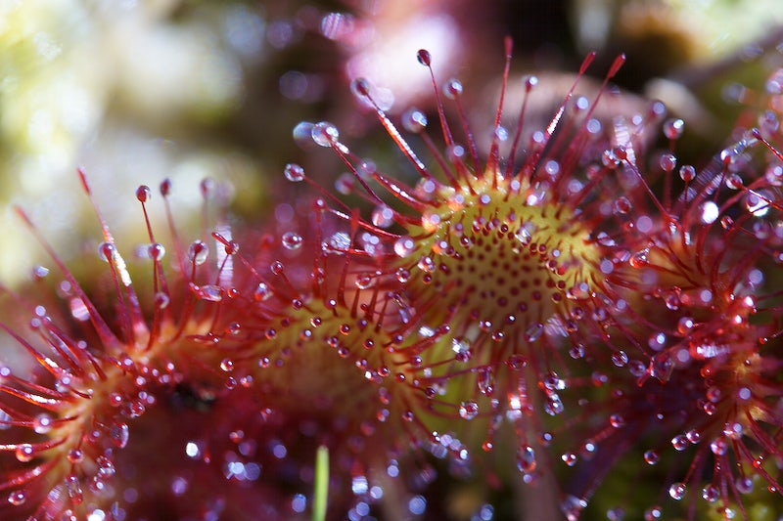

Slide 2
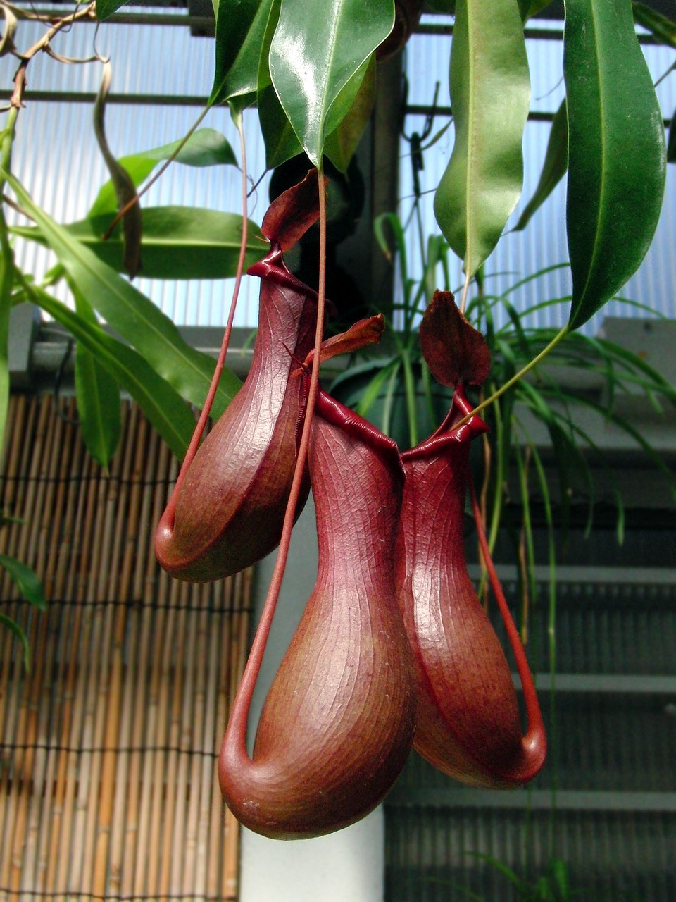
Lesson Objective
This is a long term lab project where we will combine many of the BIG IDEAS and SCIENCE PRACTICES in AP Environmental Science to understand course themes such as species diversity, plant physiology and anatomy, adaptation and predator/prey relationships, matter and energy cycling, and many more!
Your goal is to observe, document, analyze AND CARE for your plant in it’s simulated classroom environment. You will research and learn about your specific plant, connect it to themes of the course, and create a finalized product to connect your plant to APES.
You also get to take your plant home at the end of the year. :)
Notes:
Advanced Placement® Environmental Science is a multidisciplinary course that ties together scientific principles from geology, chemistry, biology, geography, and Earth Science. It is designed to represent a one-semester introductory environmental science course. Students are expected to practice various scientific methodologies to examine, analyze, and interpret scientific evidence to propose and evaluate solutions to environmental problems.
Upon completing this course, you will be able to use scientific principles, concepts, and methodologies required to:
understand interrelationships of the natural world
identify and analyze environmental problems both natural and human-made
evaluate risks associated with these problems
examine solutions for resolving them
The goal of the laboratory and field investigation component of the AP Environmental Science course is to complement the classroom portion by allowing students to learn about the environment through firsthand observation. Experiences both in the laboratory and in the field provide students with important opportunities to test concepts and principles that are introduced in the classroom, explore specific problems with a depth not easily achieved otherwise, and gain an awareness of the importance of confounding variables that exist in the "real world.”

Slide 3
For the generous grant and opportunity to play and grow!
This Photo by Unknown Author is licensed under CC BY

Slide 4
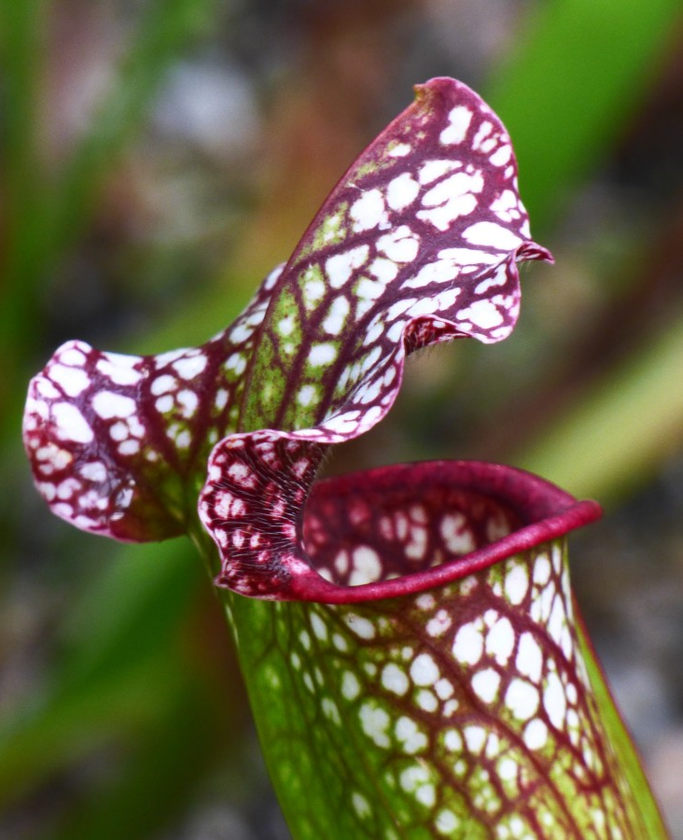
PART 1: Get to know your “Chompy Plant Buddy”
Get to know your selected plant and learn about it’s place in the world. You will research and create a poster introducing your plant to the class!
Posters must include:
Name (common and scientific)
Location (geographical, habitat, type of environment, ecosystem type)
Where is it in the ecological system? Primary producer?
Fun Fact about your specific plant!
POSTERS MUST HAVE IMAGES (drawn or printed and be visually appealing!)
You must turn in a sources list!
Notes:
Project requirements are multi-pronged.
Part 1: Students need to understand their plant – it’s genus and species, environment, place in the ecological system etc. This coincides with Units 1 and 2 (Ecosystems and Biodiversity).
Students will research, create a poster or product, and present their plant information in a gallery walk style.
Day 1 – plant selection and research
Day 2 – Research and poster creation
Day 3 – Poster Gallery Walk (visit https://www.theteachertoolkit.com/index.php/tool/gallery-walk for information on this strategy)
Students turn in: research notes with source list, completed posters for part 1.

Slide 5
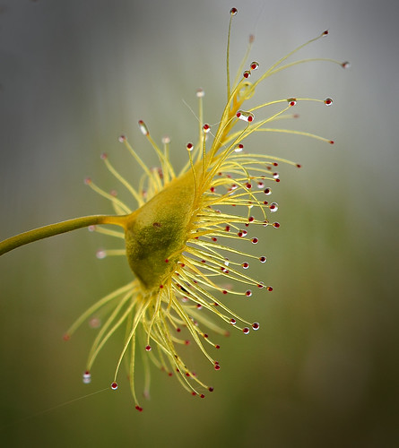
May I suggest the International Carnivorous Plant Society as a source option?
www.carnivorousplants.org/

Slide 6
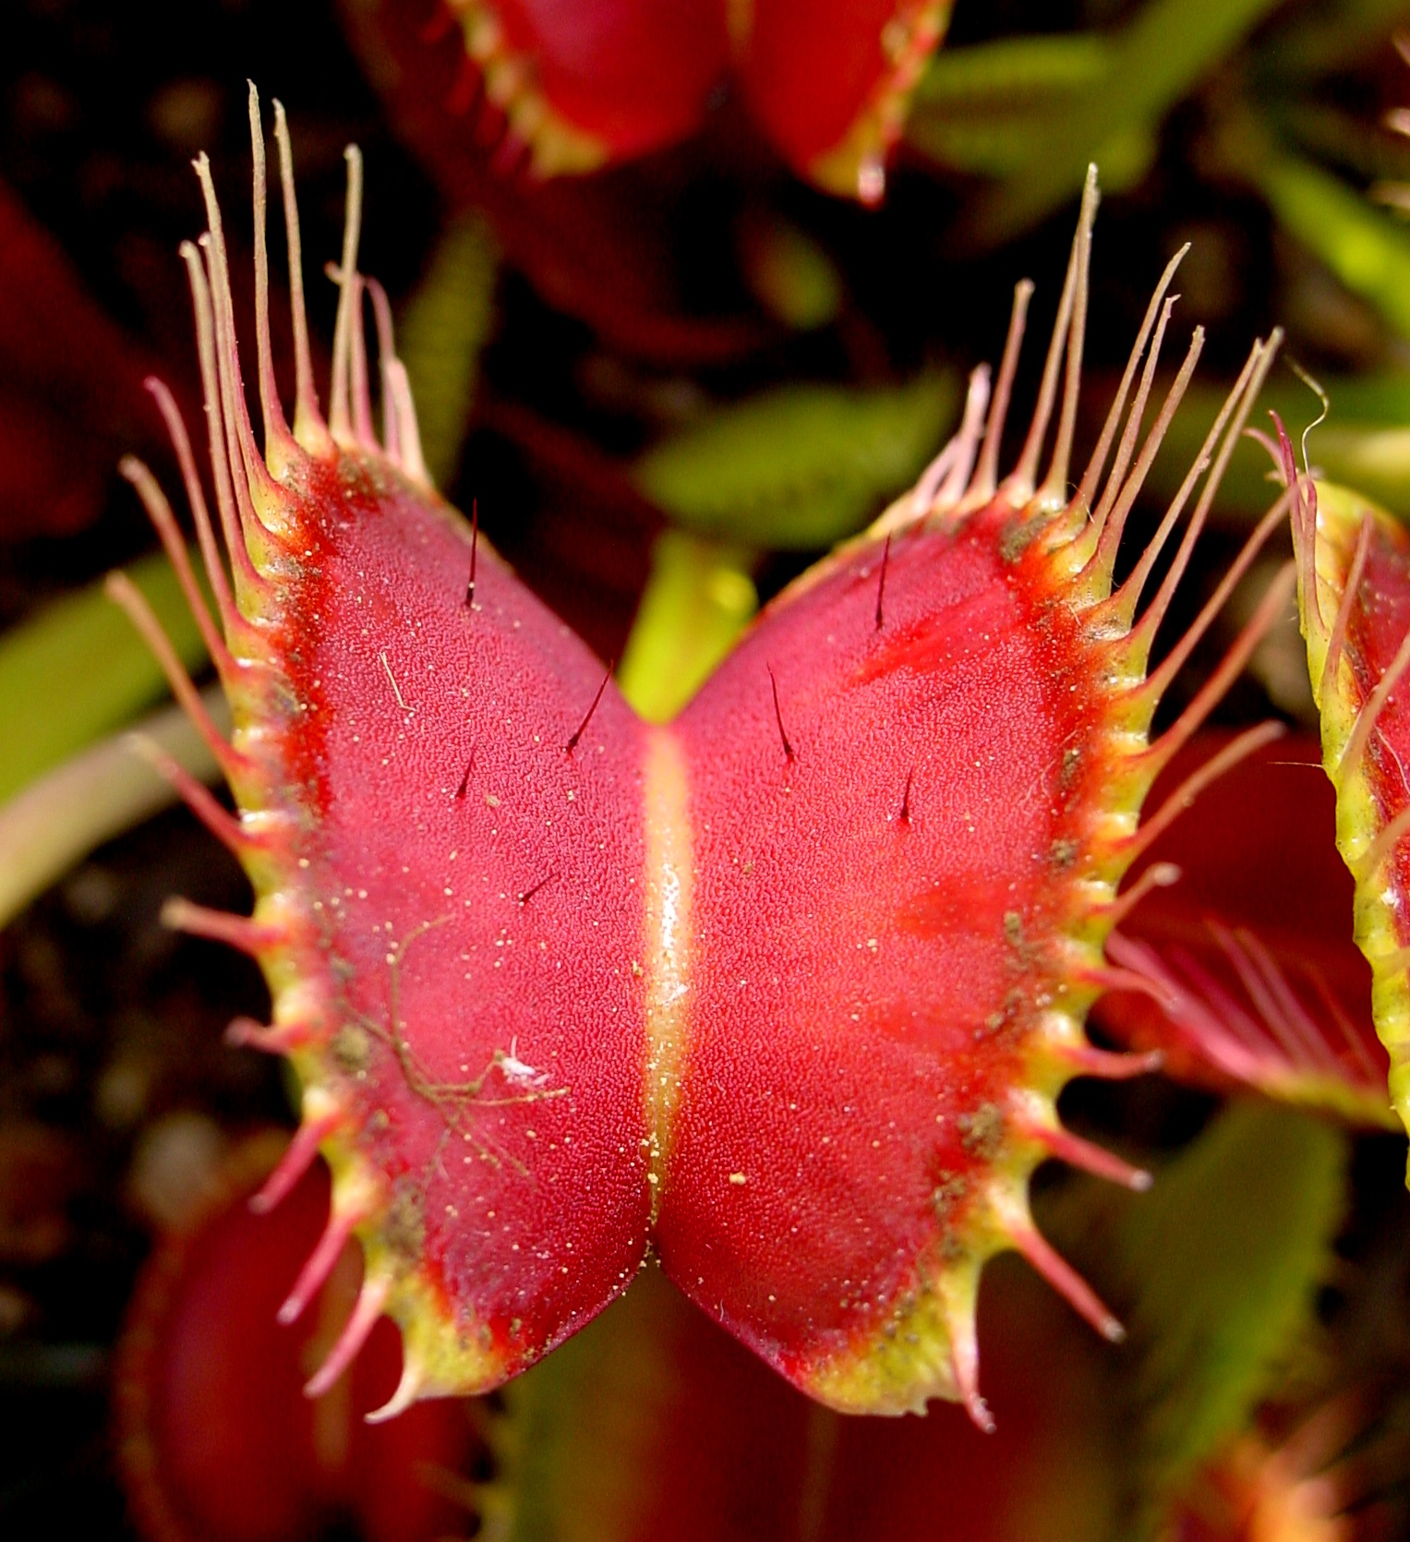
PART 2: Gather Data and Compare
Now comes the fun part! For the next several months, we’ll track growth patterns, water use, soil and water properties, even insects eaten! You get to pick!
Requirements:
Select four factors to track for your specific plant. Explain why you’ve chosen these four factors and CONNECT it to our course themes or unit topics.
Create a Google Slides data sheet – share with me so I can progress monitor.
Check your buddy once a week and record data.
Keep track of problems and good things!
Notes:
For part 2: Students will then gather data long term: plant growth, water amounts, insects eaten (if any), problems with growth, and even soil or water properties.
Students will select data to gather – they must choose 4 factors to track long term. Depending on the factors chosen, they will connect their data to other Units in AP Environmental Science and describe how that data connects. They will be required to create a spreadsheet with their data and share it with me to watch as we go throughout the trimester.
Data will be gathered independently during the last 10 minutes of class, once a week. Students will also be invited to come in before or after school if they need more data points.
Turn ins for this part: Data taken over the course of several months, with data connections justification written in paragraph form.

Slide 7
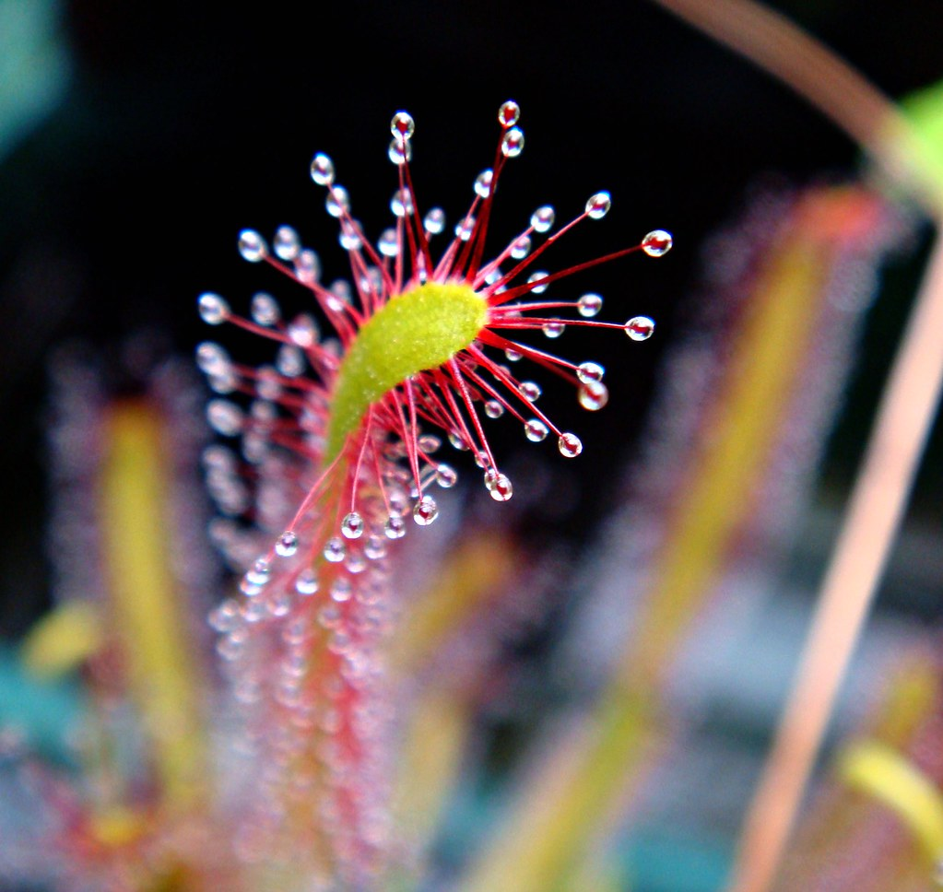
PART 3: Analyze and Interpret
We can’t just have raw data – we have to visualize, analyze, and interpret!
You will take your data and create graphs to show trends about your plant buddy.
Graphs must include:
Title
Axis labels
Appropriate graph type for data
Write a conclusion based on what you see in your data! Draw conclusions!
Notes:
For part 3: students will take their data and use it to create digital graphs and then show trends about their carnivorous plants. Were there seasonal cycles apparent? Did plants grow consistently through the course of the school year? Did soil and water maintain equilibrium in terms of pH or other factors?
Day 1: Slides Tutorial and data graphing
Day 2: Graph and data analysis discussions as a class.
Turn ins for this section: Data graphs, created in a digital format such as Excel or Slides.

Slide 8
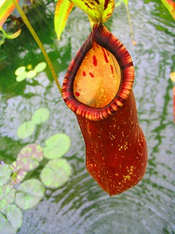
PART 4: Present and Communicate
Scientists share their work and collaborate – time to communicate out what you’ve learned!
Your final project is a set of slides (5-10 total) that summarize all we’ve learned about carnivorous plants. We will present our slides to one another!
Slides must include: Title
Plant overview – species, location, ecosystem, common prey, special characteristics
Data gathered – factors, procedures to gather data, issues with data gathering
Analysis – what did you learn? What did your data tell you?
Connections to APES: what course units connect to the data you gathered? What you learned about your plant? How does your carnivorous plant connect to the larger themes of our course?
Sources
Notes:
For Part 4: Students must communicate findings as they are a scientific community. They will create a short 5-10 slide presentation to summarize their plant’s information, data taken, graphs, and interpretations of data. They will share out to the class. Then students in a final writing assignment, will compare and contrast the different carnivorous plants again and revise their connections to the APES course (hopefully expanding their list of connected topics!)
Day 1-2: Slide creation (5-10 slides)
Title
Plant overview – species, location, ecosystem, common prey, special characteristics
Data gathered – factors, procedures to gather data, issues with data gathering
Analysis – what did you learn? What did your data tell you?
Connections to APES: what course units connect to the data you gathered? What you learned about your plant? How does your carnivorous plant connect to the larger themes of our course?
Sources
Day 3: Presentations

