Slide 1
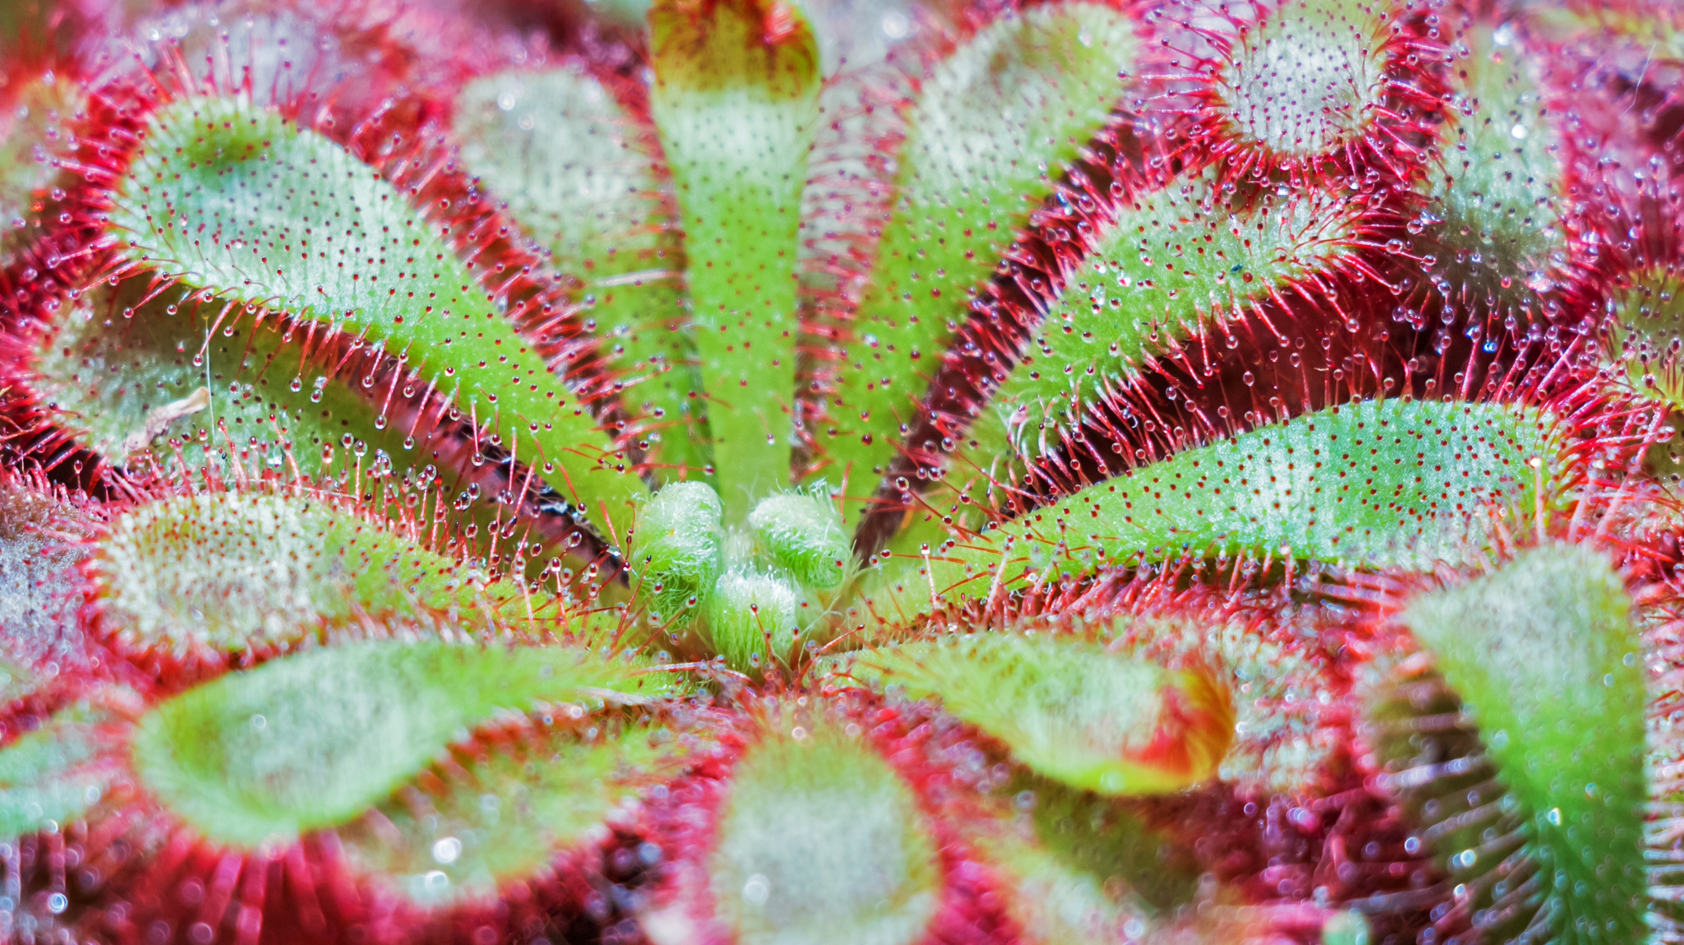
Carnivorous Plants
High School Biology (9th Grade)

Slide 2
Plants
Plants are autotrophs/producers because they produce their food through the process of photosynthesis and break it down through cellular respiration.
Plants need 5 things to survive:
Light
Air
Water
Nutrients
Space to grow

Slide 3
Light
Light is a limiting factor for plants. Determine how light effects plants.
Why do they need light?
What is the primary source of light?
What wavelengths of light are most important?
If you are growing a plant indoors, what type of lighting should you use?

Slide 4
Air
Plants need to different gasses to survive, carbon dioxide and oxygen.
How do they use both gases?

Slide 5
Water
All plants need water, some more that others. For example, succulents have adaptations to help them survive with less water and thus allows them to live in the desert.
How are carnivorous plants different?
What type of environment are they adapted to live in?
What type of water do they need and why?

Slide 6
Nutrients
Most plants need nutrients to survive. This includes nitrogen, phosphorous, and potassium. Once dissolved in water these nutrients are absorbed through the roots of the plant. Most plants benefit through the addition of fertilizer.
Carnivorous plants are different.
How do they obtain their nutrients?
What happens if you plant them in or give them fertilizer?
Are their any types of fertilizer that they can use?

Slide 7
Space to grow
All living things need space to grow. Plants are no exception. They need space for their leaves to access sunlight and space for their roots to absorb water and nutrients.
Determine how much space is needed in general for the following types of carnivorous plants:
Venus Flytraps
Pitcher Plants
Sundews
Butterworts
Cobra Plants

Slide 8
Bog or Terrarium (Assessment)
Imagine that you could create either a small bog or terrarium for carnivorous plants for your class.
What do you need to get started? (equipment, soil, lighting, testing equipment)
What plants would you choose and why?
How would you feed your plants?
How would you water the plants?

