Slide 1
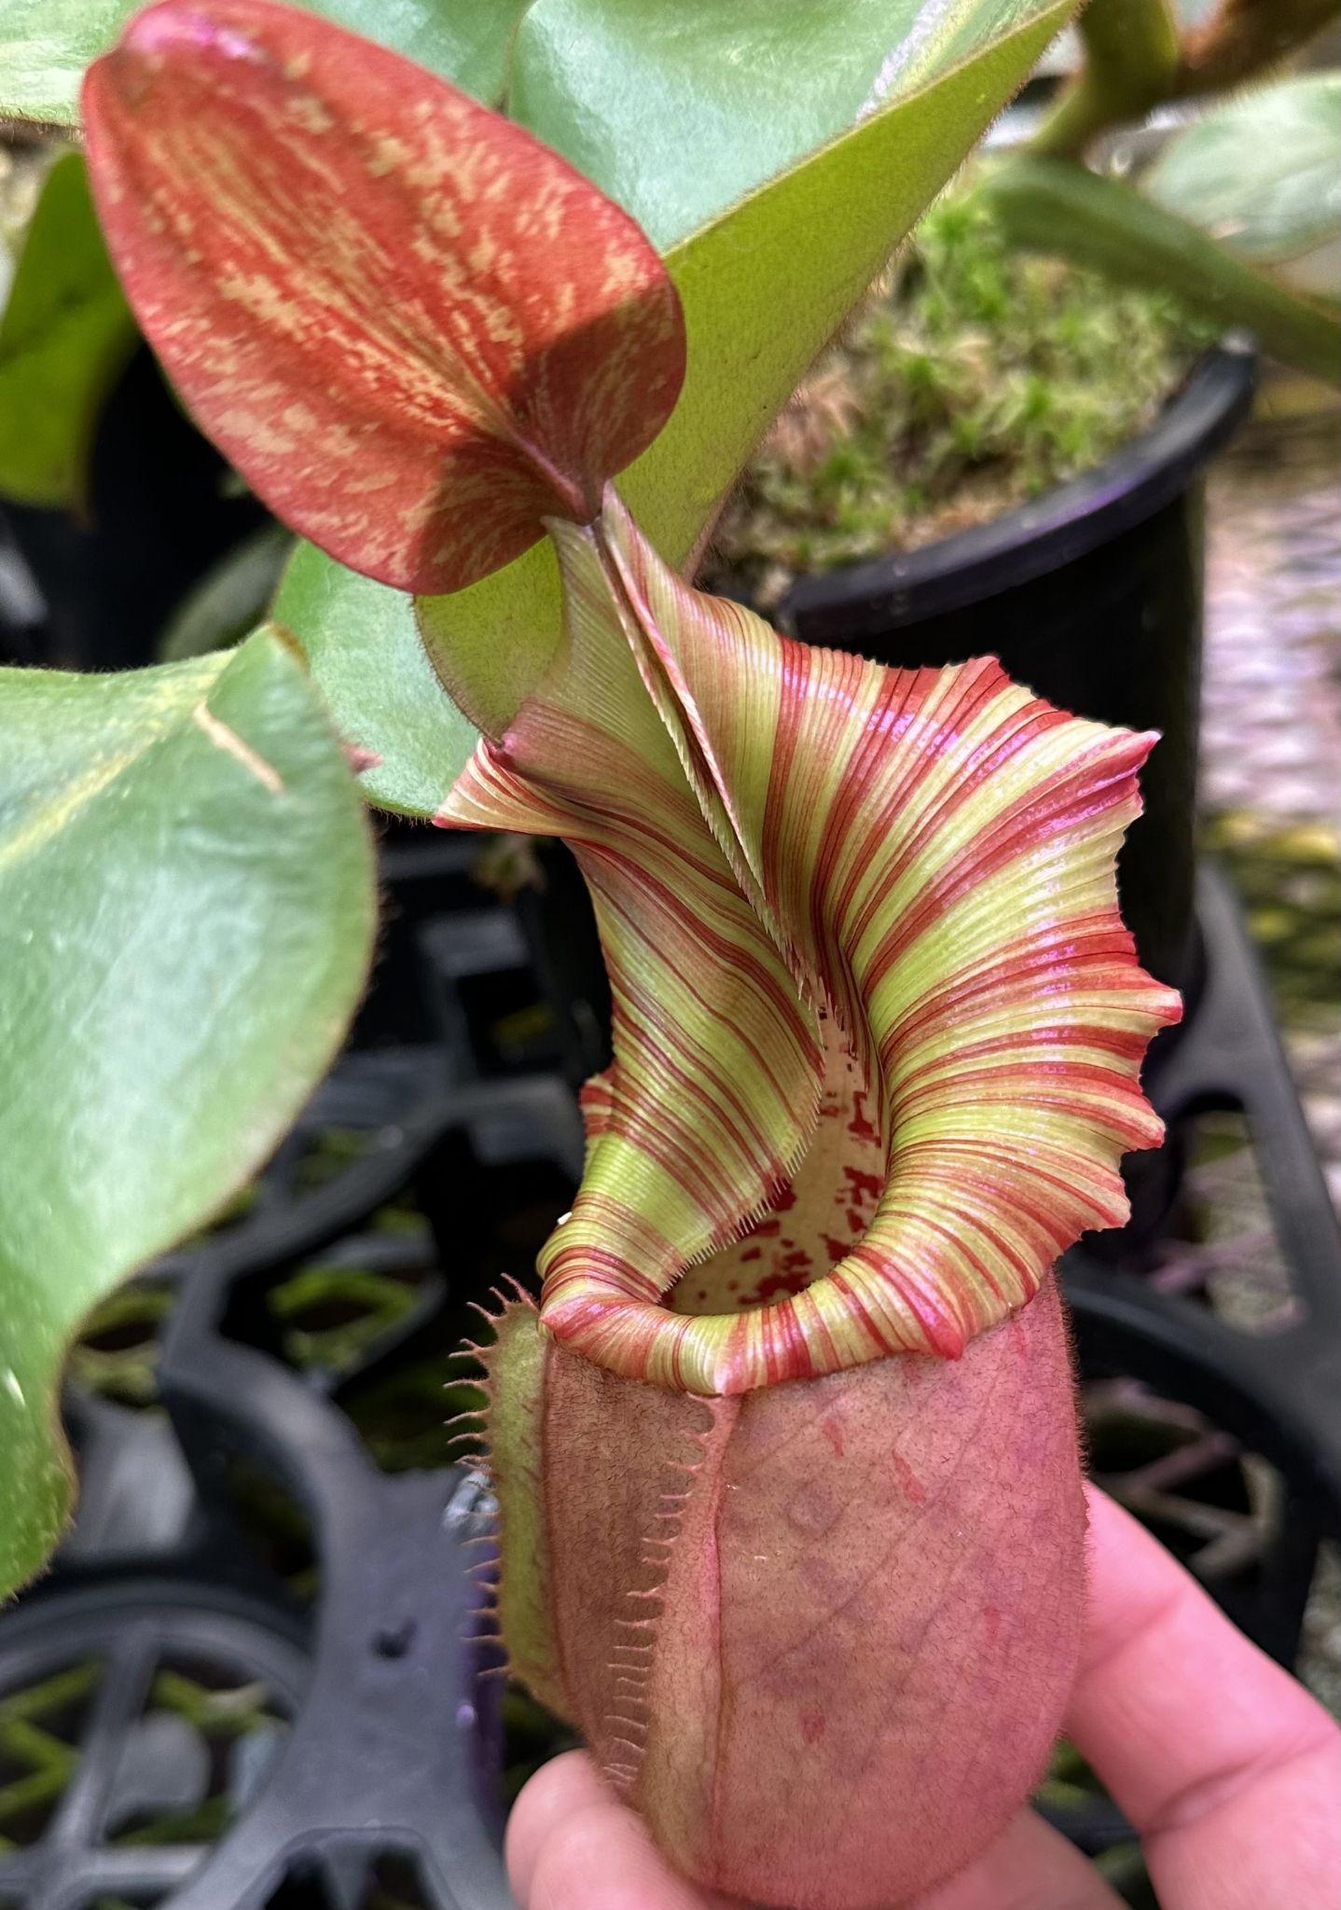
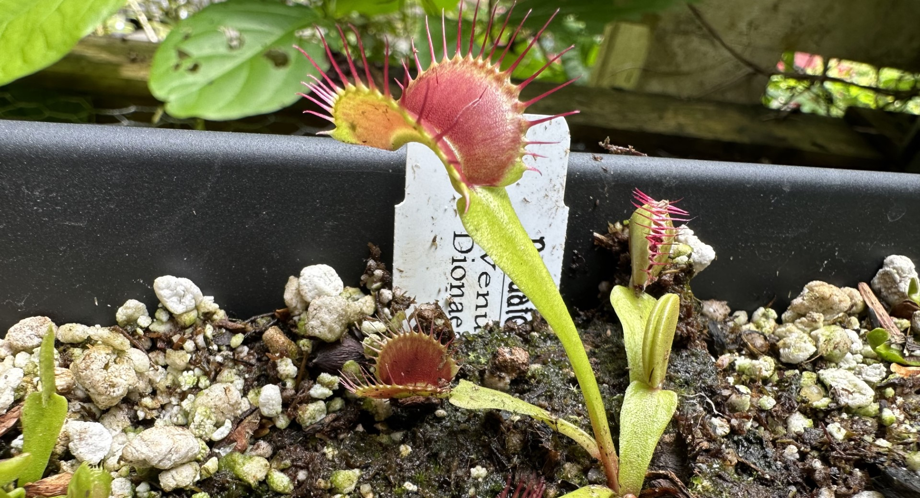
What’s Your Carnivorous Plant Personality?
Notes:
Benchmark 1A: Demonstrates awareness and understanding of one’s own emotions and emotions' influence on behavior.
Benchmark 4A: Demonstrates awareness of other people’s emotions, perspectives, cultures, languages, histories, identities, and abilities.
Benchmark 6B: Demonstrates the ability to work with others to set, monitor, adapt, achieve, and evaluate goals.
Here is the link to the inventory.
I will be using this activity as a way to launch get to know you activities in my room this year. I teach 4th graders, but I imagine it can be adapted to other grade levels.
**All photos are belong to me and are of my plants.

Slide 2
Carnivorous plants come from all over the world and live in very challenging environments. Most of these plants are not related but evolved carnivory separately. This is called convergent evolution. Despite their common carnivorous nature, they are unique in the way they catch and eat their prey.
Just like the plants are unique, we are all unique too. We are not related, but we all have converged into this classroom and will coexist for the school year. In order to get to know each other better, I thought we could do a fun activity. Each carnivorous plant has some unique personality traits that translate well to human personalities.
On the next few slides you will find 5 different types of carnivorous plants. This list is not extensive, but it shows a good variety. Be open to figuring out which one you are most like. Each of the five plants have five points (3 strengths and 2 areas to watch out for). Pay close attention so that you can start to see which that you are most like.
When we are finished, I’ll hand out an inventory sheet that you can read through and check which ones you identify with to figure out which plant you are most like. You may have many tick marks all over the place. I am going to ask that you find the one you have the most in common with and choose that one as your plant personality.
Notes:
This slide can be hidden and just used for talking points. I included it in the presentation just in case.
I will hold off on passing out the inventory until I have gone through each plant. I want the students to pay attention to what is on the board. When finished, I’ll pass out their inventories and they can choose which plant they identify with.

Slide 3
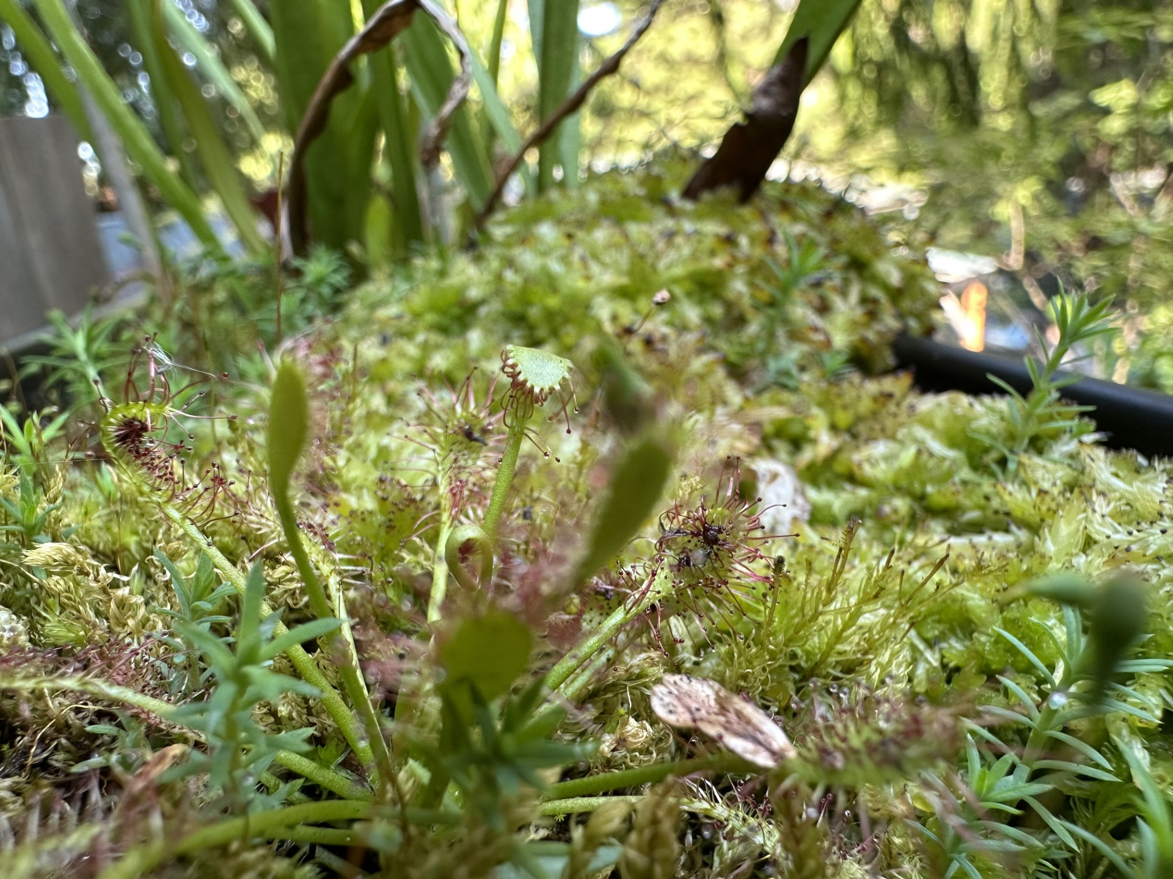
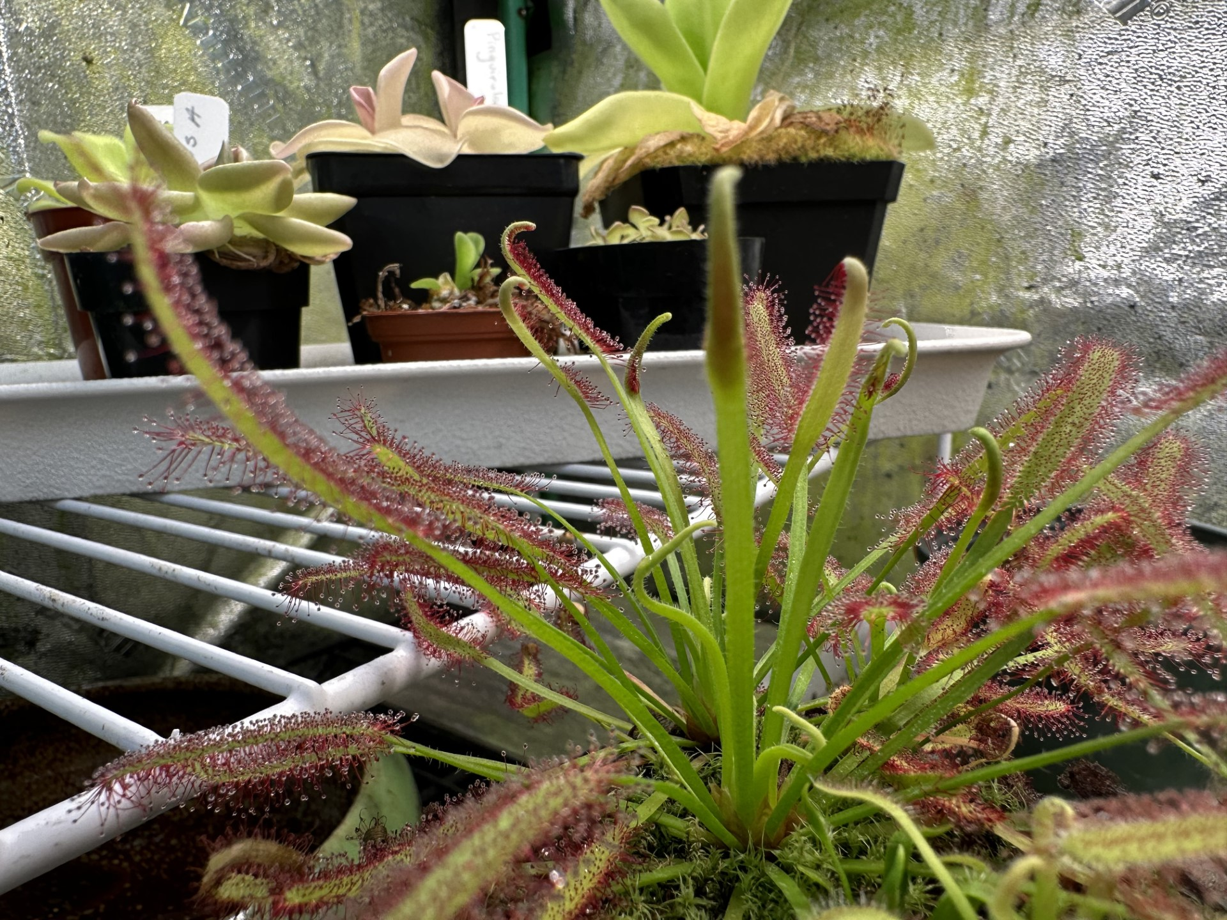
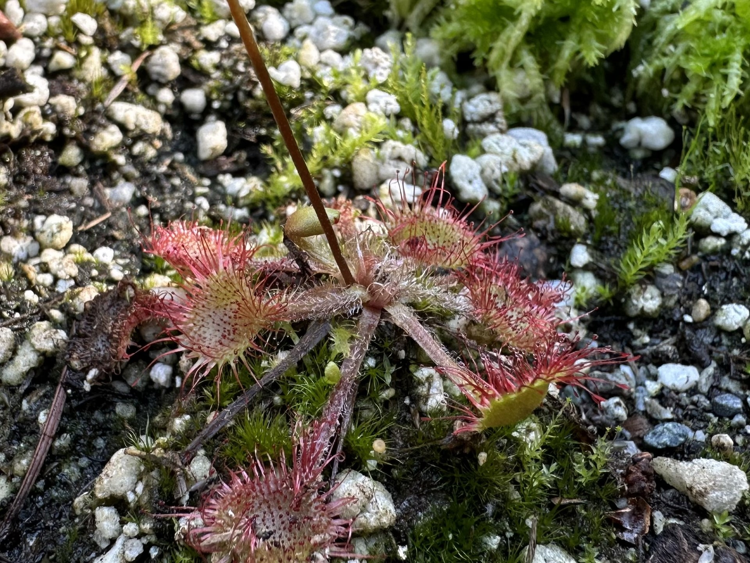
Drosera
If you are a Drosera:
You are a happy person.
You have lots of ideas and it makes you super fun to be around.
You curl up with things you love and you don’t let go unless you have to.
Watch out for:
When you don’t get your needs met, you melt down quickly.
You might have too many ideas going at once and can get them tangled up.
Drosera, or the sundews as they are called, are one of the largest groups of carnivorous plants. They have sticky leaves that lure insects close and then curl around them to get their nutrients. Drosera are found in bogs, fens and swamps where they can get plenty of sun and the insects are plenty. Their roots are used mostly to anchor them and drink water. Sundew blooms are little fireworks in their habitats.
Notes:
Feel free to add other characteristics to this. If you come up with something, feel free to e-mail me at cinks@nsd.org.

Slide 4
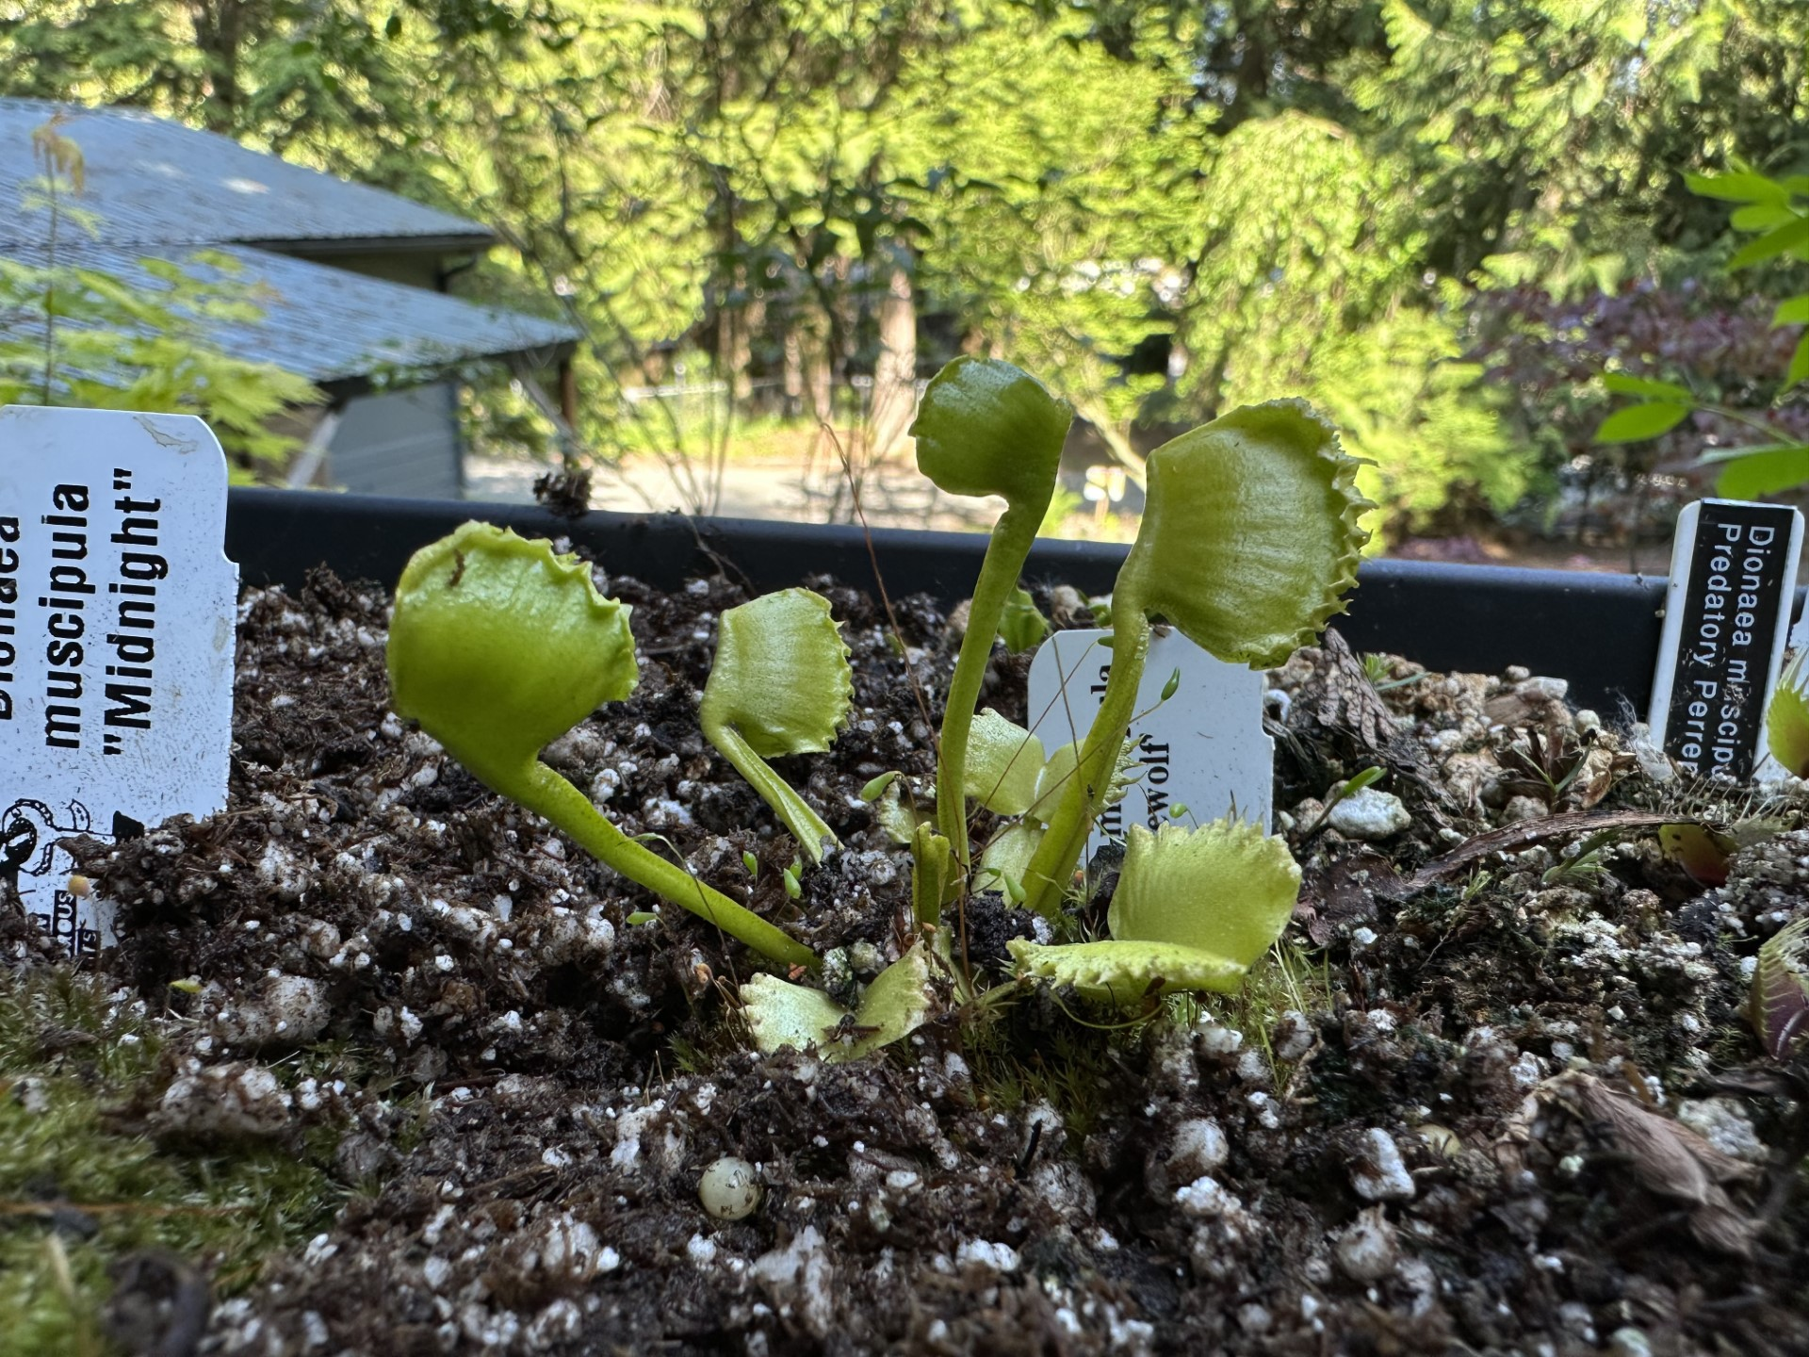
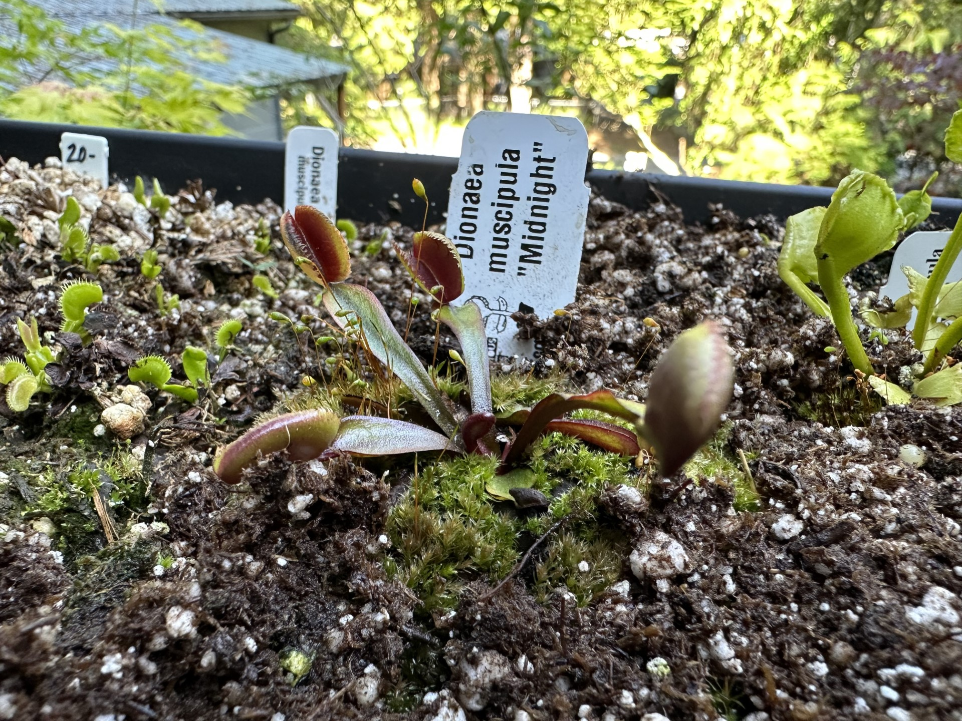
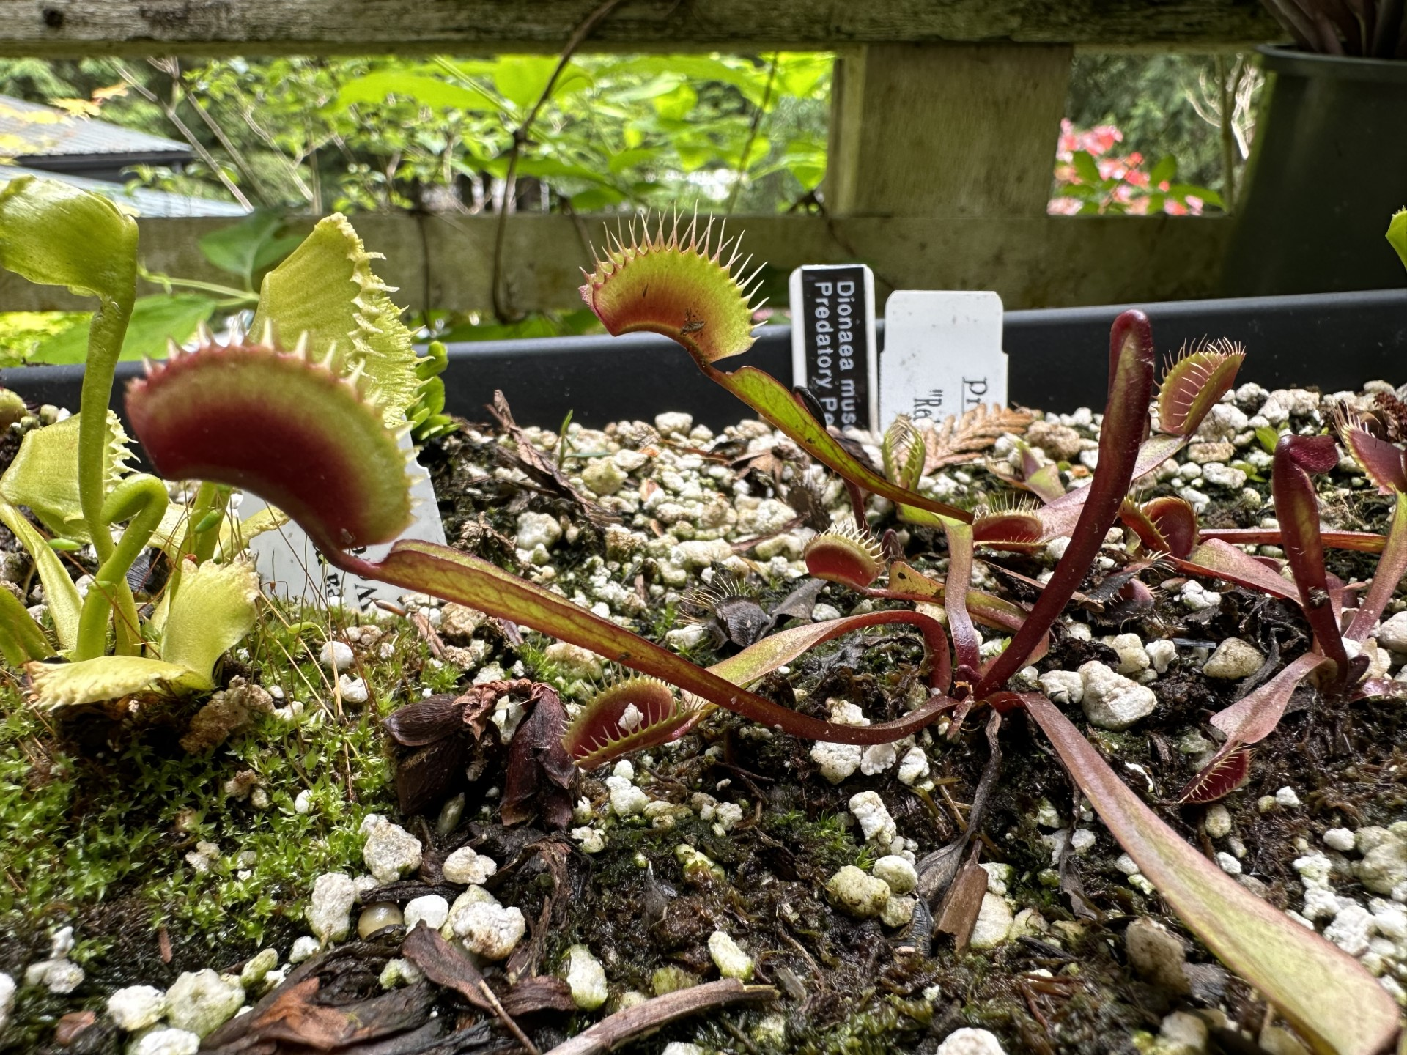
Dionaea
If you are a Dionaea:
You are happy being amongst friends.
You like to stay close to home and not venture too far out.
You grab ahold of things that you love and that recharge you ,and you don’t let go!
Watch out for:
When life seems out out of control, you may get burned by getting too close and trying to control it.
You have a tendency to be a bit “snappy” when your nerves are triggered. Relax.
Dionaea muscipula, or the Venus flytrap, is the most iconic of the carnivorous plants. They have a small home range in the Carolinas where they grow in nutrient-poor soil and create carpets. They depend on wildfires to clear the canopy that would shade them out. When it comes time to eat, insects trigger the snapping mechanism and feed the plant. Sometimes traps are triggered by accident and close unnecessarily.
Notes:
Feel free to add other characteristics to this. If you come up with something, feel free to e-mail me at cinks@nsd.org.

Slide 5
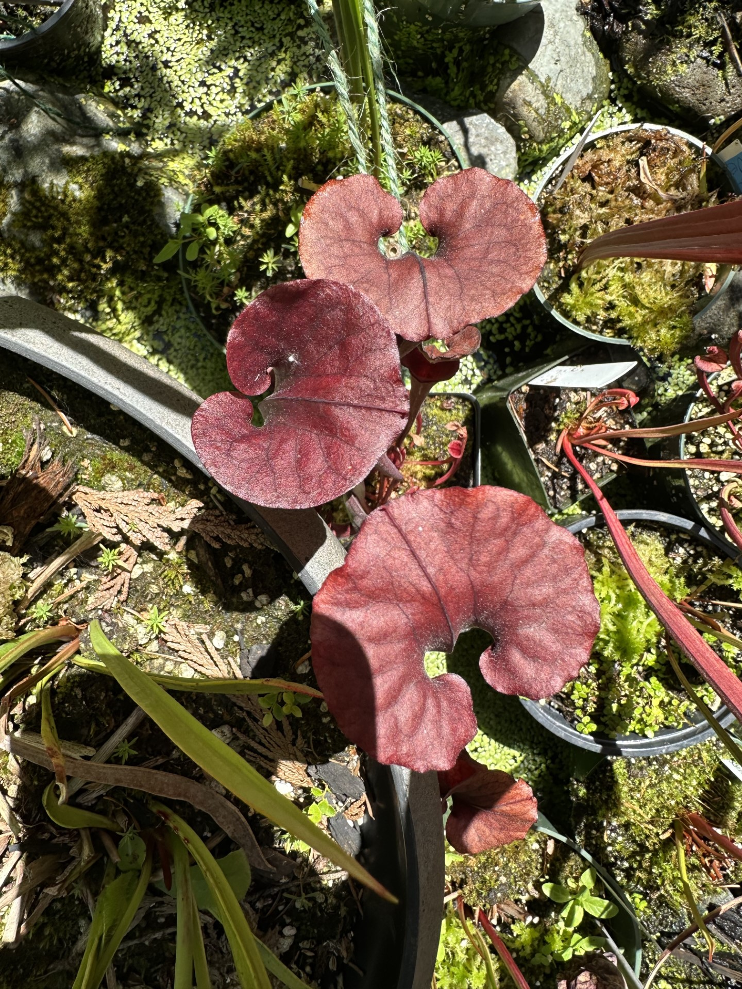
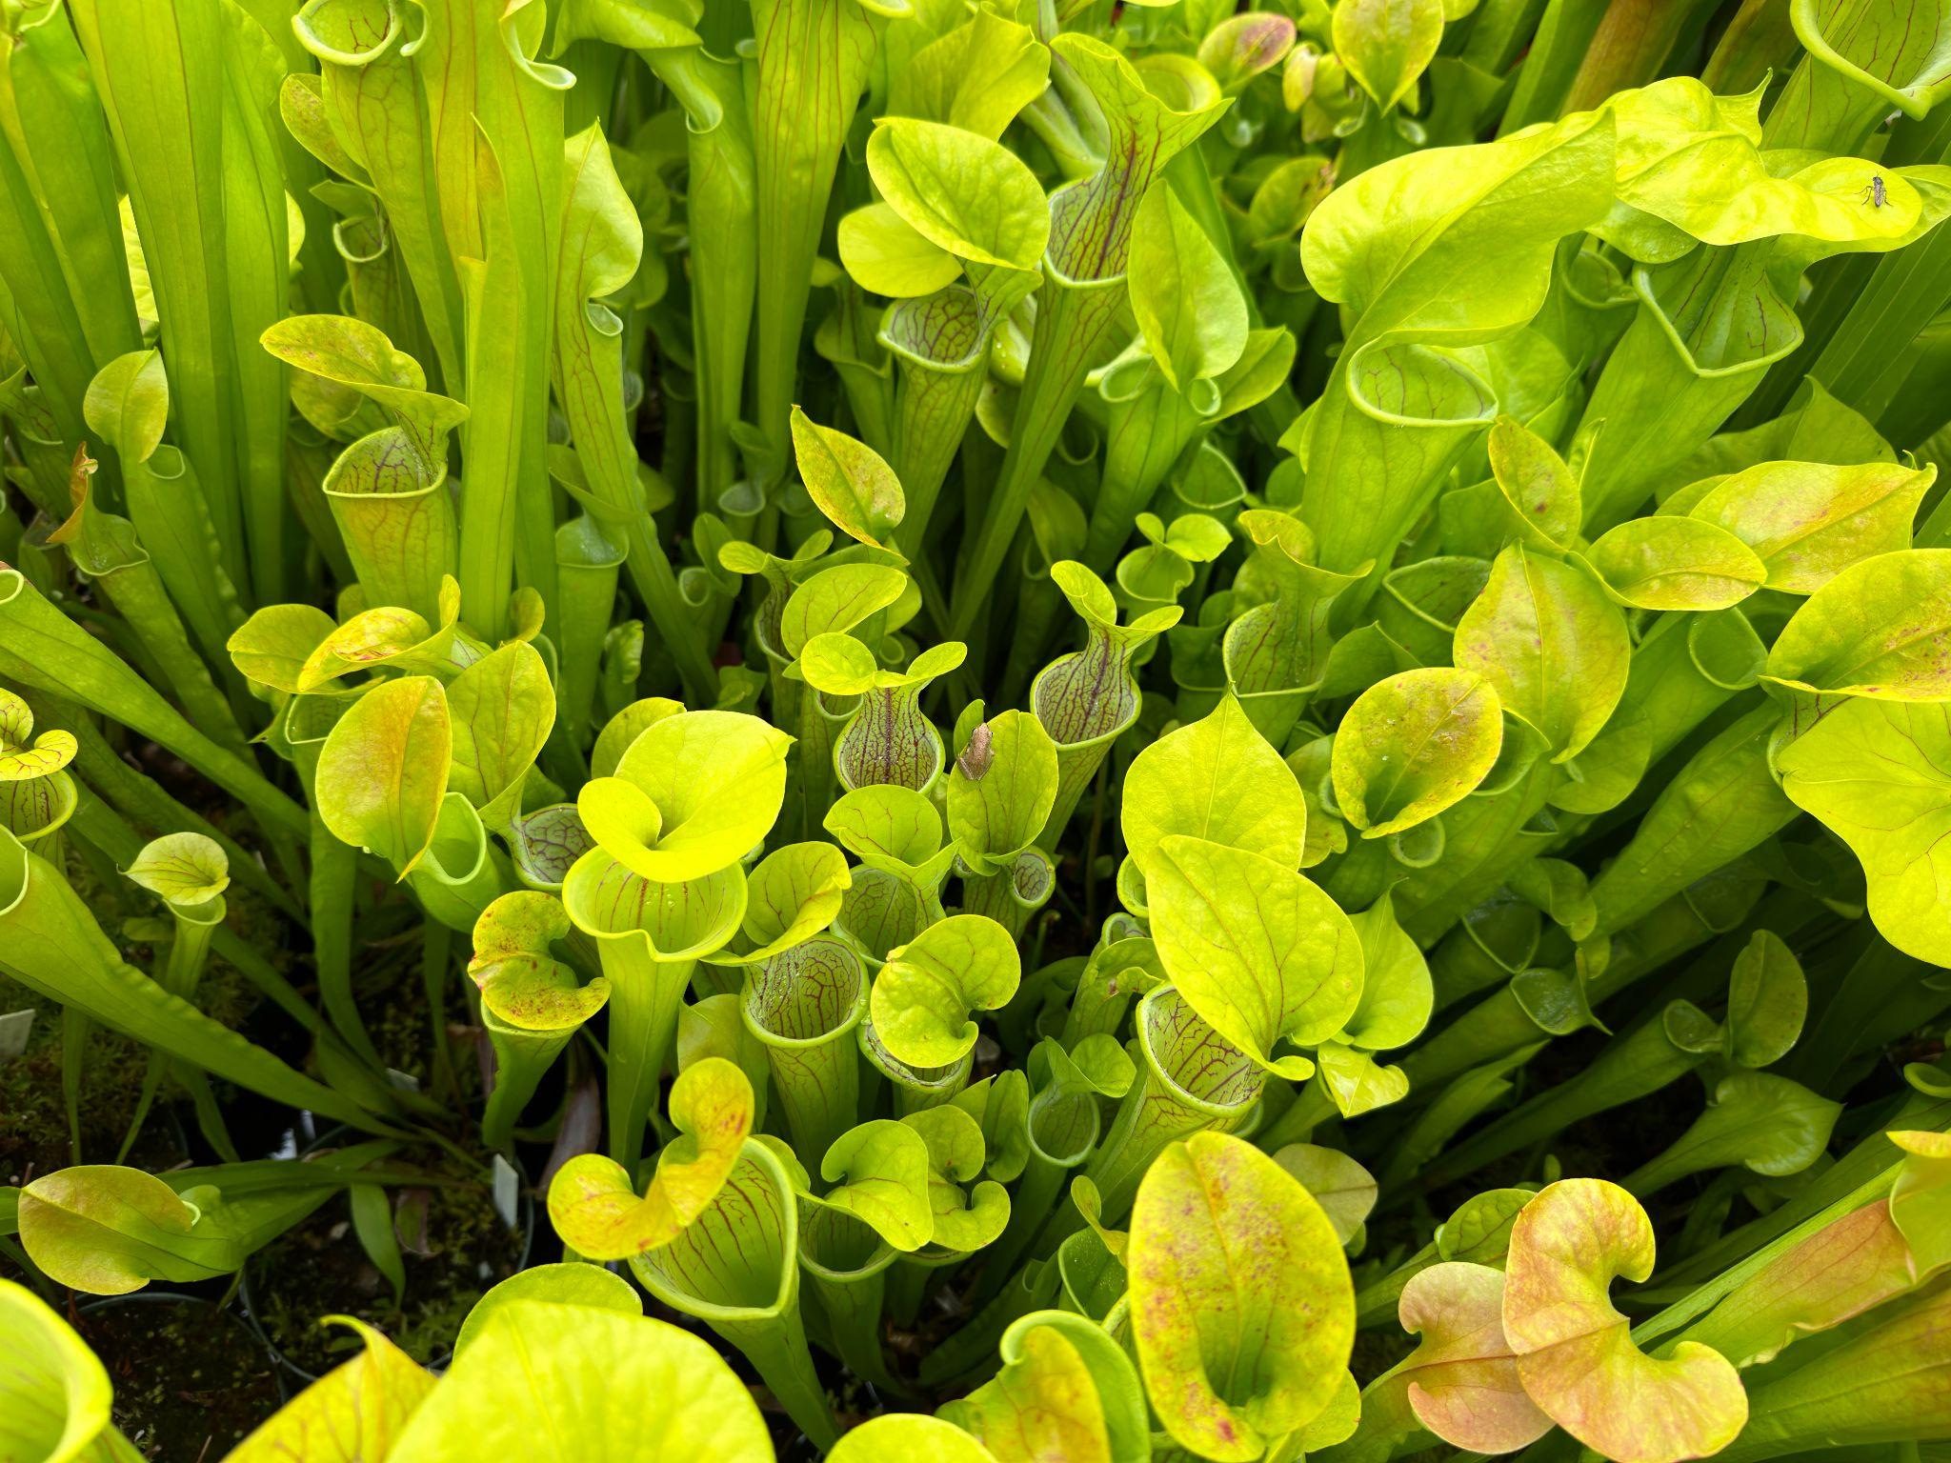
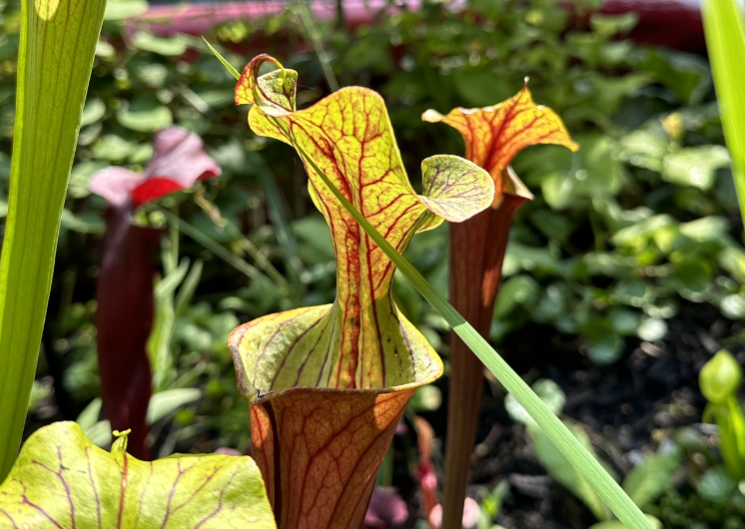
Sarracenia
If you are a Sarracenia:
You are bold (personality, fashion, etc).
You attract a lot of friends because you are sweet and fun to be around.
You are not afraid to let people know your interests even if they are unusual.
Watch out for:
Because you attract so much attention, sometimes it can blow you over and leave you feeling empty.
Your image is important to you, but can alienate you from your peers if your not careful.
The trumpet pitchers, or Sarracenia, live on the east coast, with the majority of them in the southeast. They grow in similar conditions as all other carnivorous plants. These tall, attractive pitcher plants, come in all sorts of colors and patterns. They are pitfall traps and attract insects with nectaries (nectar glands that develop on foliage instead of flowers). The insects get too curious or greedy, and fall into the traps where they are digested. Since the trumpets can be quite tall, sometimes they fall over in heavy winds. Sarracenia flowers are strange alien-like structures specifically designed to protect from self pollinating in order to ensure genetic diversity.
Notes:
Feel free to add other characteristics to this. If you come up with something, feel free to e-mail me at cinks@nsd.org.

Slide 6
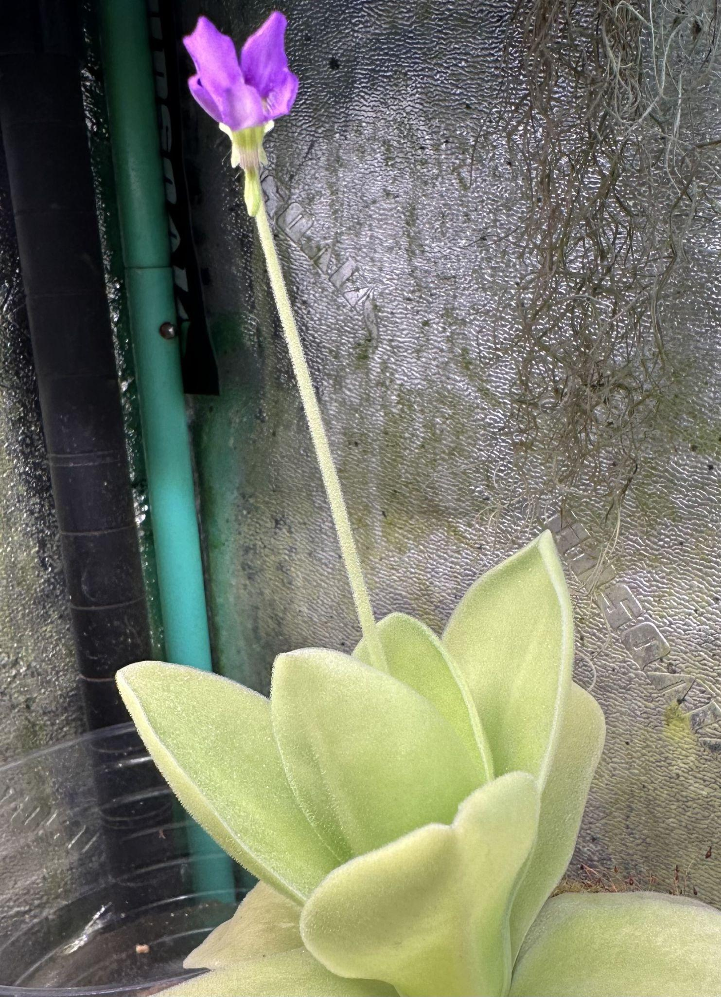
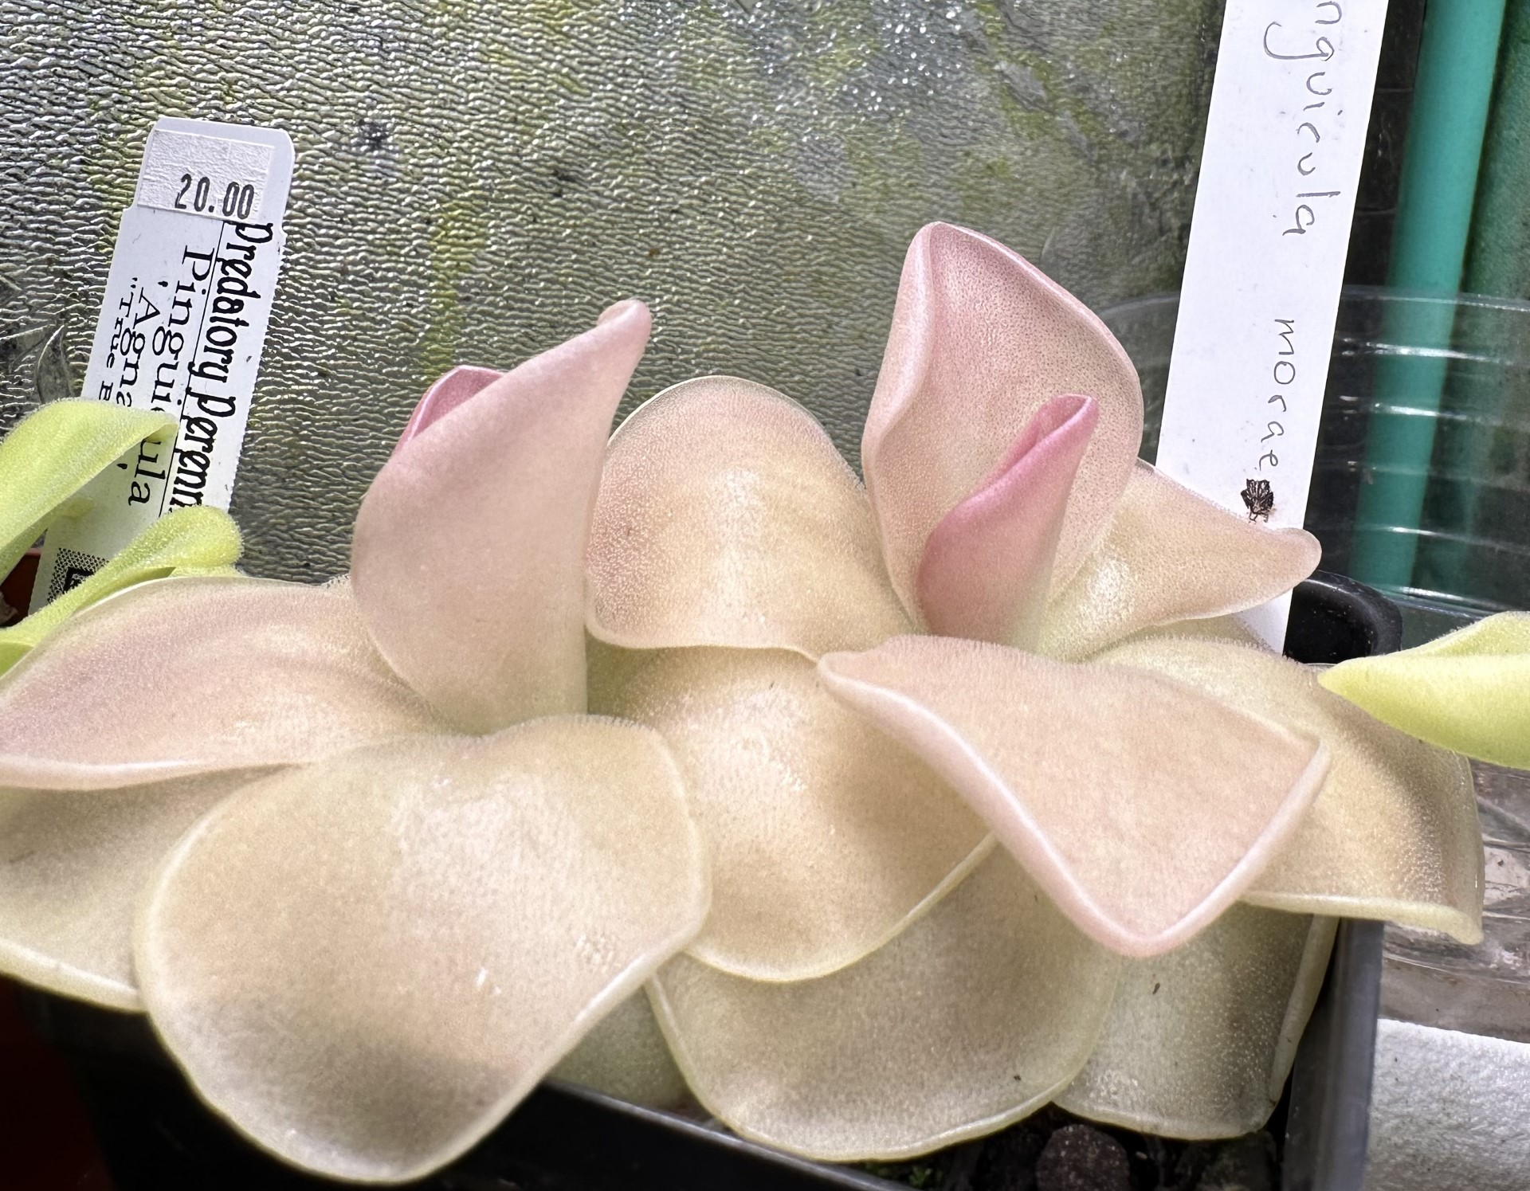
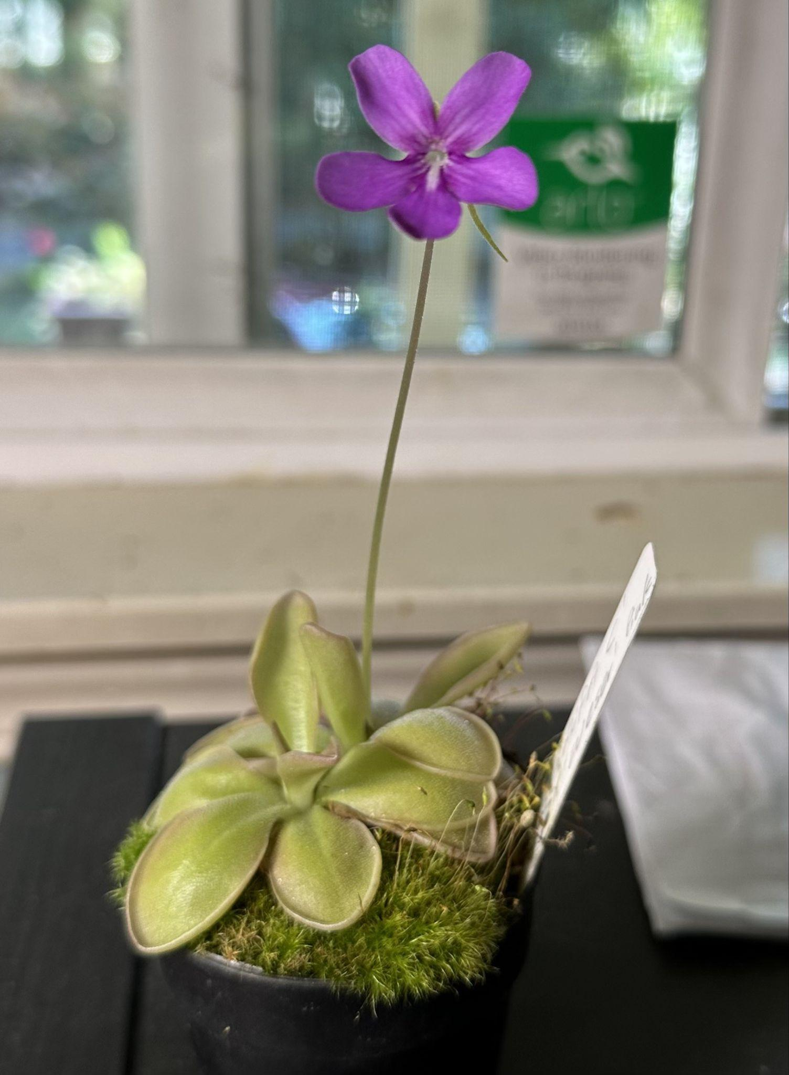
Pinguicula
If you are a Pinguicula:
You are flexible and easy to get along with.
You can’t help but shine and people take notice of you.
When life rains on you, you shrug it off easily.
Watch out for:
When you feel the chill of life, you may turn into yourself. This is not always a bad thing but you may struggle to come out of it.
When you are too flexible, you can lose your footing and experience failure to thrive.
Pinguicula, or pings as they are commonly called, are a wonderful group of carnivorous plants found all over the world. They are a sticky trap, but unlike there Sundew cousins, they do not curl around their prey with dewy tendrils, but they have a grease-like slick on their leaves that bugs can’t get away from. Pings grow in a variety of habitats, but always in the sun. Some pings like to be fully submerged by water, and others prefer to be in rocky, well draining soil. When cooler weather comes, many Pinquicula will form a hibernacula where they turn into tiny succulent rosettes. This protects them from frost damage. One of the more striking features of the Pings are their stunning flowers. They are violet-like and come in a range of colors - white, pink, purple, blue. There are even bi-color flowers!
Notes:
Feel free to add other characteristics to this. If you come up with something, feel free to e-mail me at cinks@nsd.org.

Slide 7
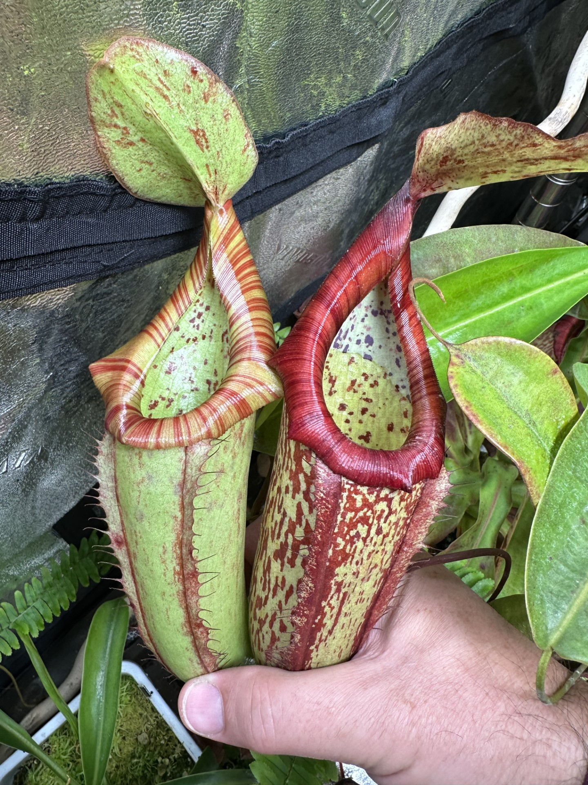
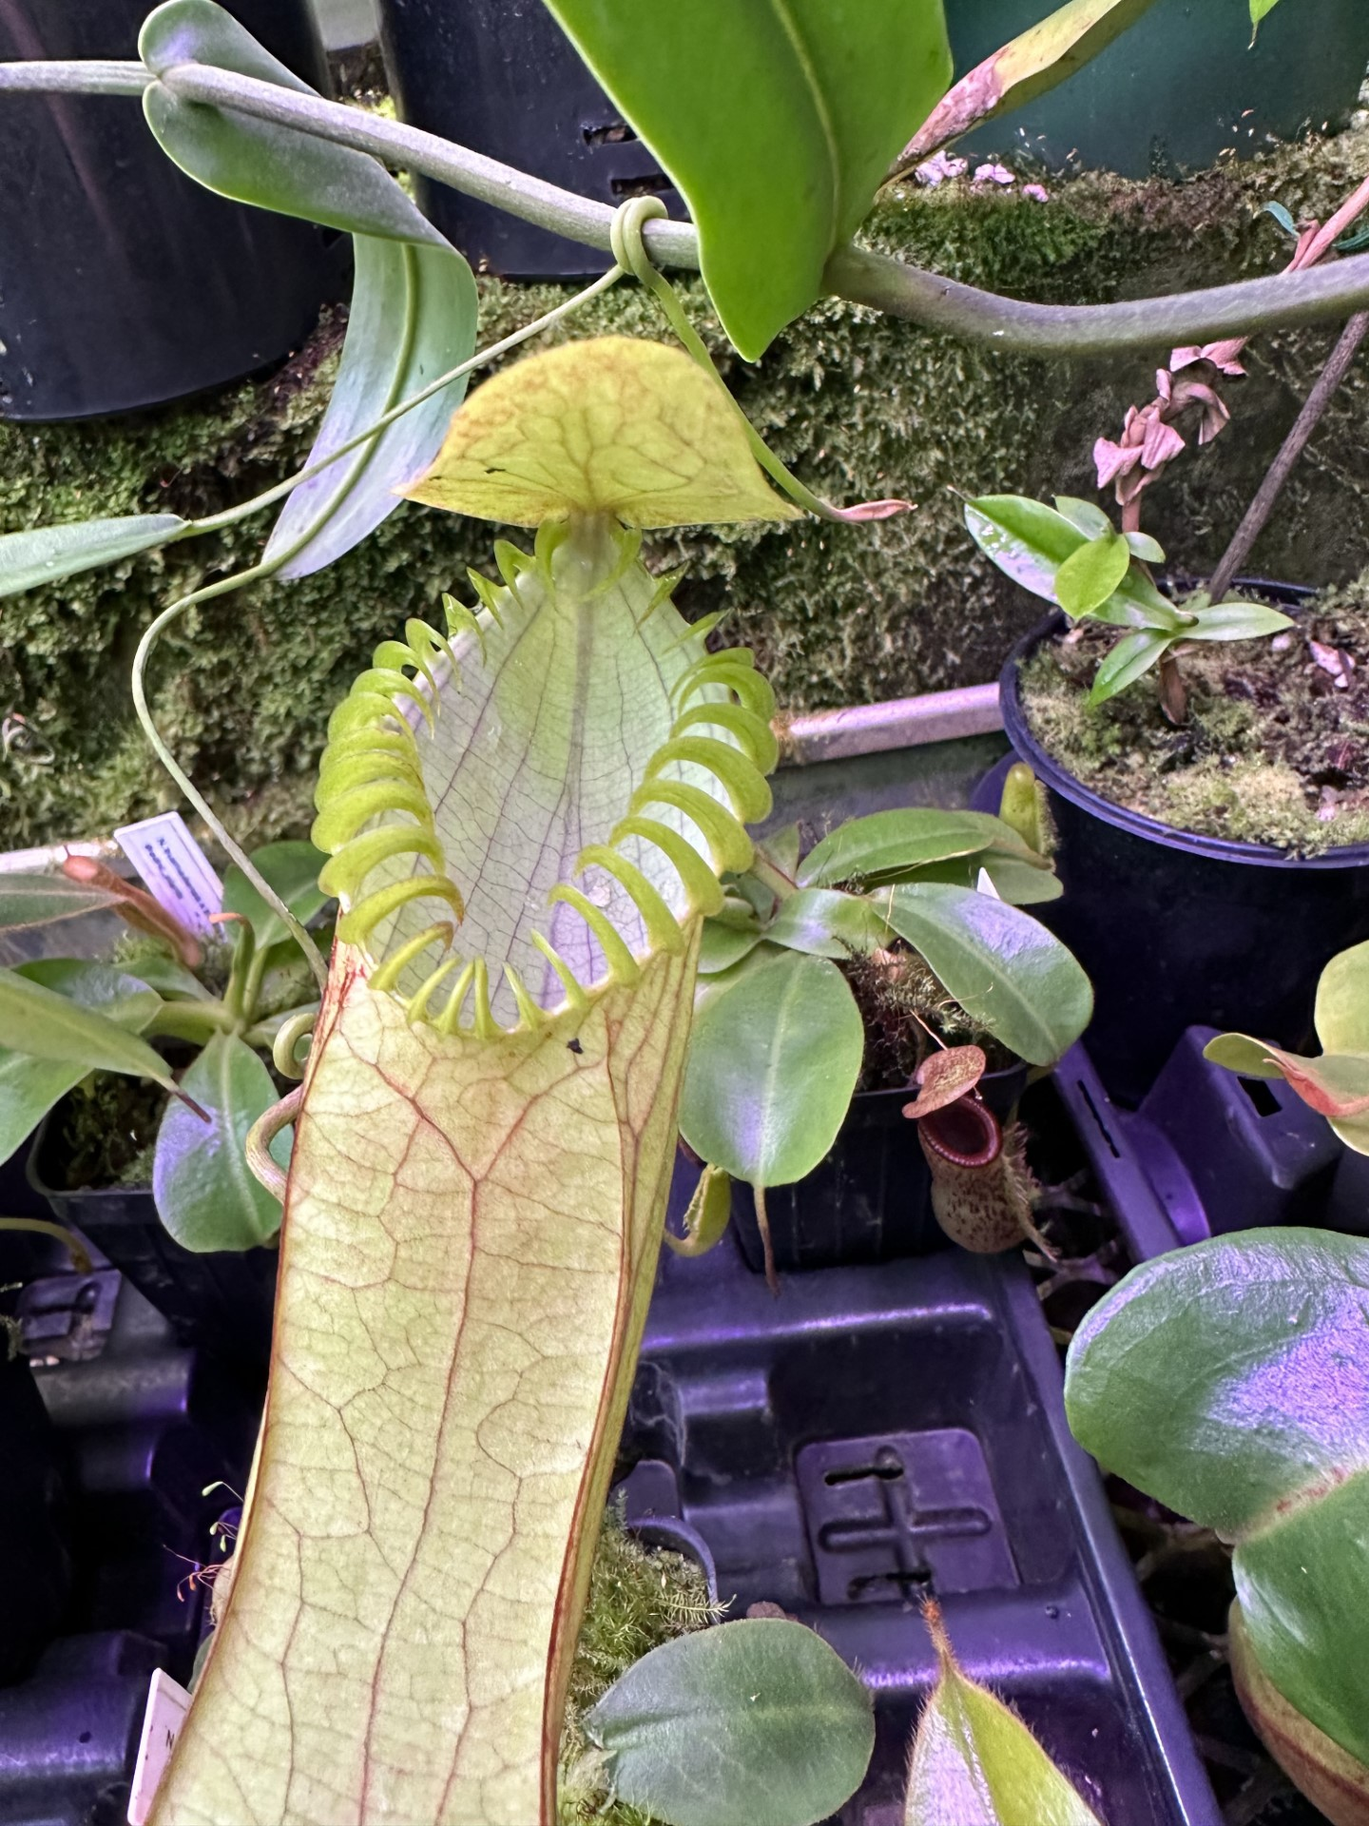
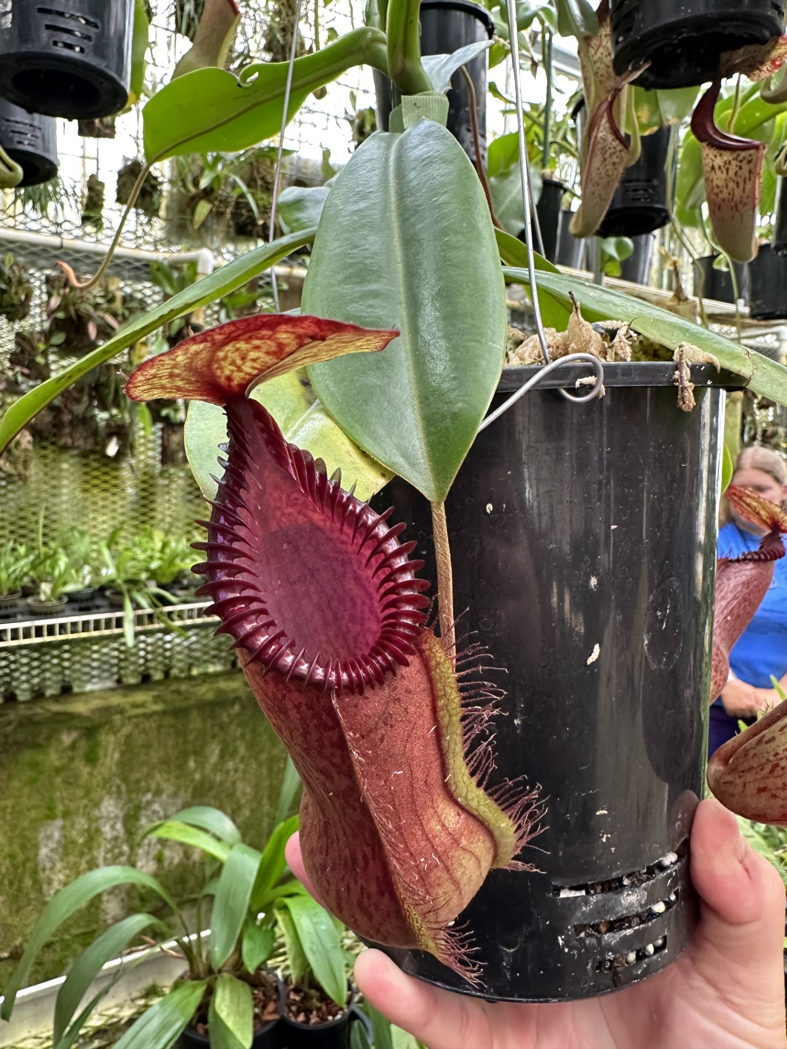
Nepenthes
If you are a Nepenthes:
You are resilient! You handle the changes of life well.
You are beautiful inside and out.
You have a wide variety of interests, and are open to trying new things.
Watch out for:
Sometimes people overlook you because you have not reached your full potential yet.
People may use you and not appreciate you.
Nepenthes, or the monkey cups, are an eclectic group of tropical pitcher plants native to much of tropical Asia (with a small population in Madagascar and Australia). They form elaborately decorated pitchers at the tips of their leafs. Not only is the outside of the pitcher beautiful, but the inside frequently has splotches called “pixels”. These modified leaves help the plant catch and digest their prey. Monkey cups grow in nutrient-poor soil and are frequently found climbing in and around trees. These plants grow slowly, and can take many years before they are the amazing plants that you see in these photos. The flowers of these plants are unique in fragrance, and have a subtle kind of appeal. This resilient plant is able to activate dormant nodes that form basal plants when old enough, or when stressed or broken. It is hard to keep these plants down!
Notes:
Feel free to add other characteristics to this. If you come up with something, feel free to e-mail me at cinks@nsd.org.

Slide 8
Now that we have figured out our plant personality. We are going to get into personality groups and figure out what else we have in common!
Drosera
Dionaea
Sarracenia
Pinguicula
Nepenthes
In your group, I want you to make a poster of all the things you have in common. Be prepared to share these posters when they are complete.
Notes:
The posters can look however they want, but it must be made up of items that they all have in common. They can draw pictures, make lists, do a venn diagram, etc. I’ll try and upload examples once I have some to show.

