Slide 1




CARNIVOROUS PLANTS...
IN SPACE!
FEATURING: 5TH GRADE STEM SKILLS
Amanda Mayo & Lexi Grimmett
Bayou Academy
Cleveland, MS

Slide 2
5th Grade Skills from the Mississippi College and Career Readiness Standards (MSCCRS)
  5.OA.3- Analyzing patterns and graphing on a coordinate plane MSCCRS (2016 Framework)
  5.G.2- Graph points on the coordinate plane to solve real-world and mathematical problems MSCCRS (2016 Framework)
  L.5.3A- Students will demonstrate an understanding of photosynthesis and the transfer of energy from the sun into chemical energy necessary for plant growth and survival.
  L.5.3B- Students will demonstrate an understanding of a healthy ecosystem with a stable web of life and the roles of living things within a food chain and/or food web, including producers, primary and secondary consumers, and decomposers.
Notes:
This slide can be removed by the teacher! I just included it so it can be categorized correctly!

Slide 3
TODAY'S GOAL IS TO INVESTIGATE THE DISTRIBUTION OF CARNIVOROUS PLANTS IN THE UNITED STATES USING A COORDINATE PLANE
THEN, WE WILL DETERMINE IF CARNIVOROUS PLANTS MAY BE A GOOD CANDIDATE FOR NASA BIOLOGY RESEARCH

Slide 4

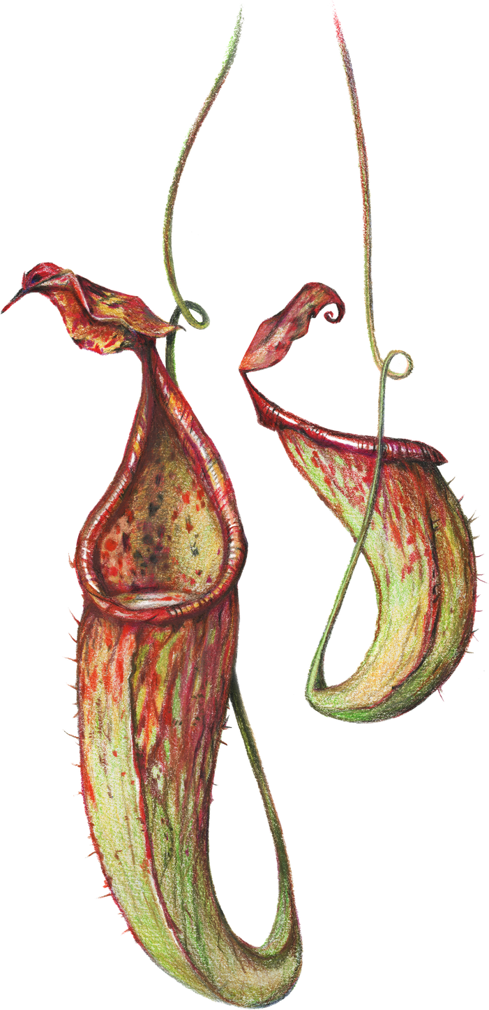

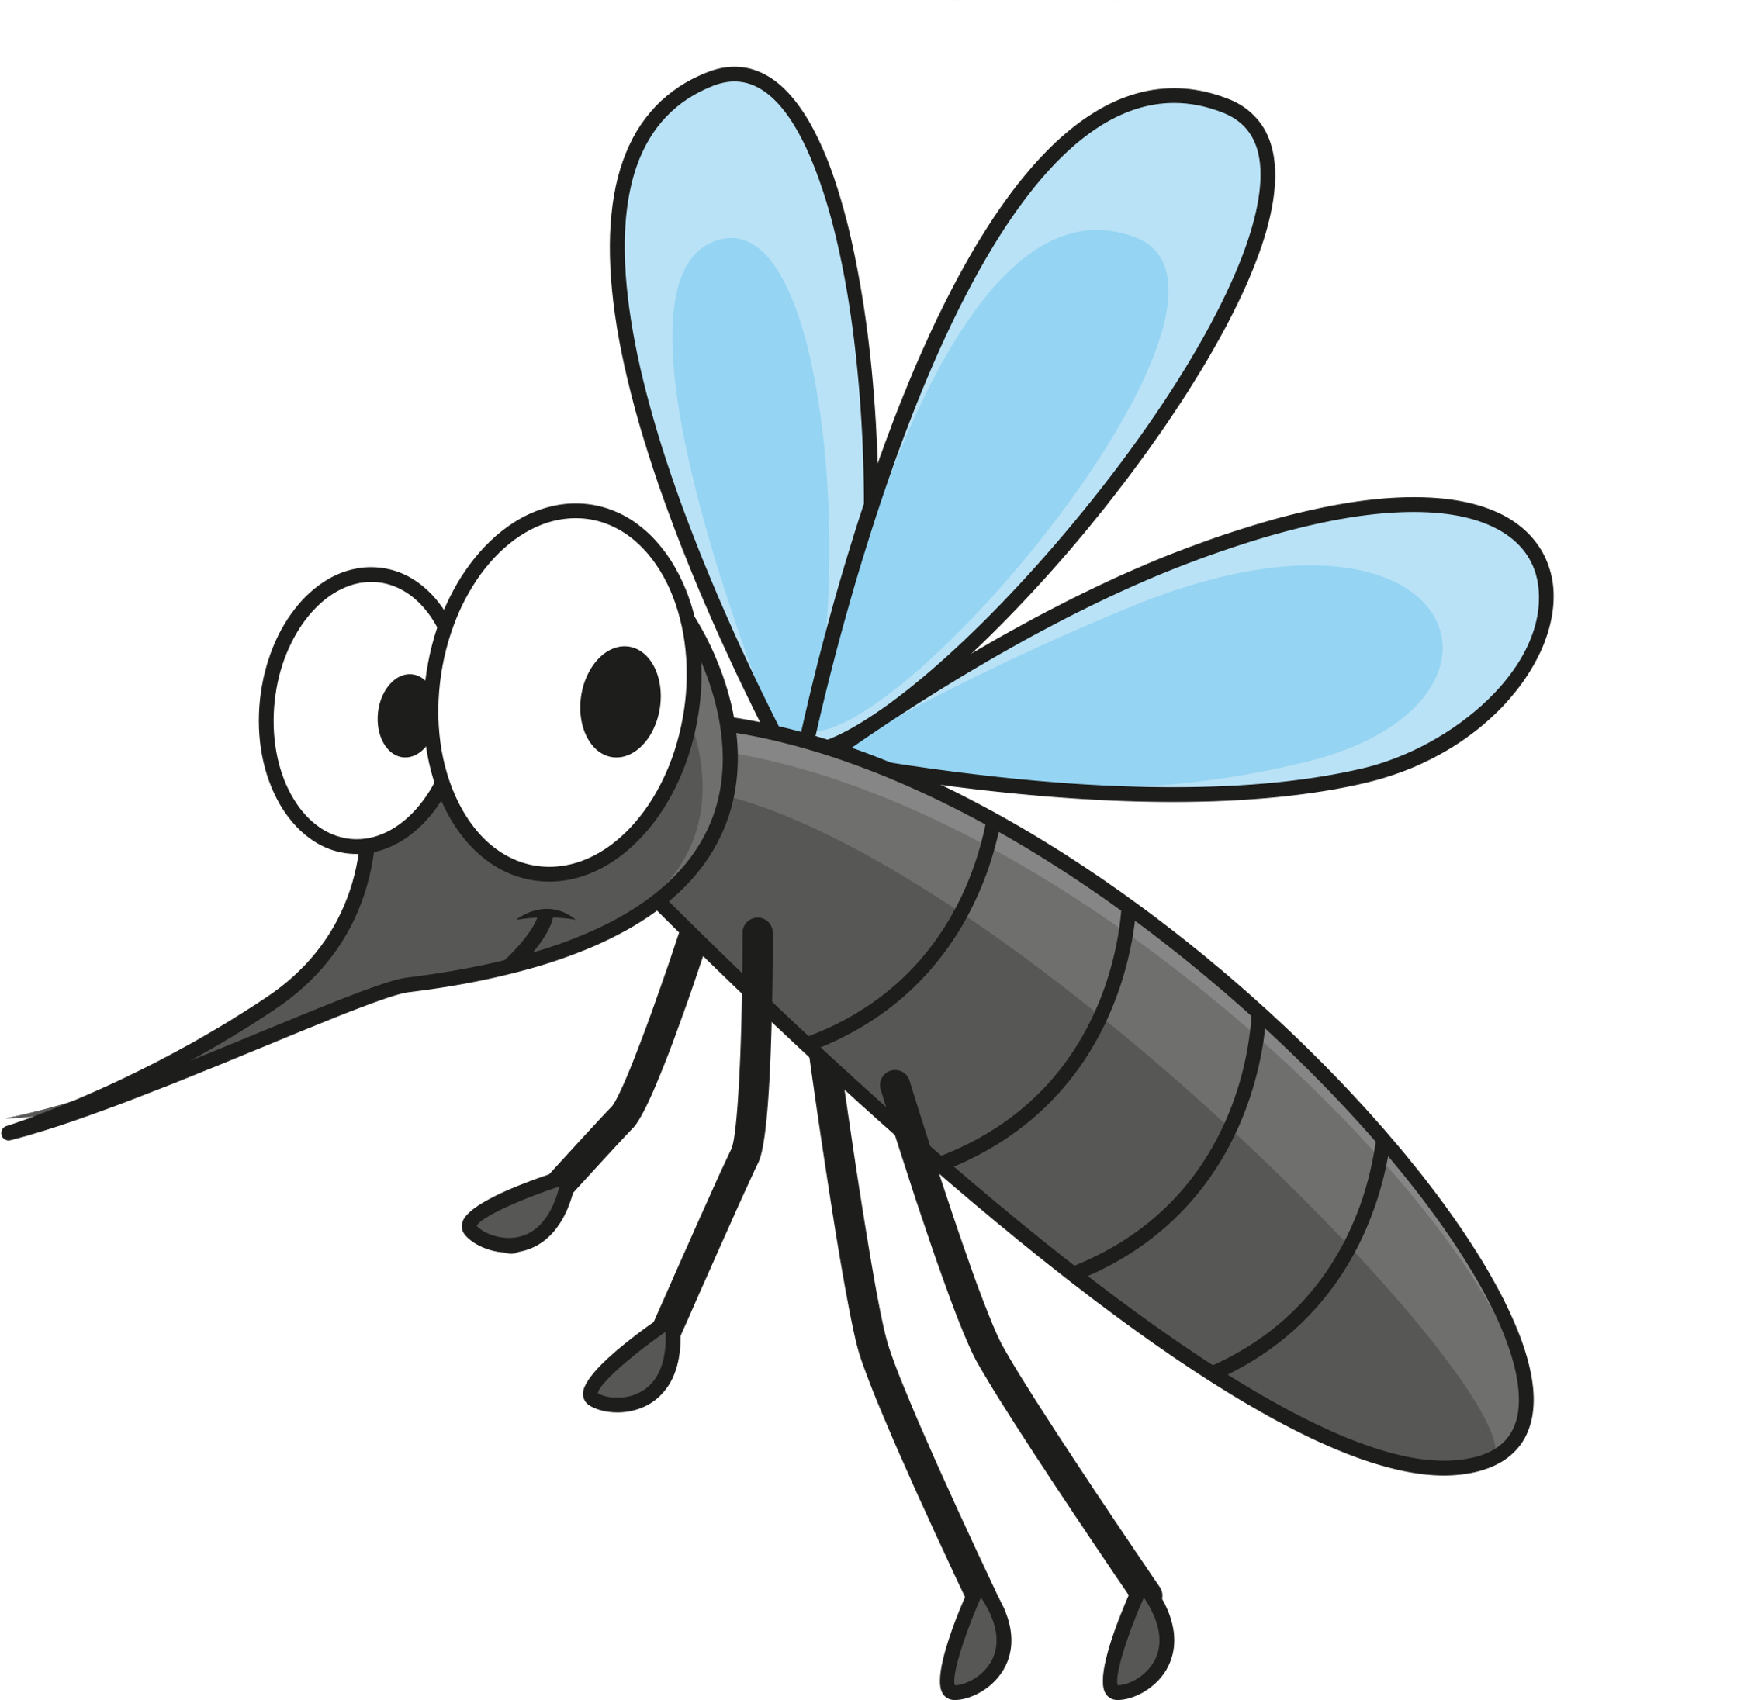
What is a Carnivorous Plant?
A Carnivore?
These plants are specially adapted to capture and digest insects by using a variety of adaptations and features. Currently, there are more than 600 species of plants that can digest insects!
Are plants usually carnivores?
Notes:
For this section, I plan to talk about how usually we think of plants as green, photosynthesizers, but nature can be interesting! We usually talk about the process of photosynthesis and how plants get their nutrients from the sun. Carnivorous plants are a little different than most plants. I have “adaptations” bolded because it is an important science vocabulary term.

Slide 5
What is a Carnivorous Plant?
A Plant?
Carnivorous plants ARE still plants because they carry out photosynthesis! They have similar enzymes, structures and chlorophylls to other "normal" plants.
However, plants like pitcher plants (on the left) get their nitrogen by consuming insects! Some pitcher plants are even large enough to digest vertebrates like lizards and frogs.
Notes:
I would again, hammer home the concept that carnivorous plants are different from most plants because they do not just photosynthesize, they also need other nutrients from insects and other small animals.

Slide 6
What types of habitats do carnivorous plants thrive in?
Carnivorous plants are usually found in areas that are wet and low in nutrients. Some examples of these habitats could include bogs, swamps, bodies of water, forests, sand or even places with rocks.
In fact, carnivorous plants can be found on every continent except Antarctica!
Notes:
I might introduce some additional science terms here such as biome and habitat that students may have heard in previous science classes.

Slide 7

Quick Refresher on Using a Coordinate Plane
01
Identify the X and Y Axis on your map
The X Axis is Horizontal
The Y axis is Vertical
02
Use the coordinates on your worksheet
Count the number of spaces for the X axis along the number line, then count up the number of spaces for the Y value.
03
Mark your US Map in your packet
Mark each coordinate with the correct color as you find them.
Notes:
This is just a quick review. I will gauge the students understanding of the concept or add more review on coordinate planes if needed.

Slide 8


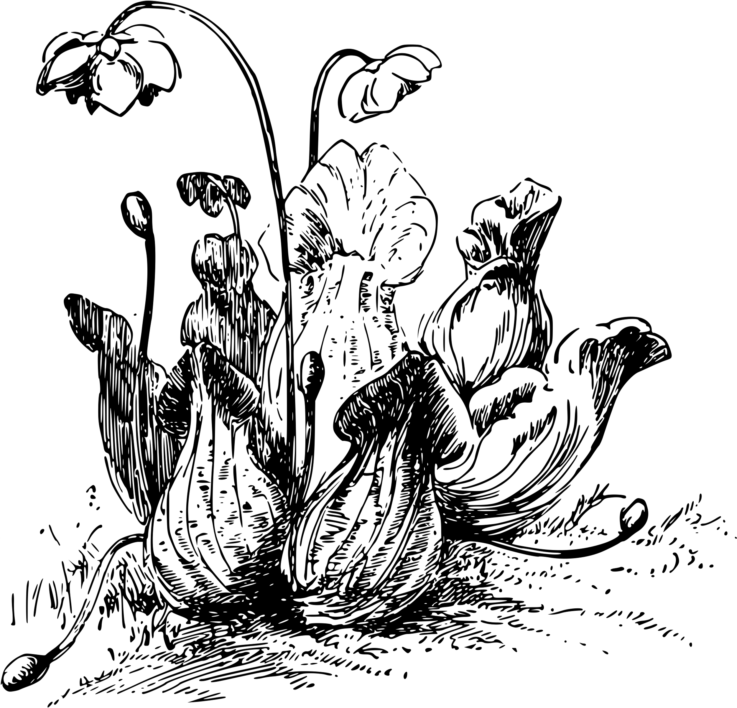

FOR THE NEXT 25 MINUTES, WORK ON GRAPHING THE POINTS ON YOUR MAP
If you finish early, you may color the cover of your packet.
Notes:
This time can be adjusted based on class size or needs of students.

Slide 9


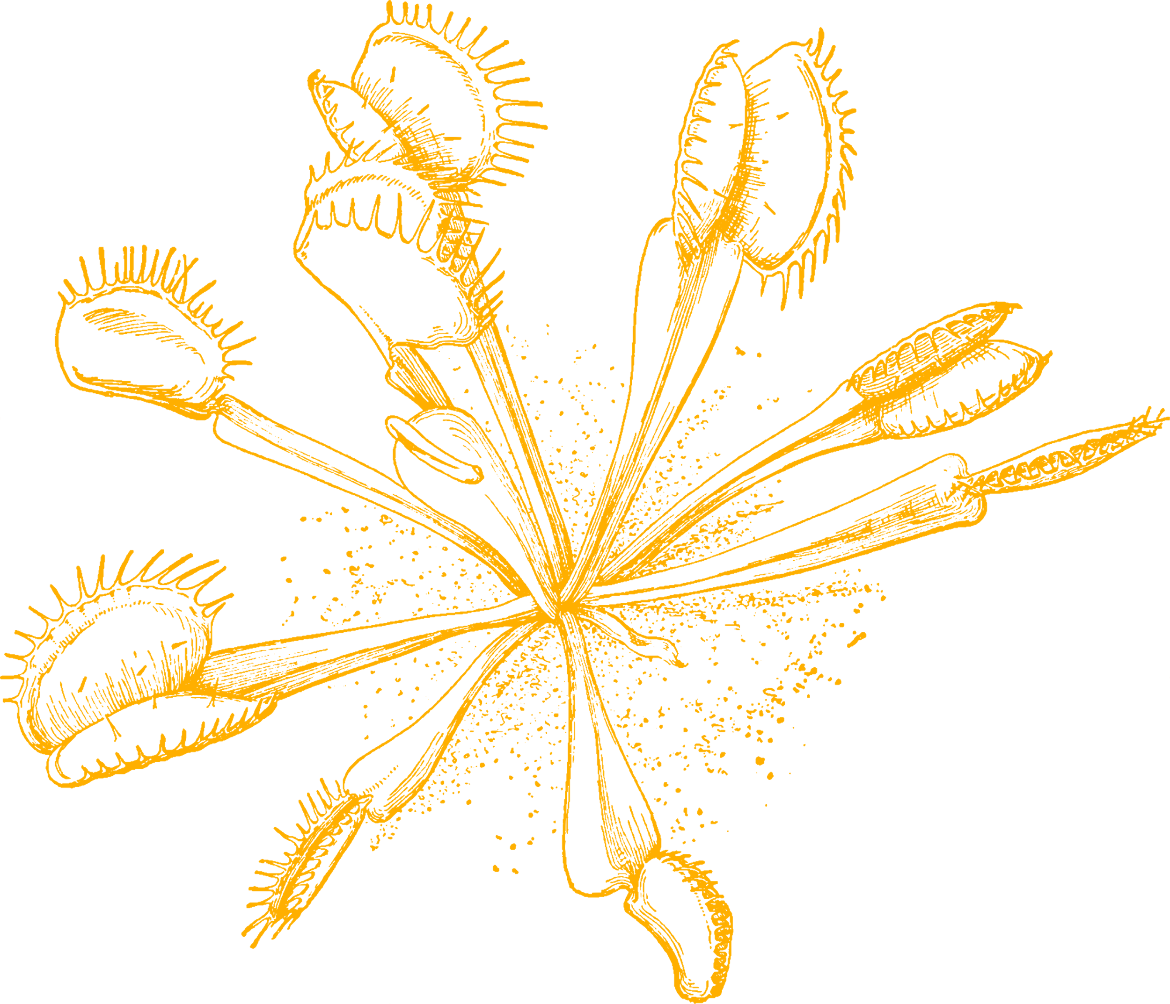
Do you notice any similarities in the locations where carnivorous plants can live based on your map?
Follow along and record your answers in your packet as we discuss!
Is there a specific geographic region where the plants can live?
What are the temperatures like in those areas?
Do those areas get lots of rain?

Slide 10

Surface Biology and Geology
NASA SBG
"One of the goals of SGB is to quantify the distribution of the functional traits, functional types, and composition of vegetation and marine biomass, spatially and over time in the United States."
Notes:
There is more information online about the SBG. There are some interesting videos that could be added to this slide to give students a more in-depth understanding.

Slide 11
NASA PLANT RESEARCH
This means that scientists at NASA are looking for organisms that have different traits that may be able to live in a variety of locations, maybe one day including space. Do you think carnivorous plants can live in a variety of locations?

Slide 12
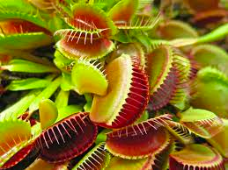
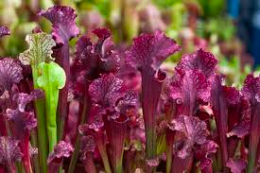
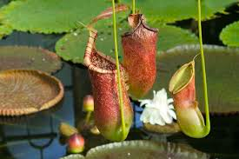
Based on your maps....Would carnivorous plants be a good candidate for SGB research?
What would make them good candidates for research
What would make them bad candidates for SGB research?
Notes:
I plan on making this a really interactive class discussion with the students.

Slide 13

IN YOUR PACKET, WRITE A LETTER TO NASA EXPLAINING WHY OR WHY NOT CARNIVOROUS PLANTS WOULD BE GOOD CANDIDATES FOR RESEARCH ABOUT DIFFERENT REGIONS OF THE UNITED STATES .
HERE ARE SOME IDEAS FOR VOCABULARY WORDS YOU CAN USE IN YOUR LETTER: TRAITS, PHOTOSYNTHESIS, CARNIVOROUS, ADAPTATION, DISTRIBUTION, & MAP.
Notes:
This activity is a great way to apply other standards in literacy. You can edit this prompt to make it an argumentative essay or an informational letter.

Slide 14

Sources:
  https://georgiabiodiversity.org/profile/profile?group=None&es_id=18829
  https://georgiabiodiversity.org/profile/profile?group=all&es_id=15432
  https://www.carnivorousplants.org/
  http://www.honda-e.com/A02_World%20Maps/WorldMap_Pinguicula.htm
  https://science.jpl.nasa.gov/projects/sbg-surface-biology-and-geology-designated-observable/#:~:text=The%20SBG%20DO%20is%20based,composition%20(eruptions%2C%20landslides%2C%20evolving
  https://www.nhm.ac.uk/discover/carnivorous-plants-meat-eaters-of-the-plant-world.html#:~:text=Where%20do%20carnivorous%20plants%20live,and%20sandy%20or%20rocky%20sites.

Slide 15
Today you investigated
Graphing on a Coordinate plane
Traits of carnivorous plants
Different habitats of carnivorous plants

Slide 16
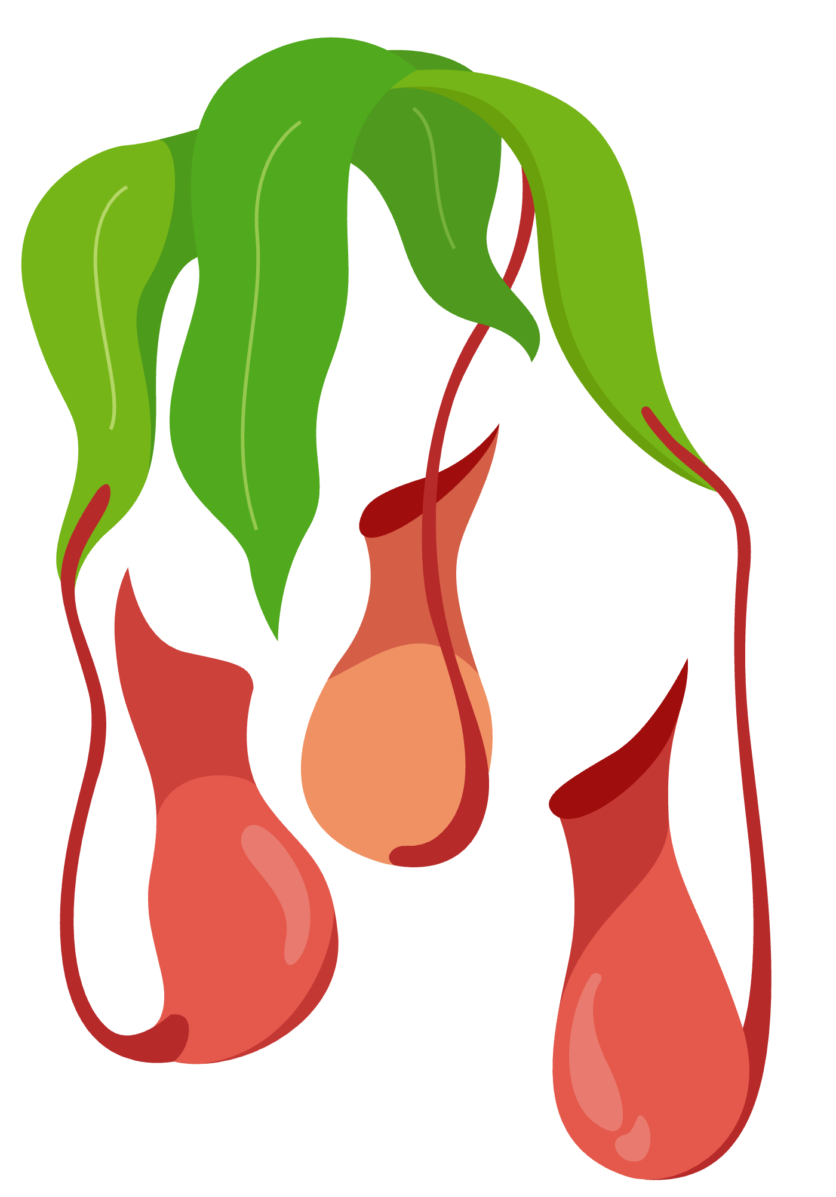

ANY
QUESTIONS?

