Slide 1
Following in the Footsteps of Darwin
Your Independent Project on Carnivorous Plant Biology
Notes:
This activity is meant to be a semester/year-long project for a high school biology course to work students through the steps of the scientific method and learn how to perform a study from conception through to communicating results. It can be adjusted to accommodate various timeframes depending on how the course is structured, but project options and designs should reflect the time available for students to feasibly get results.

Slide 2
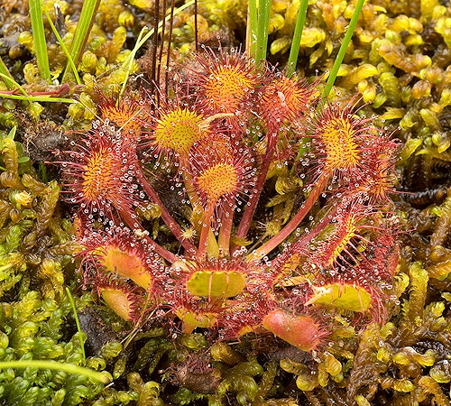
What are Carnivorous Plants?
Plants that kill animals and obtain nutrients from their bodies
Carnivorous plants all share 3 traits
They capture and kill prey
They have a mechanism to allow for digestion of their prey
They benefit significantly from the prey by absorbing nutrients
Prey can include insects, spiders, aquatic invertebrates, protozoans, and, in some cases, small vertebrates
Many types of traps exist, including the pitfall traps of pitcher plants, adhesive traps of sundews, and snap traps of Venus flytraps
Notes:
References: https://www.carnivorousplants.org/cp/carnivory/what
https://www.carnivorousplants.org/cp/carnivory/trapping
Picture: https://www.carnivorousplants.org/cp/carnivory/what

Slide 3
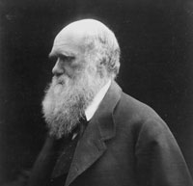
Charles Darwin and Carnivorous Plants
Though most famous for his study of the Galapagos Islands and his work On the Origin of Species (1859), Darwin studied a wide array of organisms in his life, including carnivorous plants
Darwin was fascinated by the "insectivorous plants" of his native Britain, as well as those he came across during his journeys on the HMS Beagle
He spent years asking questions and performing simple experiments to investigate how these plants captured prey, how they digested prey, and why something like this would have evolved
Darwin took meticulous notes on the results and observations from his experiments, resulting in his book, Insectivorous Plants in 1875
Notes:
References: https://assets.cambridge.org/97811080/04848/frontmatter/9781108004848_frontmatter.pdf
https://www.darwinproject.ac.uk/learning/universities/getting-know-darwins-science/insectivorous-plants
Picture: https://www.darwinproject.ac.uk/about-darwin/darwin-s-photographic-portraits

Slide 4
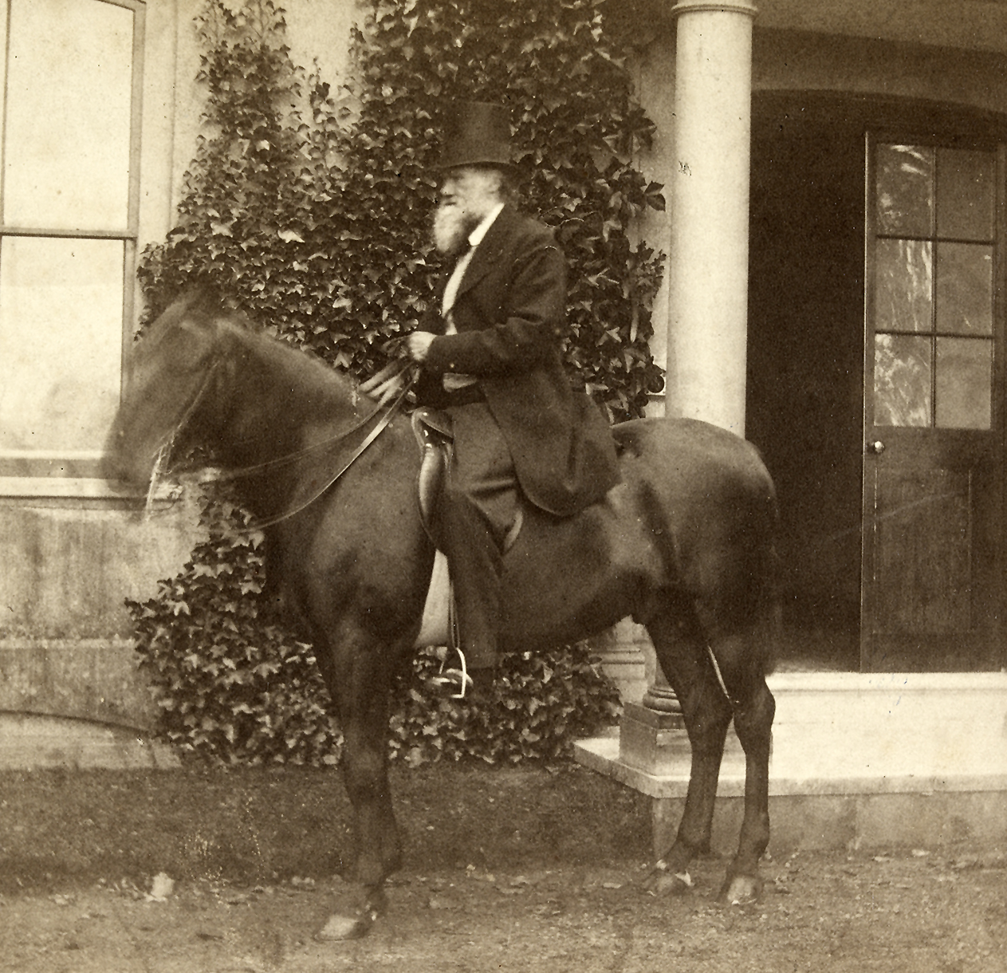
What You Will Be Doing
Following in Darwin's footsteps to answer your own question about carnivorous plant biology!
Creating a project proposal outlining an original question and hypothesis
Running an experiment to test these and collect data
Be sure to write down as much detail as possible and take pictures along the way
Analyzing your data and create a final written report on the experiment
Following the scientific method
Notes:
Picture: https://www.darwinproject.ac.uk/about-darwin/darwin-s-photographic-portraits

Slide 5
The Scientific Method
A problem-solving approach at the center of biology and other sciences
6 steps to the scientific method
Make an observation
Ask a question
Form a hypothesis (testable explanation)
Make a prediction based on the hypothesis
Test the prediction
Share the results
This is not always linear! Steps may be completed and later revisited to change things as concepts are refined, but all steps are included in good science
Often, testing predictions and sharing results leads to new questions and cycling through the process again and again. This is how science expands!
Notes:
References: https://www.khanacademy.org/science/biology/intro-to-biology/science-of-biology/a/the-science-of-biology

Slide 6
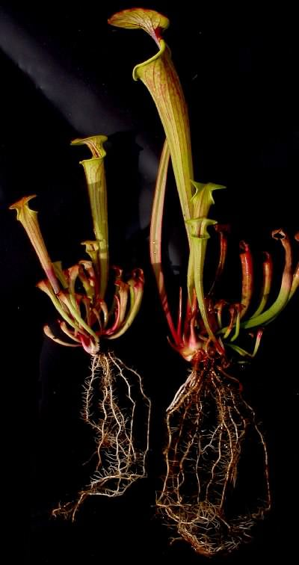
Your Proposal
This will form the foundation for your project
Be sure to read over the instructions of the proposal worksheet carefully and answer everything fully
Based on your available materials, create a question and testable hypothesis about carnivorous plant biology that can be tested
This can be anything that can be controlled in a lab, such as growth rate compared to other plants, trap speed/capture rates, digestion times, soil preferences, pitcher plant liquid pH, etc.
When working on experimental design, think carefully about how the experiment will be set up to keep the experimental variable the only thing different between groups
Proposals need to be approved by your instructor before an experiment is set up and started
Notes:
The associated project proposal worksheet should be handed out to students now.
This is where a lot of student customization comes into the project. This can be as free or restricted as desired. It is recommended that basic supplies, including soil, pots/containers, and plants be supplied to the students. Other supplies could be supplied by the instructor or student at the instructor's discretion. Students likely will benefit from googling carnivorous plants, particularly the types available in the class for experimentation, to determine what interests them for the project.
In all cases, students should be mindful of experimental
If ideas are needed for potential projects, the following websites have some ideas that may be helpful;
https://carnivorousplantnursery.com/blogs/classroom-materials/carnivorous-plant-science-project-ideas
https://www.education.com/science-fair/article/how-do-carnivorous-plants-digest-insects/
https://www.saps.org.uk/teaching-resources/resources/174/investigations-with-carnivorous-plants-science-club-activity/
Picture: https://www.carnivorousplants.org/cp/carnivory/costs

Slide 7
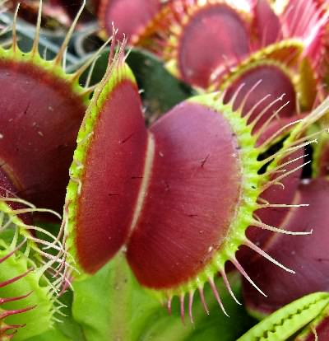
Setting up the Experiment and Recording Data
Follow the experimental design laid out in your proposal approved by your instructor
Any changes should be pre-approved!
Be sure to stay consistent with all control variables. Remember; only the experimental variable should be different between groups
Set up a table to collect your data
Often a good idea to collect numerical (quantitative) data and observational (qualitative) data
Discuss how to do this for your experiment with your instructor
Run your experiment long enough to get at least 5-7 data points
Notes:
Instructions can be flexible based on needs for the class.
Picture: https://www.carnivorousplants.org/cp/carnivory/trapping

Slide 8
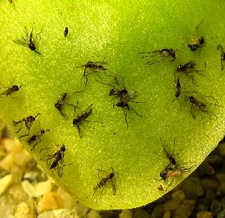
Final Report
Once data collection is complete, perform an appropriate analysis of your data and create graphs for visual displays of your results
Graphs should be able to stand alone without much explanation
Be sure they have descriptive titles, axis labels, a key (if needed), and other markings (i.e. a line of best fit for a scatter plot)
The last stage of the project is to write a final report based on the provided rubric and guidelines. Be sure to read over the guidelines carefully and include all aspects to fulfill step 6 of the scientific method!
Notes:
The project guidelines and rubric should be handed out to students now.
Statistics can be as simple or complex as desired based on class level. Even something as straightforward as finding the average (mean) of the data points should give the students something to compare and discuss in their papers.
Picture: https://www.carnivorousplants.org/cp/carnivory/trapping

Slide 9
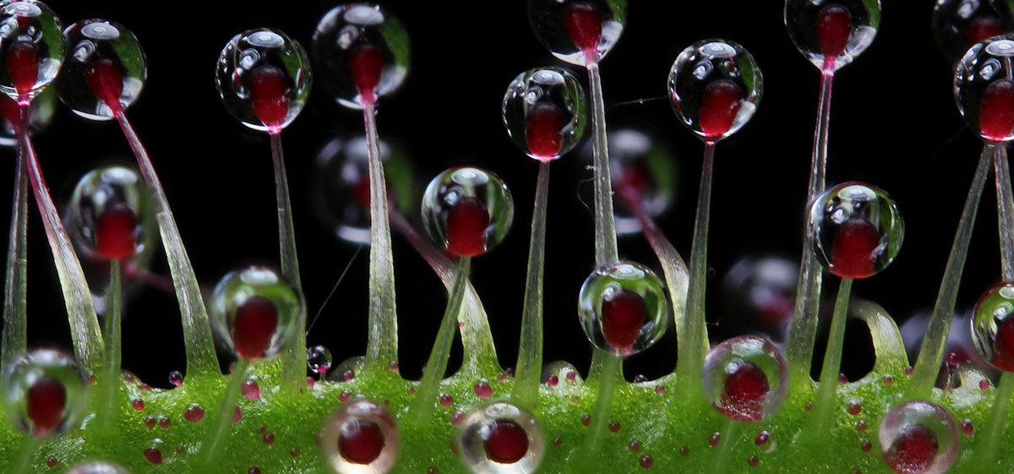
QUESTIONS?
Notes:
Picture: https://www.carnivorousplants.org/cp/carnivory/trapping

