Slide 1
Convergent Evolution
Case study 1; Carnivorous plants

Slide 2
Video provided by the International Carnivorous Plant Society

Slide 3
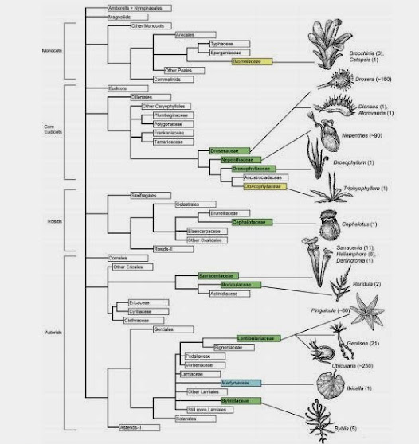
What is Convergent Evolution
Two organisms who are not closely related develop similar features
Notes:
Convergent evolution is the development of similar traits independently in evolutionarily distinct groups. In this phylogenetic tree we can see that carnivory has arisen at least five times, with a very distant common ancestor. The common ancestor that unites the possible oldest carnivorous plants (aldrovanda) with the newer carnivorous plants is back 84 MYA

Slide 4
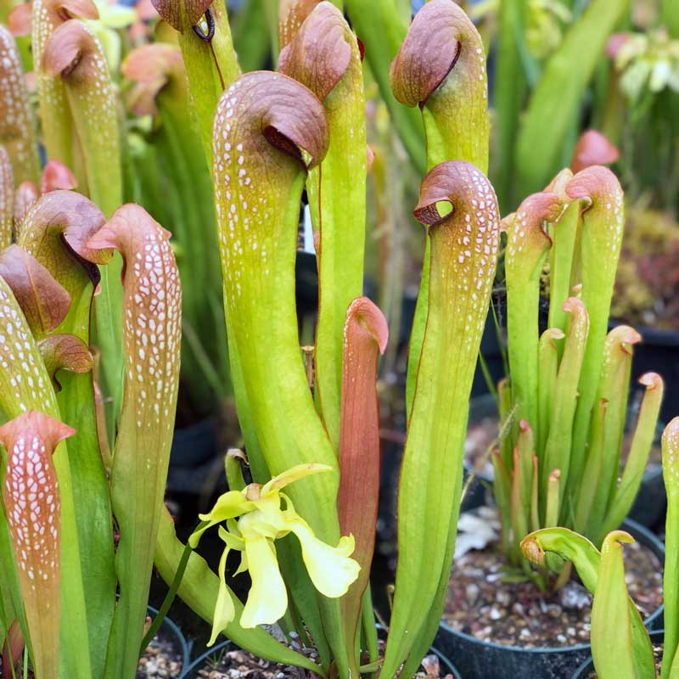
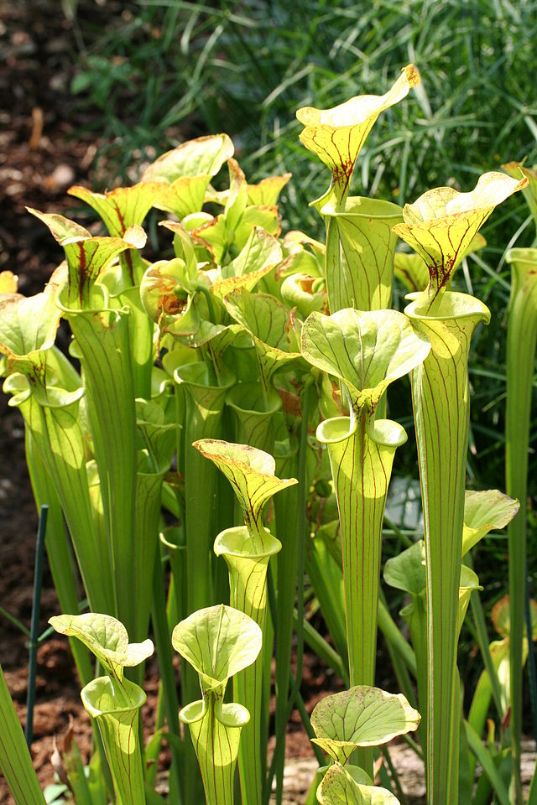
Notes:
What do we think, are these plants closely related or no?

Slide 5
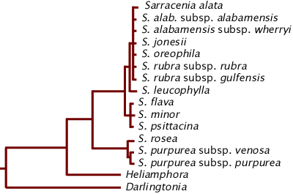
Notes:
In the grand scheme of things they are very closely related!

Slide 6
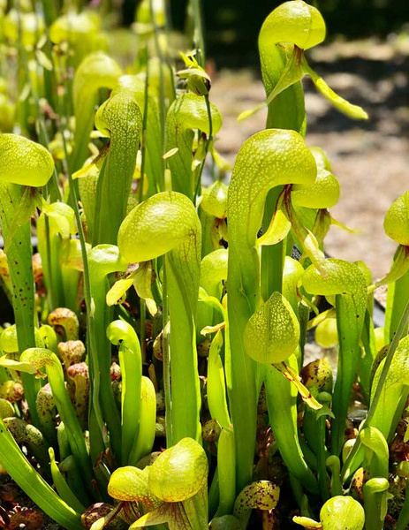
Notes:
What about these too?

Slide 7
Notes:
Even though they look more similar than the last set they are actually very different!

Slide 8
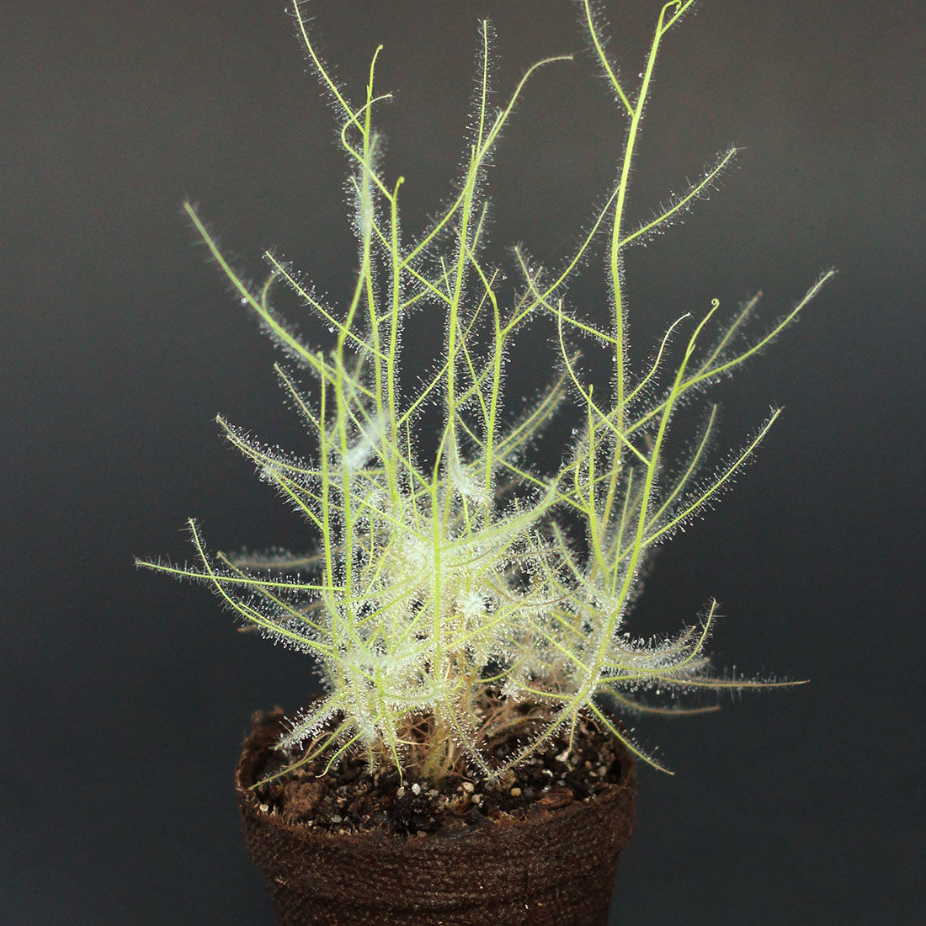
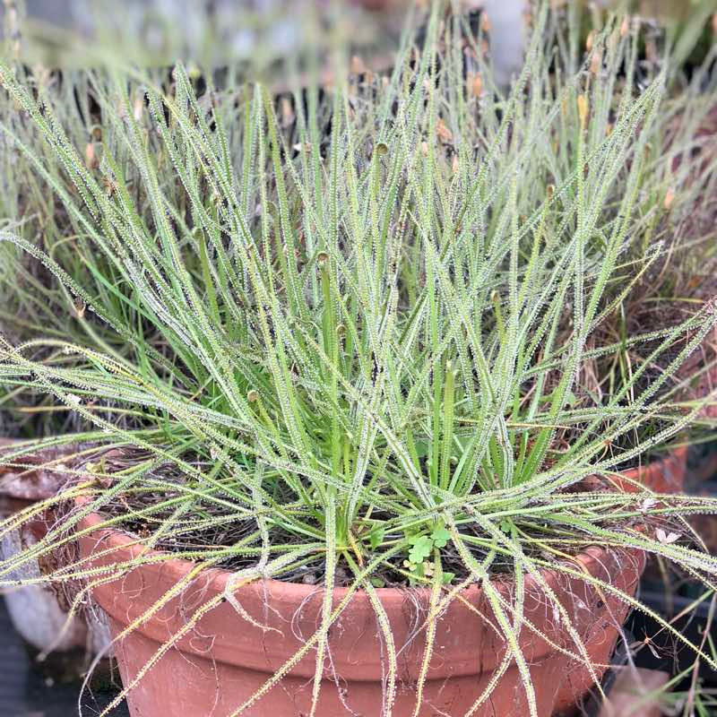
Notes:
What do we think, are these plants closely related or no?

Slide 9
Notes:
They are so not closely related that I don’t even have a phylogenetic tree to show how not closely related they are! The plant on the left is a Byblis and is native to australia, the plant on the right is a drosophyllum and is native to spain and portugal. They are both sticky trap users and though similar in appearance, the morphology of the glue producing glands is very different between the two

Slide 10
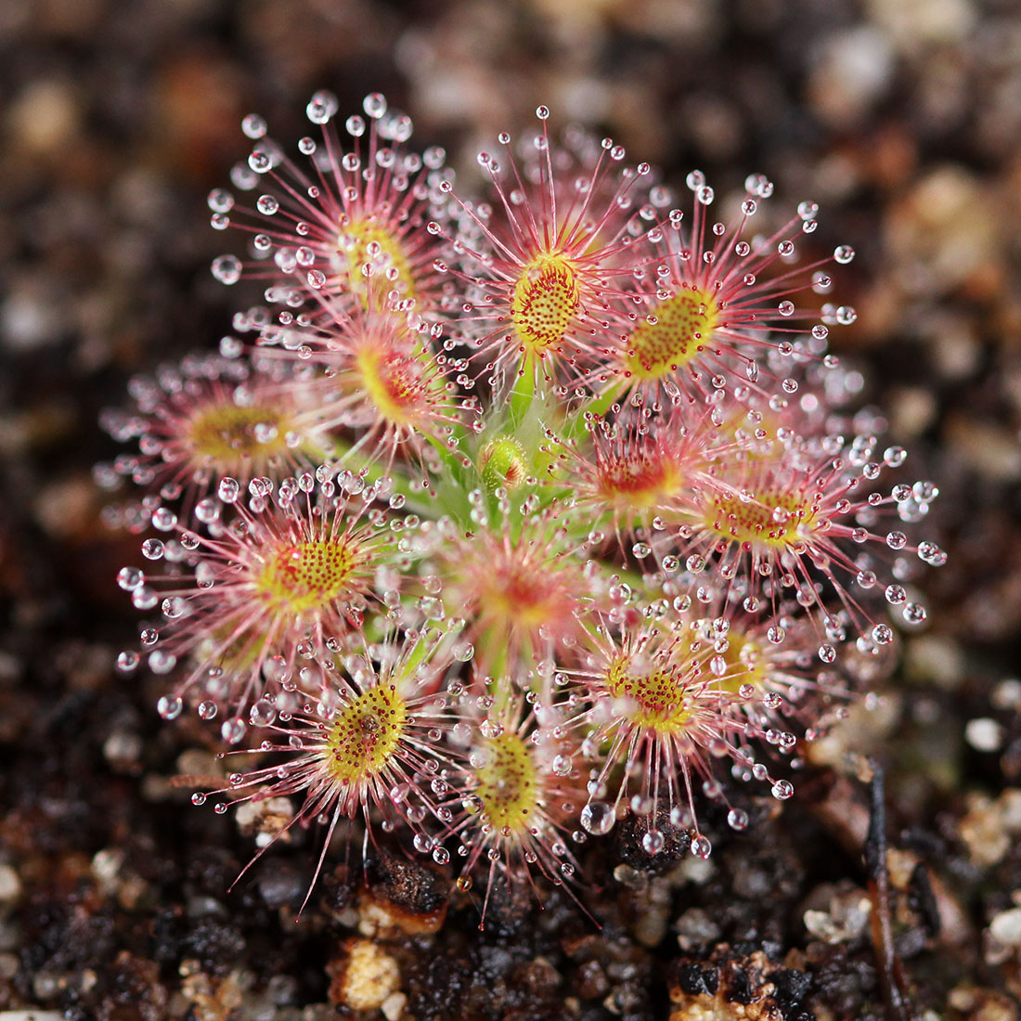
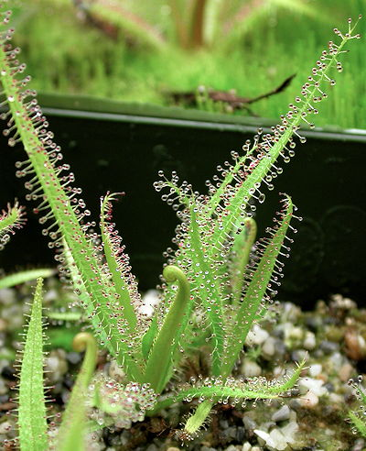
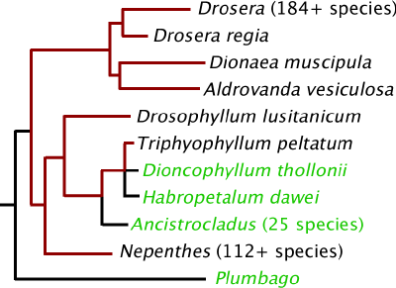
Notes:
These last two are from the same genus, drosera. Though they may look different they are very closely related

Slide 11
Why eat bugs?
Filling a niche
Grow in nitrogen poor soil
Notes:
Eating bugs sounds gross right? And like a lot of work if you’re a plant that can’t chase after a bug with a net. You’d have to lure bugs to you and then find a way to make their nutrients available. Why do it? Carnivorous plants typically live in very nutrient poor soil. There are not many plants that live in nutrient rich soil because plants depend on nitrogen and a whole host of nutrients to live. Carnivorous plants filled a niche by living in these poor soil and developed their own way to make nutrients available.

Slide 12
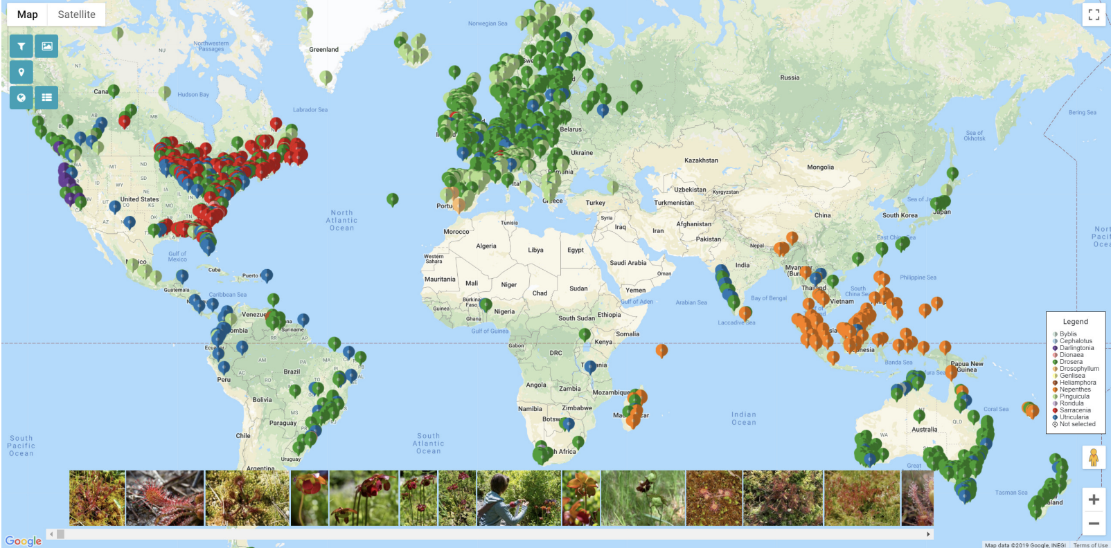
Notes:
Carnivorous plants are everywhere! The next time youre on a hike, think about how cool carnivorous plants are and teach a friend or family member!

Slide 13
References
Adamec, L. (1997). Mineral nutrition of carnivorous plants: a review. The Botanical Review, 63, 273-299.
Brewer, J. S., Baker, D. J., Nero, A. S., Patterson, A. L., Roberts, R. S., & Turner, L. M. (2011). Carnivory in plants as a beneficial trait in wetlands. Aquatic Botany, 94(2), 62-70.
Ellison, A. M., & Gotelli, N. J. (2009). Energetics and the evolution of carnivorous plants—Darwin's ‘most wonderful plants in the world’. Journal of Experimental Botany, 60(1), 19-42.
Notes:
Carnivorous plants are everywhere! The next time youre on a hike, think about how cool carnivorous plants are and teach a friend or family member!

