Slide 1
Amazing Attributes of Carnivorous Plants

Slide 2
Are carnivorous plants carnivores, predators, or both?
What classifies a carnivore?
Eats meat
Hunts prey
What is a predator?
Notes:
Introduce the question
Have students take stances. They can choose sides of the room one side carnivore one predator and the middle of the room is both.
Ask students to define and describe the differences of carnivore and predator.
Teacher Information:
Carnivores (nationalgeographic.org)

Slide 3
Plants evolved into carnivores...
Convergent Evolution
Nutrient scarce soil (minimal Phosphorous and Nitrogen)
Digestive fluid proteins
Catching insects
How Plants Evolved into Carnivores - Scientific American
Notes:
Have students explain and provide examples of convergent evolution. Expect answers such as the development of wings for flight (butterfly, bat, bird) or fins/flippers for swimming (whale, shark, fish—modified penguin, turtle)
Explain that carnivorous plant potentially evolved due to the lack of nitrogen and phosphorous in the soil, thus sought another means of acquiring those nutrients.
Review the article linked for additional talking points.

Slide 4
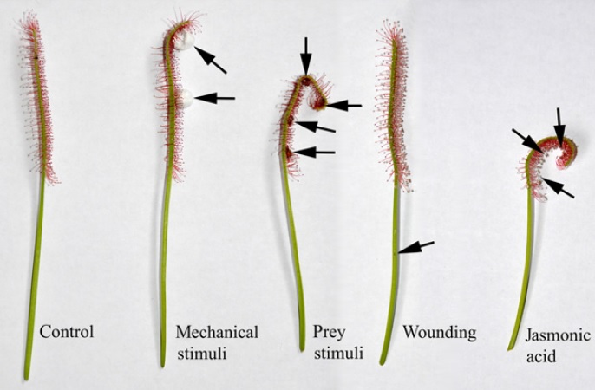
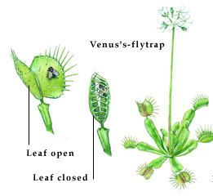
The defense and offense of carnivorous plants.
https://youtu.be/hMNNj_KNq-o?si=EOFFGrwQw6ik9GF0
https://youtu.be/gjHv8Z48Fl4?si=yV1We0rBmpvjzgA9
Notes:
Teacher Background talking points:
Turning defence into a carnivorous offence in the Cape sundew | New Phyt blog (newphytologist.org)

Slide 5
Pitfalls of pitcher plants
One way in
Insects enter and stay
https://youtu.be/Ytjpi7r18eo?si=NAd9rR69VXe_VtTo
Notes:
Teacher Resource: North American Pitcher Plant (Sarracenia) - Carnivorous Plant Resource

