Slide 1
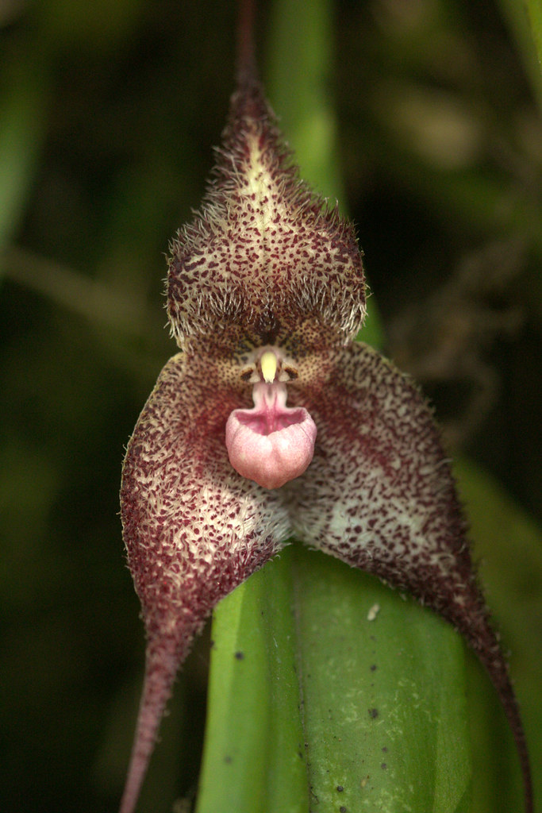
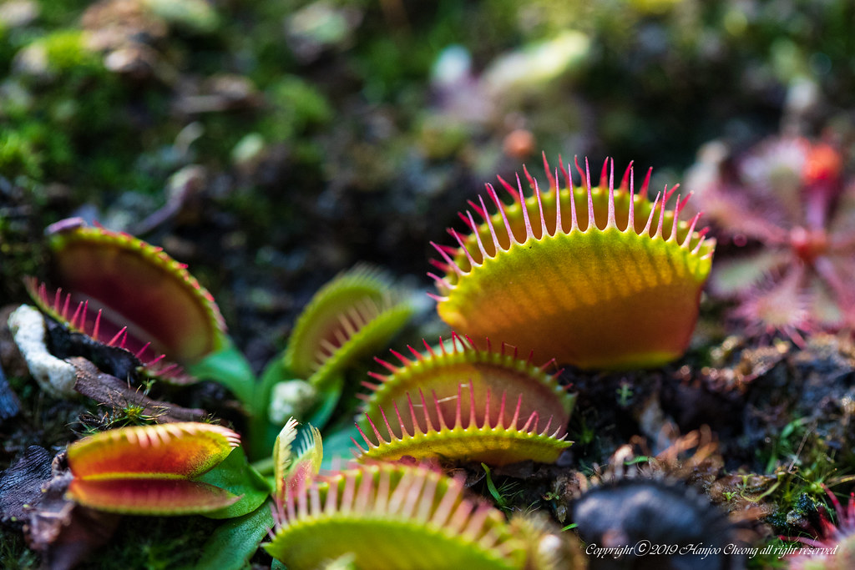
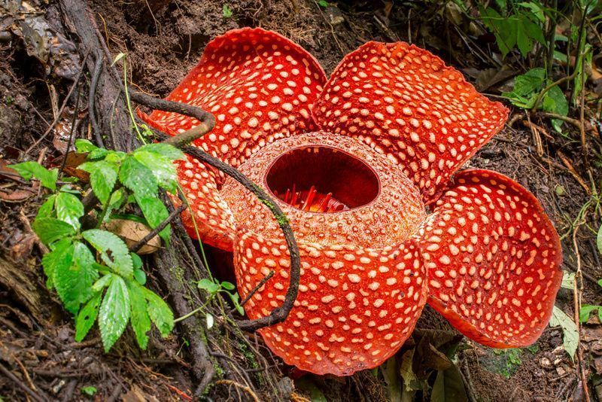
Plants are Cool
This Photo by Unknown Author is licensed under CC BY-SA-NC

Slide 2
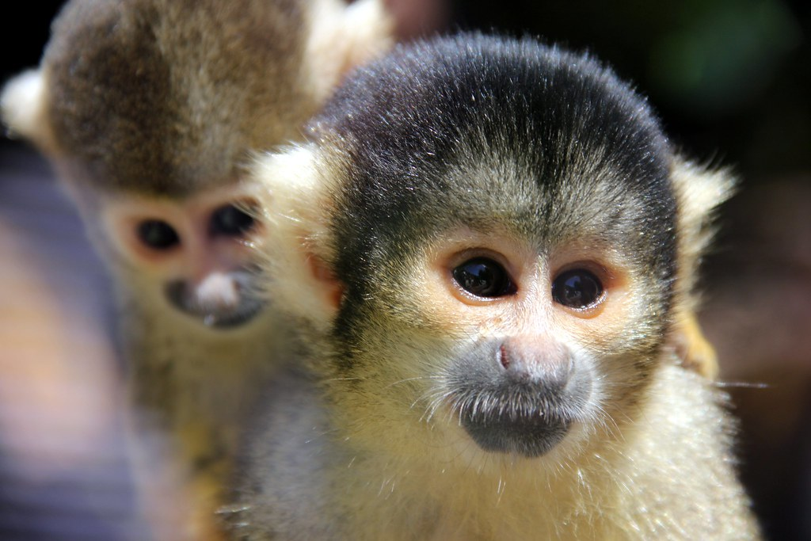
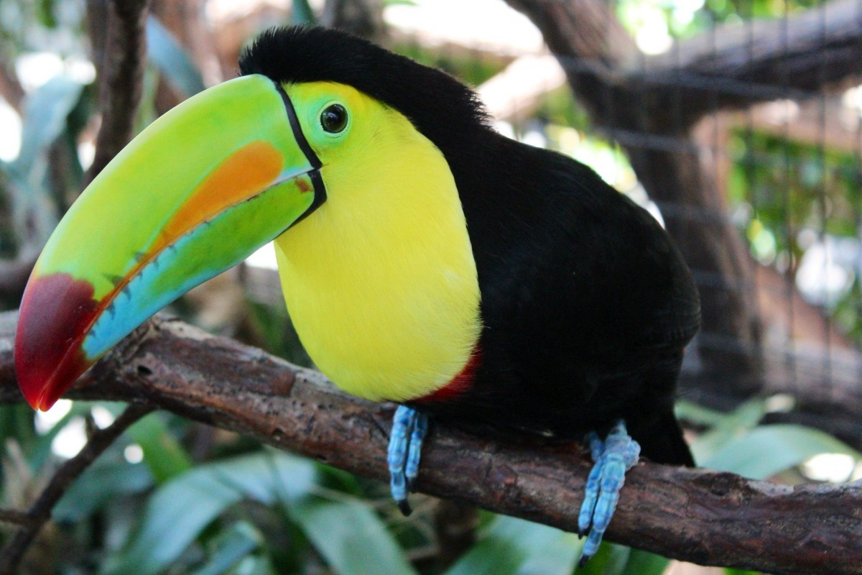
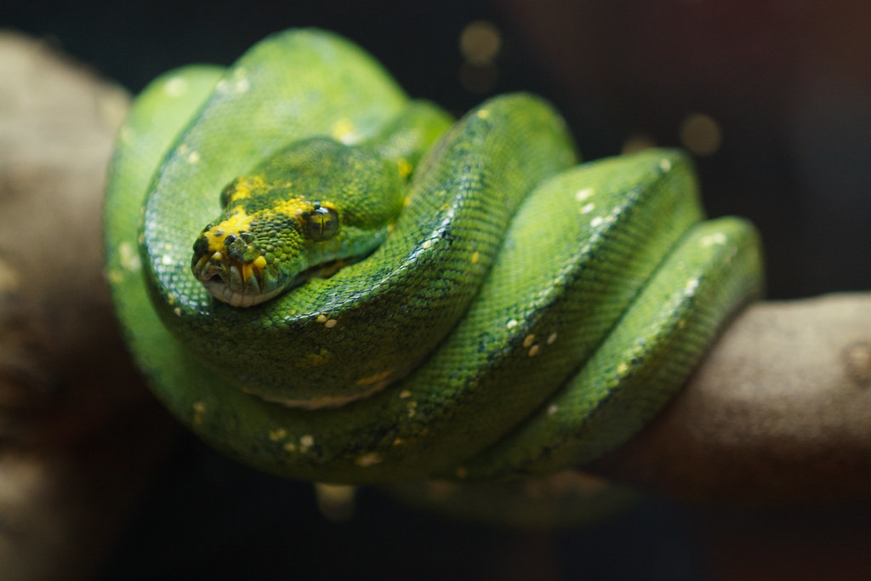
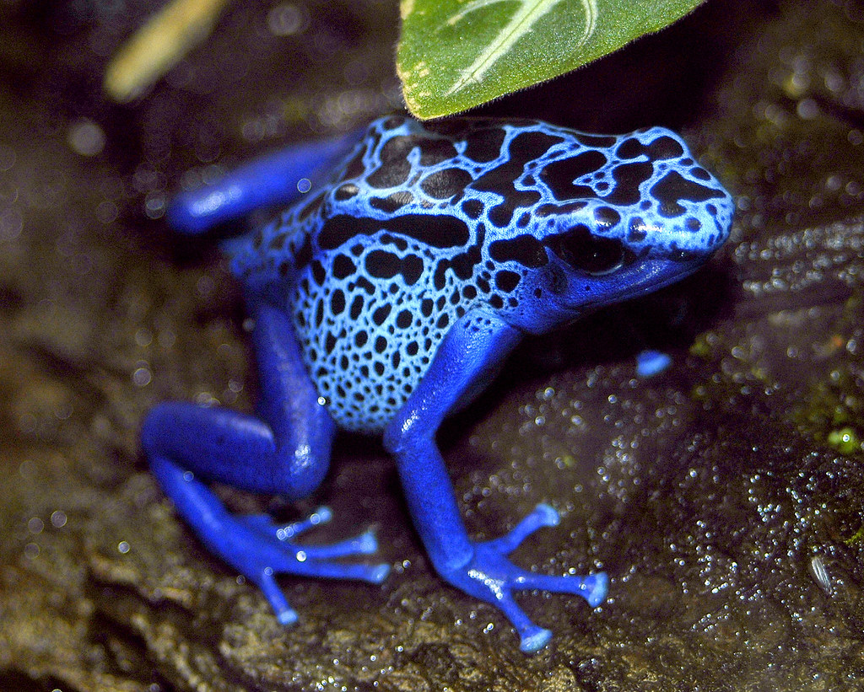
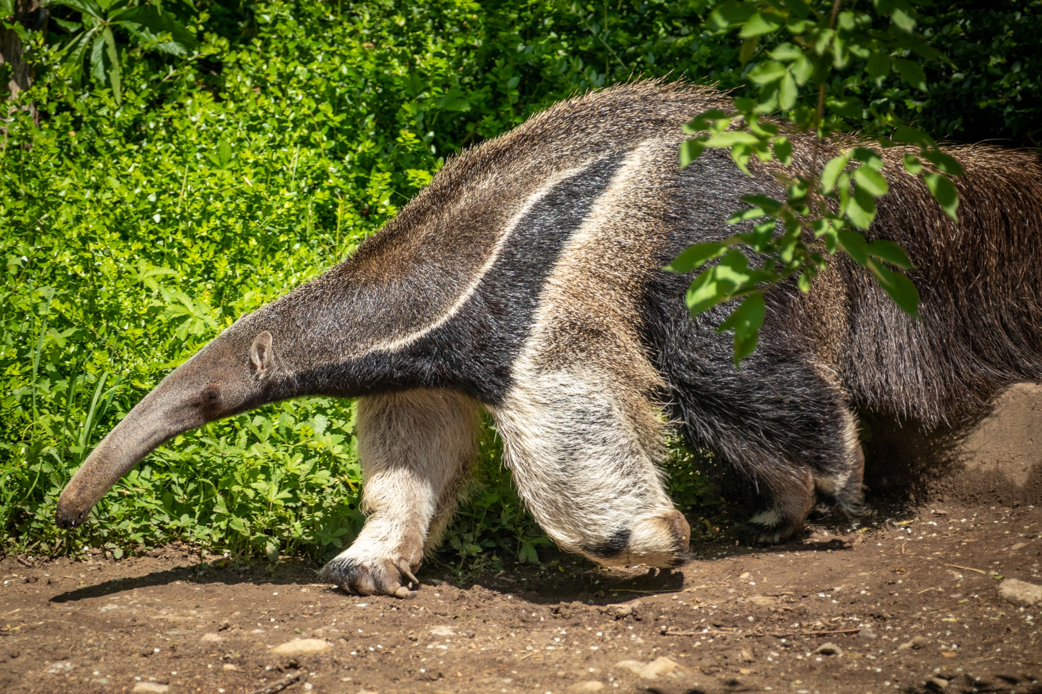
When you go to the amazon this is what people want to see……

Slide 3
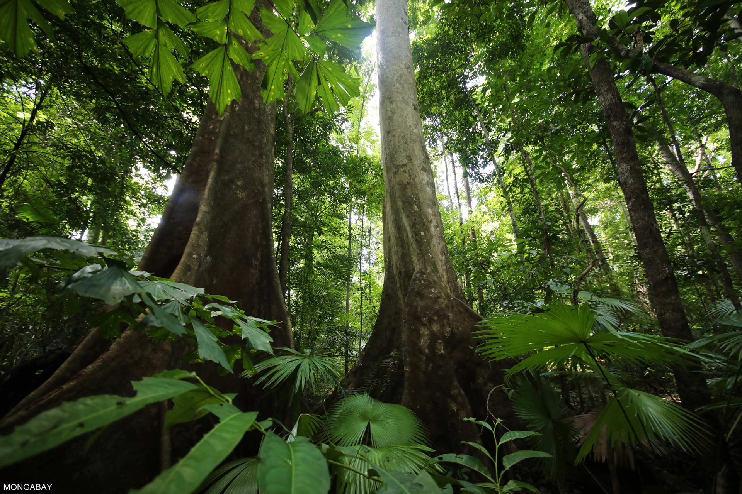
But this is what you get……. What do you notice, what do you see?

Slide 4
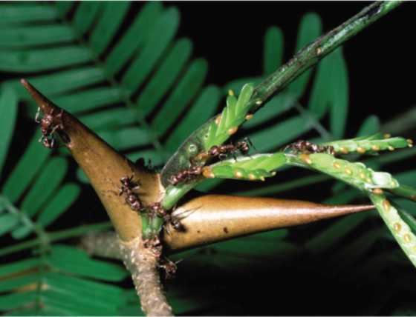
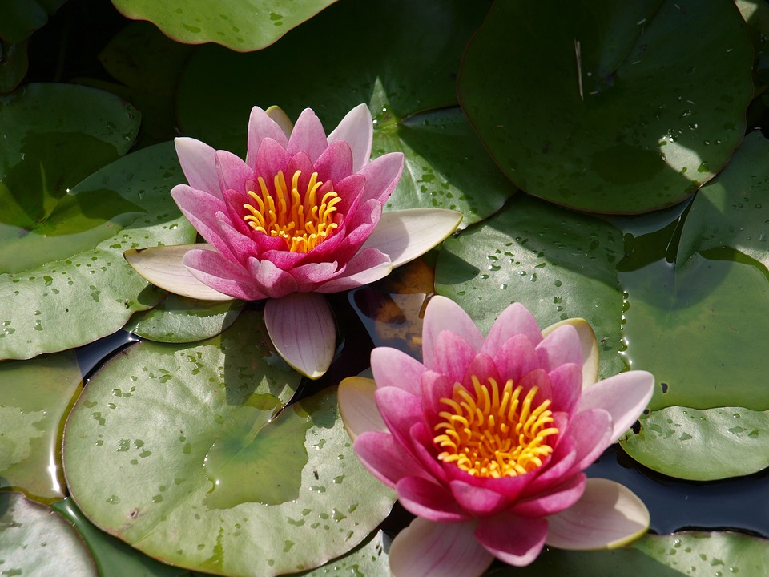
Plants can’t run away, they don’t hide. They are always there for us to see. They have special adaptations like…..
Acacia trees have a symbiotic relationship with ants. They have horns the ants use as shelter and they product protein pods that serve as food for the ants. When the tree is under attack the ants defend it.
Bee orchid has a petal that looks like a species of bee. The male bees think and they come to the orchid. While they are moving around they pollinate the flower.
Waterlilies have a special adaptation that traps air in their stems to keep them afloat.

Slide 5
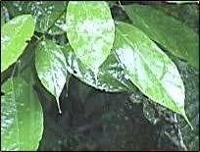
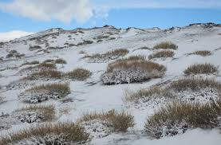
Plants need to survive in their environment.
Plants in the dessert store water and have adapted leaves that can look like needles which protect the plant from animals seeking a water source.
Many plants in the rainforest have drip tips which help them remove excess water.
Plants in the Tundra have adapted in a variety of ways. They grow close together, low to the ground and they remain small.

Slide 6
Plants make their own food through a process called photosynthesis. How cool is that, imagine being able to make you own food.
T
Let’s learn about this chemical reaction and how plants save our lives. They give us food, shelter, medicine oxygen and much more. THANK YOU PLANTS!!!!!!

Slide 7
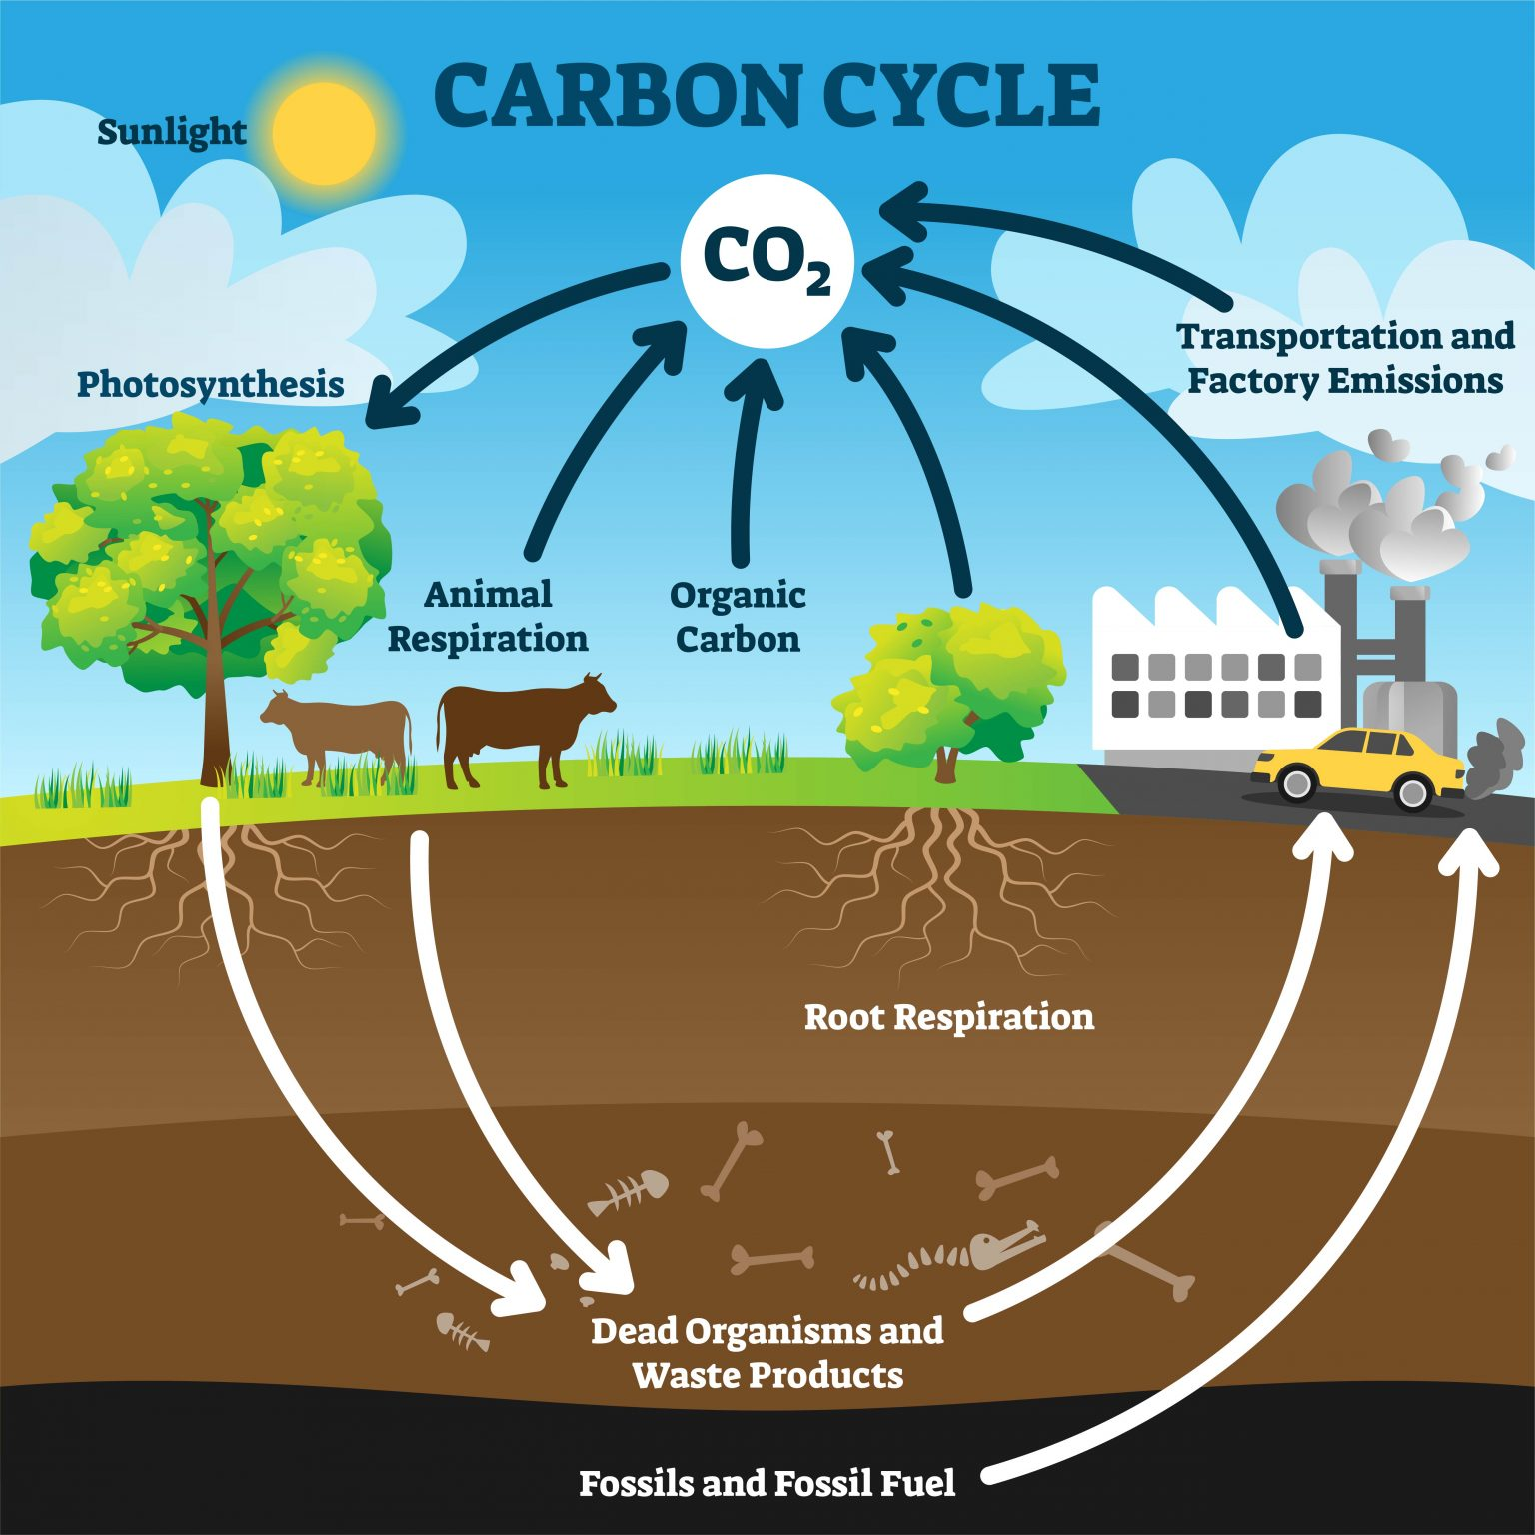
Carbon Cycle
How do plants contribute to the Carbon Cycle?

Slide 8
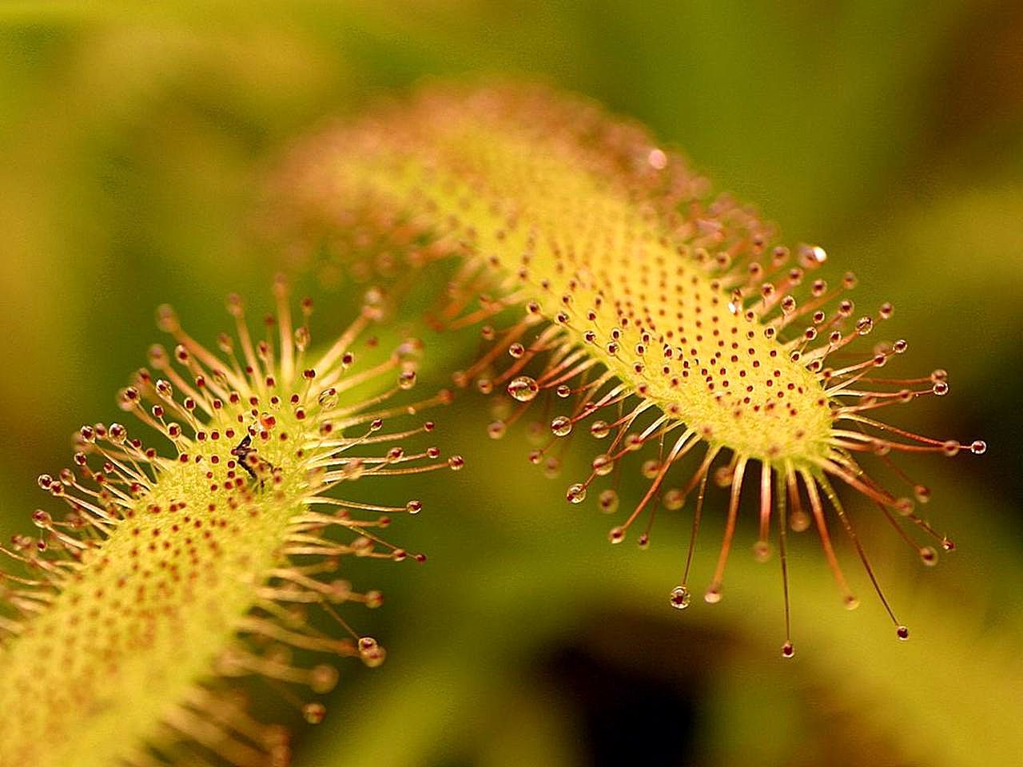
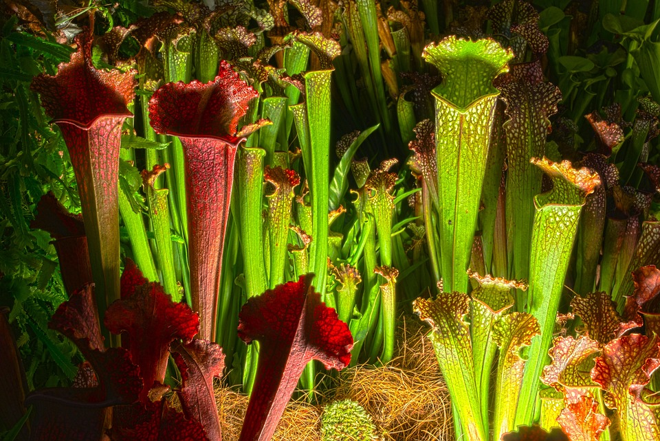
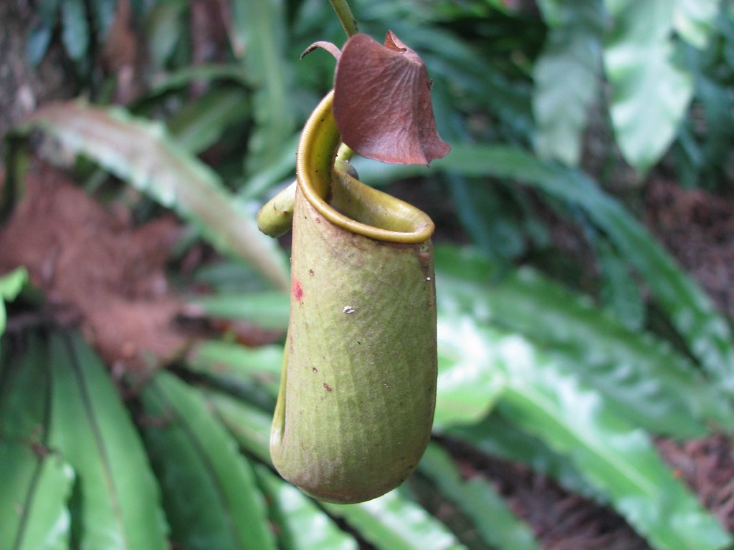
Carnivorous Plants
Carnivorous plants have one of the most fascinating adaptations. They live in areas where the soil is nutrient poor. They have adapted to trap insects and use them to supply extra nutrients to make up for the deficiency in the soil. Did you know that Florida has more carnivorous plants than any other state?

Slide 9
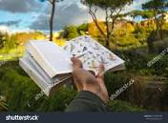
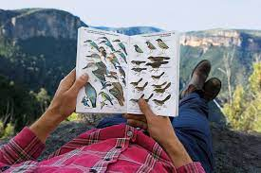
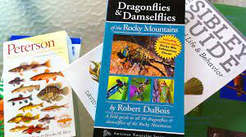
Carnivorous Plant Project
Each student is going to make a guide book.
Requirements: Field guide will be 15 pages
Page 1….cover page
Page 2…. Table of Contents
Page 3-6 Photosynthesis and cellular respiration
(include formula for each, what organelle is responsible for this function, and show diagrams. Explain why each of theses processes is important to life on the planet.)
Pages 7-14 Carnivorous plants, one per page (Total of 8)
(Include pictures, common and scientific name, where they are found and how they trap insects)
Page 15 is a Bibliography

Slide 10
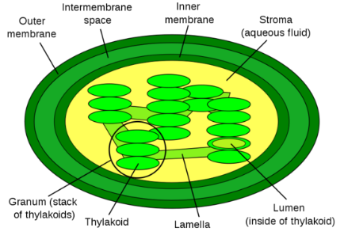
Standards
SC.8.L.18.1 - Describe and investigate the process of photosynthesis, such as the role of light, carbon dioxide, water and chlorophyll; production of food; release of oxygen
- Describe and investigate how cellular respiration breaks down food to provide energy and releases carbon dioxide.
SC.8.L.18.2 - Construct a scientific model of the carbon cycle to show how matter and energy are continuously transferred within and between organisms and their physical environment.
SC.8.L.18.4 - Cite evidence that living systems follow the Laws of Conservation of Mass

