Slide 1
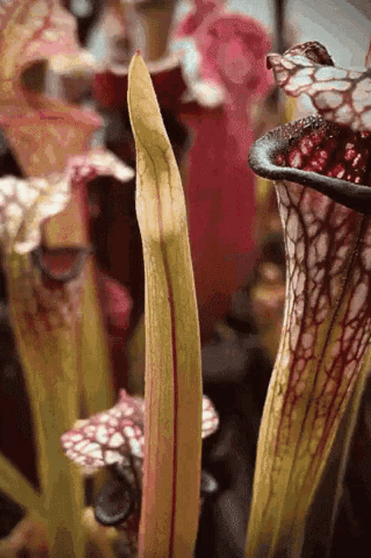
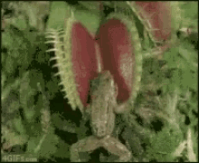
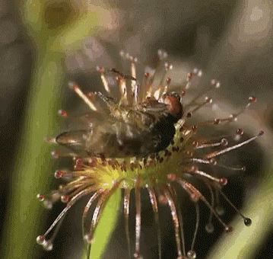
Carnivorous Plants
Notes:
Standards (many ways to tie into ecosystems, food chains and webs)
6-MS-LS2-1 - Analyze and interpret data to provide evidence for the effects of resource availability on organisms and populations of organisms in an ecosystem. (Interdependent Relationships)
6-MS-LS2-2 - Construct an explanation that predicts patterns of interactions among organisms across multiple ecosystems. (Interdependent Relationships)
6-MS-LS2-3 - Develop a model to describe the cycling of matter and flow of energy among living and nonliving parts of an ecosystem. (producers, consumers, decomposers)

Slide 2
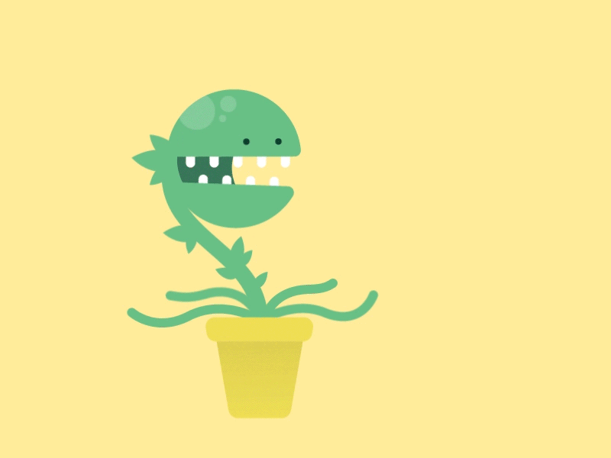
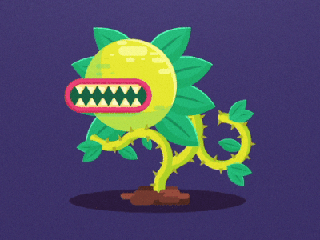
Let’s Investigate!
?

Slide 3
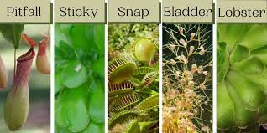
What are some types?
Notes:
Images are great to pull in students!
Ask students about how many “carnivorous plants” they know of… then pull up the image. Have students discuss with each other what they see in the images and what they are “wondering”?

Slide 4
What are some types?
What are you “wondering” based on your observations ?????
Notes:
Show Image Discuss more (students discuss), now that there are some names attached to the “Types” of Carnivorous Plants.
Have students share some of their thoughts. (This practices Observation and Inference skills for Science)

Slide 5
Where can they be found?
How big are they?
What can they eat?
What other questions do you have?
Notes:
Begin students with some general questions about Carnivorous Plants.
Give 1 minute for students to come up with another question (use post-its, looseleaf, dry erase boards, jamboard, etc. to gather their questions)
Good websites:
South Carolina - 50 interesting facts
Smithsonian - 5 Places to see them in the United States

Slide 6
Notes:
FACTS!!!

Slide 7
Did you Know!?
Plants are considered carnivorous if they have these five traits:
capture prey in traps.
kill the captured prey.
digest the captured prey.
absorb nutrients from the killed and digested prey.
use those nutrients to grow and develop.

Slide 8
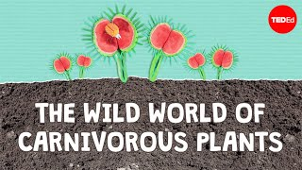
Let’s watch a video
Notes:
After the video, have students discuss something they found interesting…
What did they learn?
What was the most interesting thing?
Do they now have another question?
What was their favorite plant?

Slide 9
Now what to do with this basic knowledge???
Expand it!
Research a Carnivorous Plant!
(See your own slideshow to complete)
Notes:
Instructions: (Teacher creates handout and rubric that fits their own expectations and grading)
Teacher can have a list of plants ready to choose from, assign them to students, or allow completely free student choice
Students need to:
Research their plant and complete the slideshow with relevant information indicated on the slides
Students need to be creative and make it interesting, while sticking to important facts
Teacher can even require students to do a presentation (in class or on Flipgrid)

